Slide 1
Evolutionary Quantitative Genetics Workshop 2025 eqgw.github.io
Instructors: Josef Uyeda Fabio Machado Pat Carter Jacqueline Sztepanacz Joel McGlothlin Laura Alencar

Slide 2
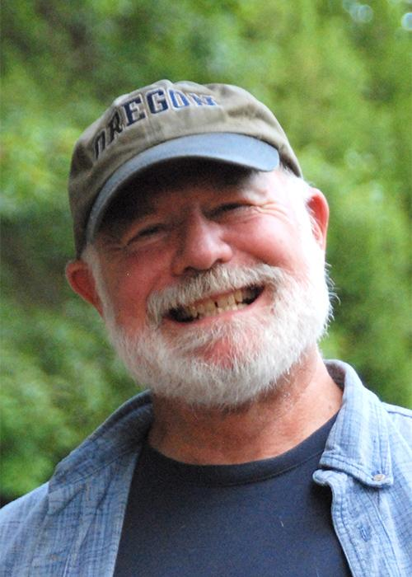
Joe Felsenstein
University of Washington
Stevan J Arnold
Oregon State University
Zoom breakouts:
Wednesday 6:30-8:00pm

Slide 3
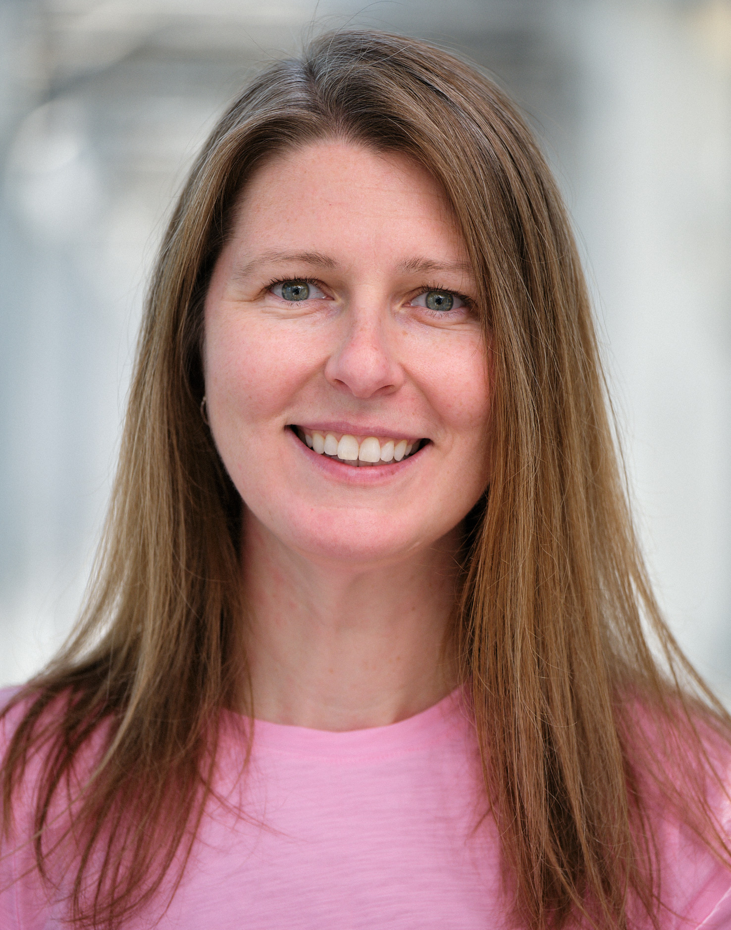
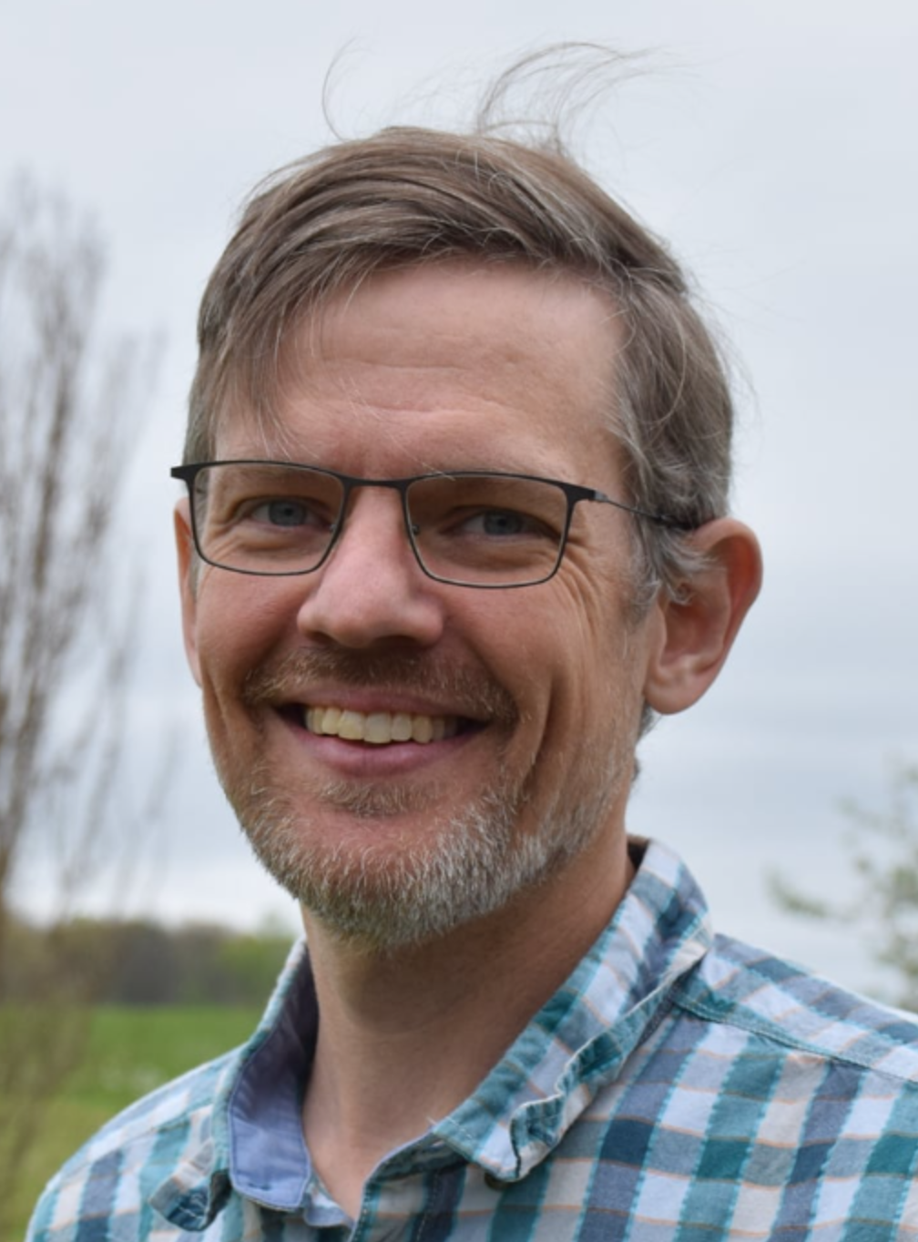
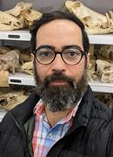
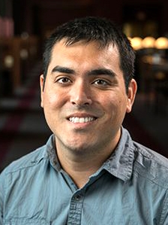
Pat Carter
Washington State
University
Jacqueline Sztepanacz University of Toronto
Joel McGlothlin
Virginia Tech
Fabio Machado
Oklahoma State
University
Josef Uyeda
Virginia Tech
Laura Alencar
Yale University
Macro
(many species, million-year
timescales, fossils & phylogenies)
Micro
(within species, generational timescales, populations)

Slide 4
2011 NESCENT

Slide 5
2014
2015
2016

Slide 6
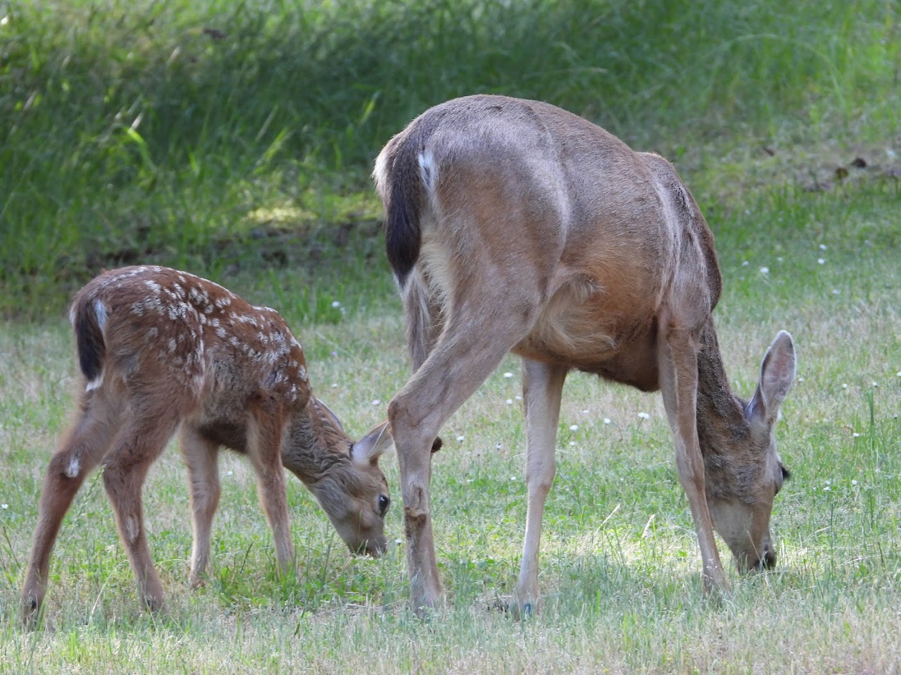
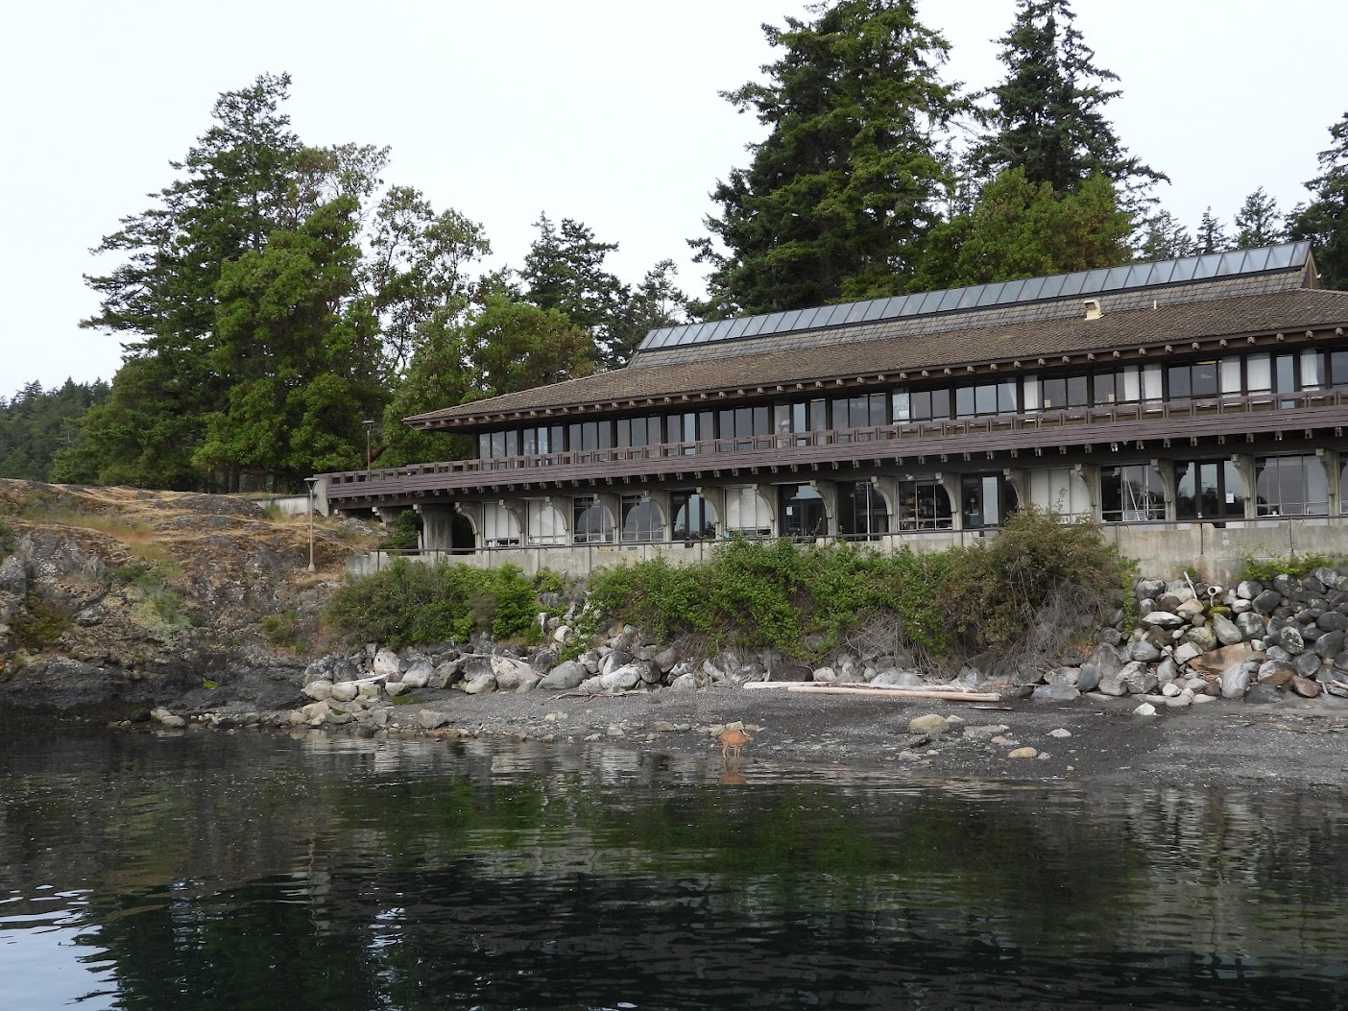
2017-2019

Slide 7
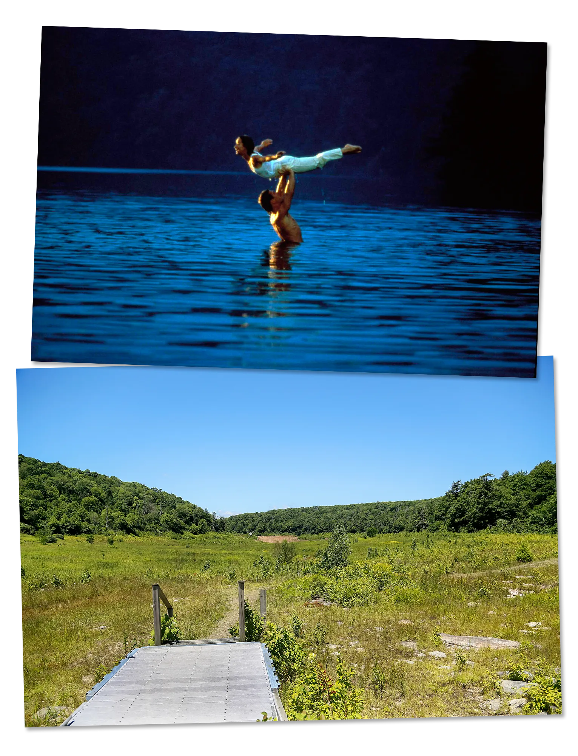
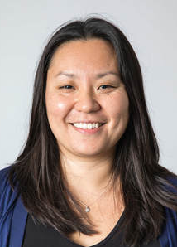
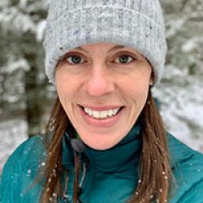
2025: Mountain Lake Biological Station Salt pond mountain
Jaime Jones
Station Manager
E.D. “Butch” Brodie III
Station Director
Sandy Kawano
Station Associate Director

Slide 8
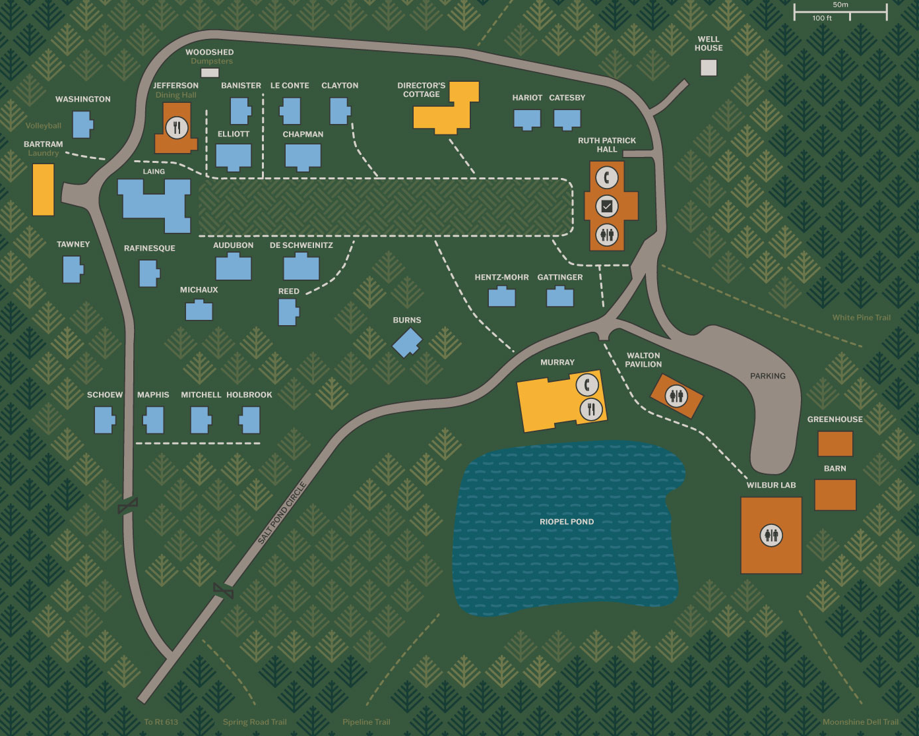

Slide 10
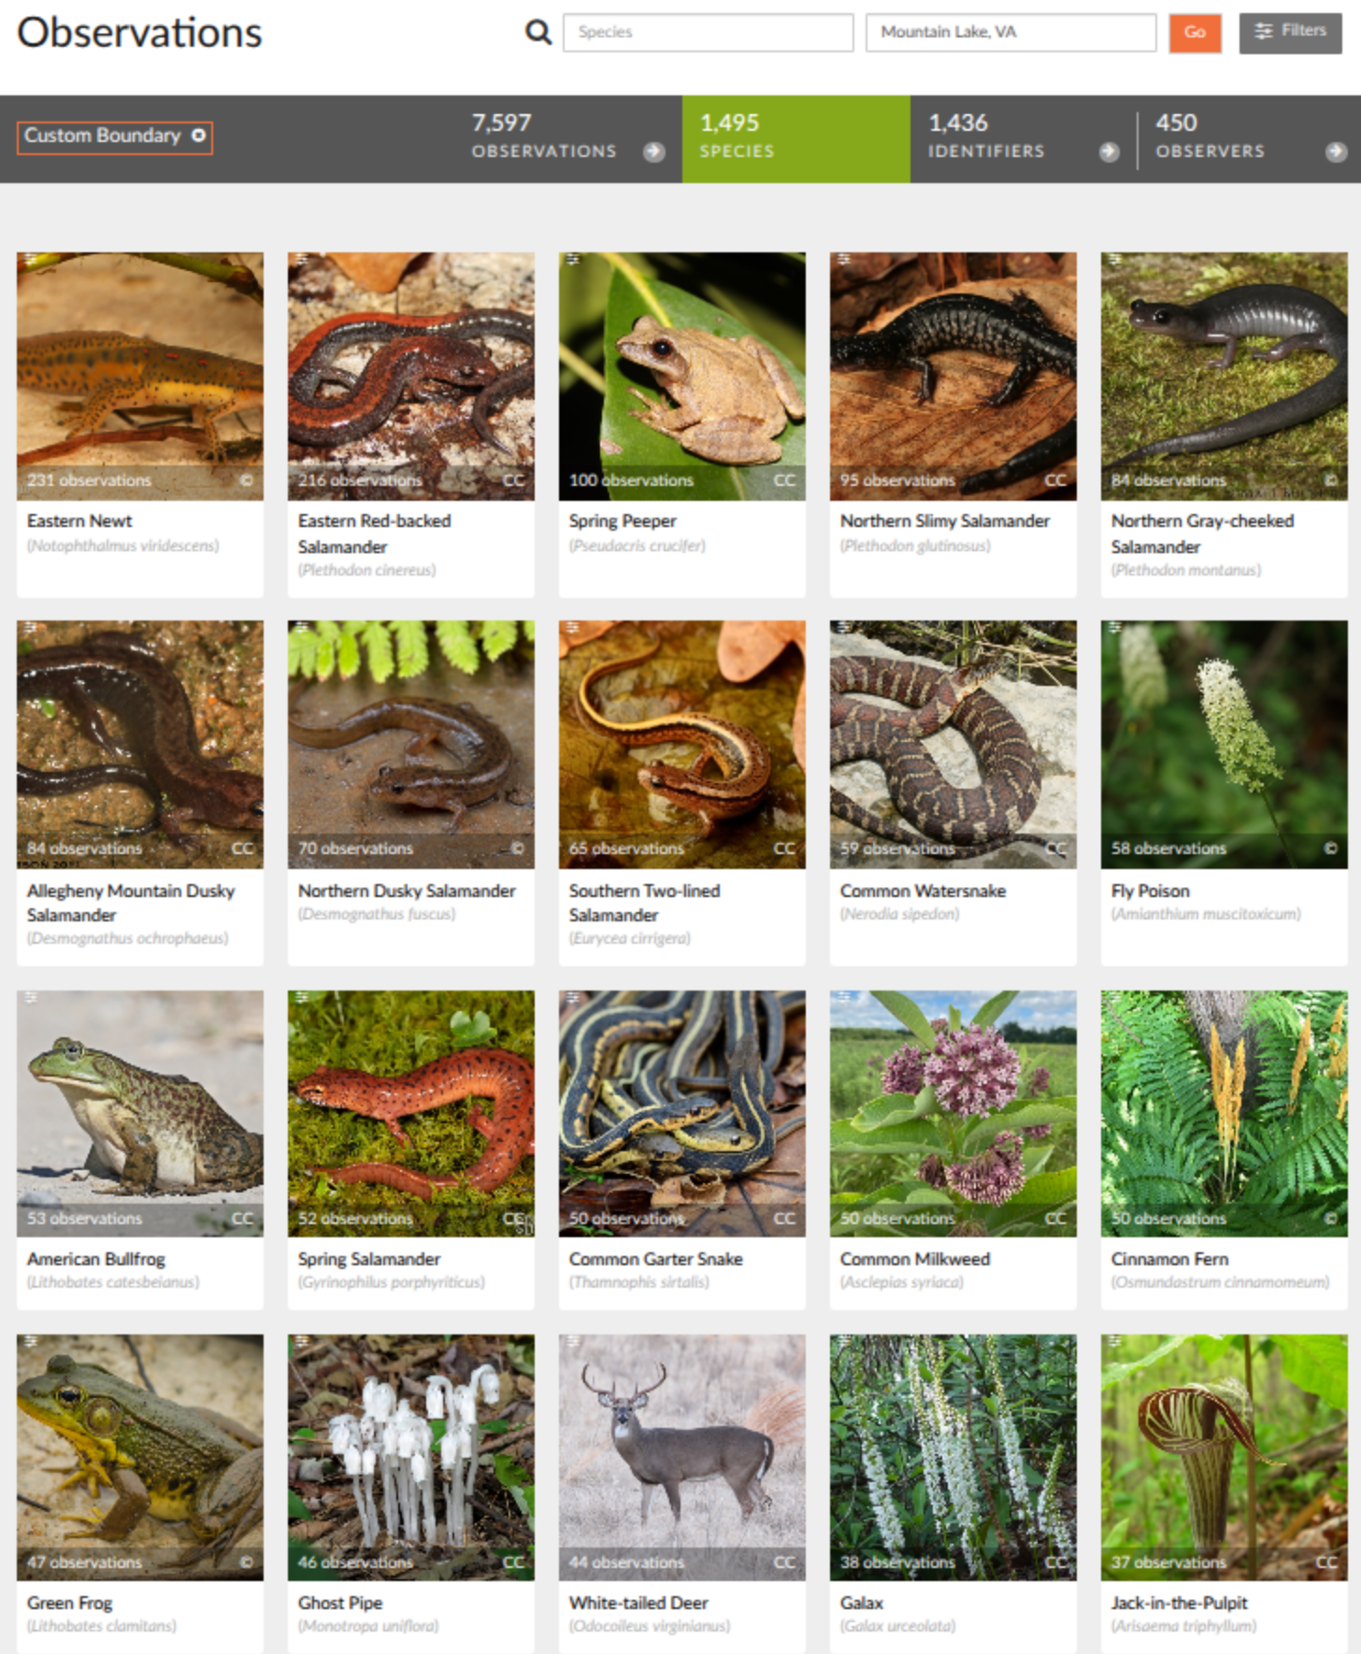

Slide 11
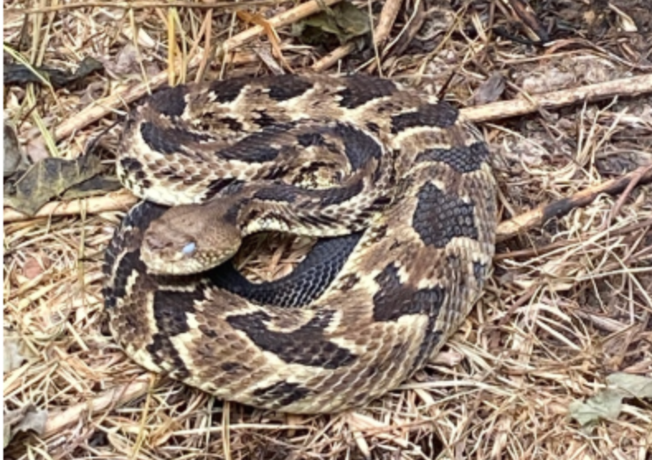
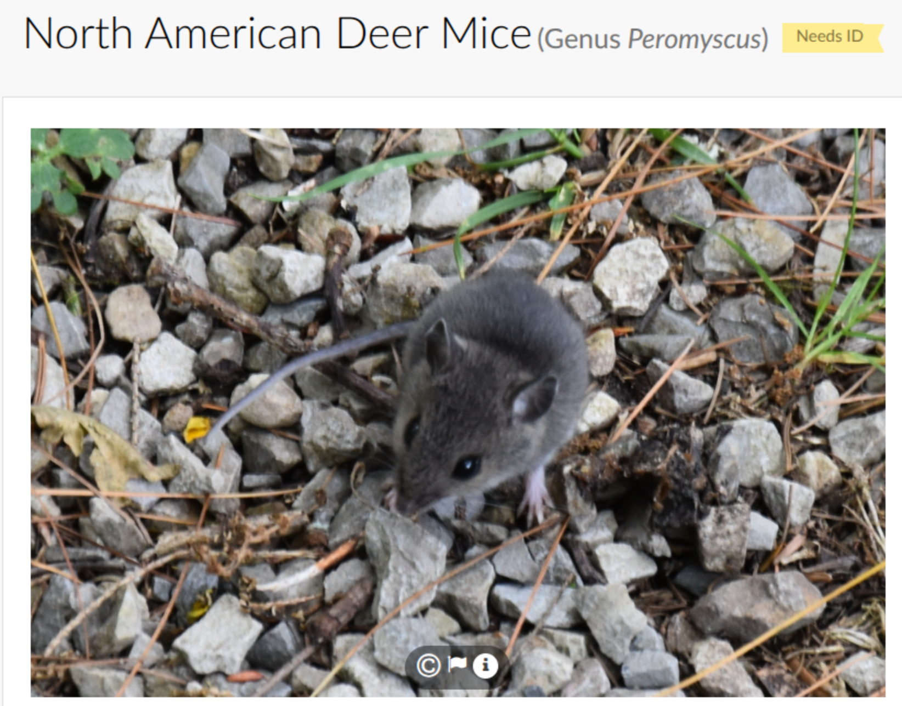
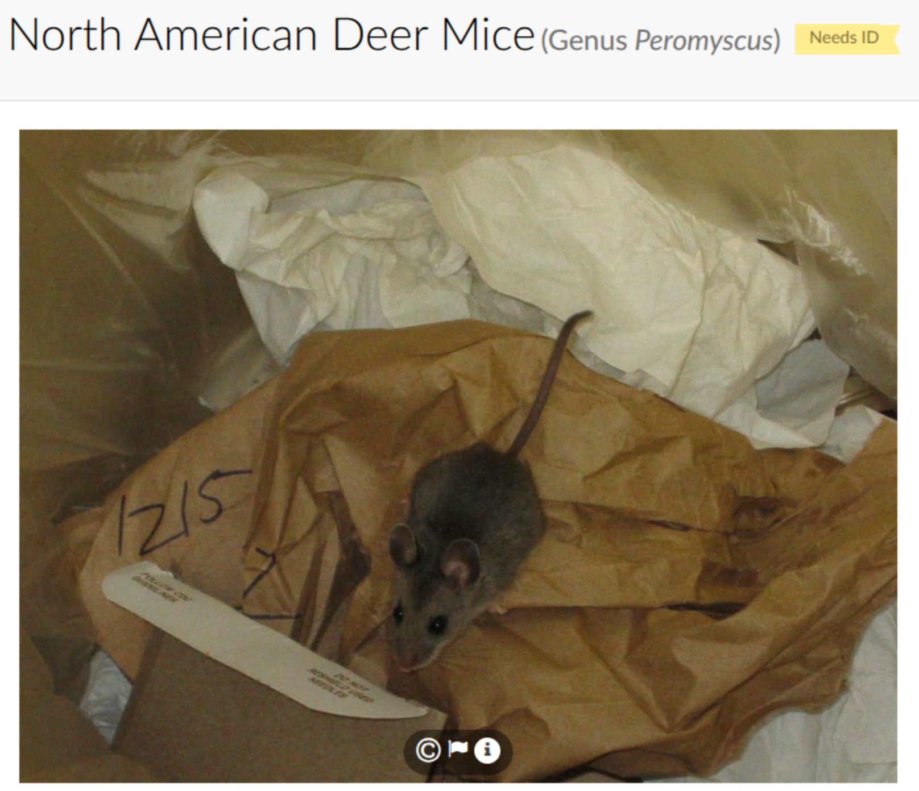

Slide 12
Questions or concerns about station logistics?

Slide 14
What do you hope to get out of this course?
pollev.com/josefuyeda941

Slide 15
Evolutionary Quantitative Genetics (or quantitative trait evolution from micro to macro)
Quantative Genetics
Mutation, Genetic variation, Natural selection, Genetic drift
A few generations/years
experiments/direct observation/field studies/breeding designs/genomics
Pedigrees
Macroevolution
Biodiversity, speciation, divergence, extinction
Phylogenetic comparative methods
Fossil record
Millions of years
Observational/patterns/ outcomes
Phylogenies
Workshop goal: Finding links
Finding gaps
Translation

Slide 16
Where do you see your scientific work?
pollev.com/josefuyeda941

Slide 17
Where do you see your scientific questions?
Macro
(many species, million-year
timescales, fossils & phylogenies)
Micro
(within species, generational timescales, populations)

Slide 18
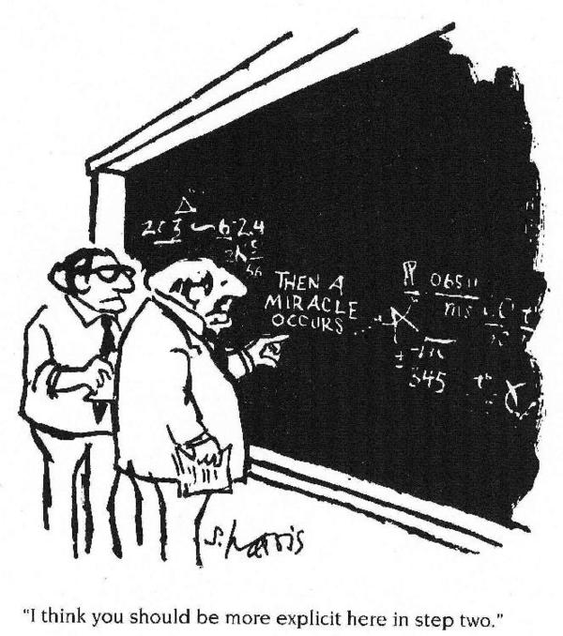
In this workshop we will talk about: The many powerful links in methodology, concepts, and data between micro and macro
The many paradoxes, open questions, and opportunities that exist in linking micro and macro
Microevolution
Macroevolution
Notes:
But this is only a hypothesis. Few have actually explicitly compared microevolutionary and macroevolutionary data to determine whether they are consistent with each other. Are they really compatible?

Slide 19
Gilliland et al. 2019. The fundamental characteristics of a translational scientist. ACS Pharmacology & Translational Science 2:213-216.

Slide 21
Introduce yourselves with 3 P’s!
Personal fact - something not visible or obvious about you, e.g. pet, passion, hobby
Professional fact - e.g. What you study, where you work (the usual)
Peculiar fact - e.g. stupid human tricks, rare/unusual claim to fame etc.

Slide 22
Participant presentations this afternoon
Upload to Google Drive by the end of Lunch!
5 minutes max!! (2 hours = 6 minutes per person x 20!)
I will enforce!
https://drive.google.com/drive/folders/1pZ-tbb4DouWzcKhAMbSK9o1nNkHwPXdf?usp=sharing
(link on slack)

Slide 23
Introduce yourselves with 3 P’s!
Personal fact - something not visible or obvious about you, e.g. pet, passion, hobby
Professional fact - e.g. What you study, where you work (the usual)
Peculiar fact - e.g. stupid human tricks, rare/unusual claim to fame etc.

