Slide 1
Micro to Macroevolution: What does Quantitative Genetics have to do with Comparative methods?
Josef Uyeda
Biological Sciences
Virginia Tech
juyeda@vt.edu
www.uyedalab.com

Slide 2
Methodological similarity

Slide 3
Ingredients

Slide 4
?
?
?
1/2 of
genetic
information
(Mendelian
model)
?
?
?
?

Slide 5
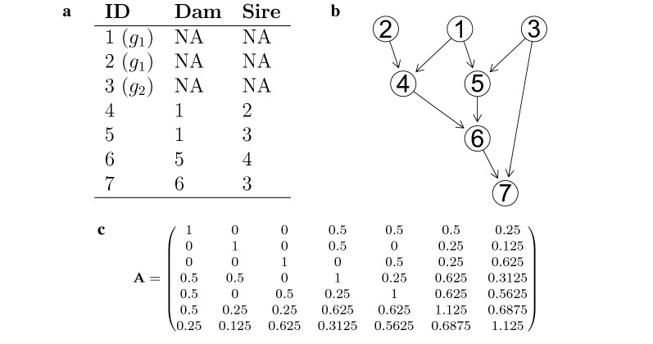
Estimating Additive Genetic Variance
Basic idea:
Pedigree provides structured knowledge and expected similarity betwen relatives, allowing partitioning of phenotypic variance among individuals and estimation of heritable genetic variation

Slide 6
“The Comparative Method”

Slide 7
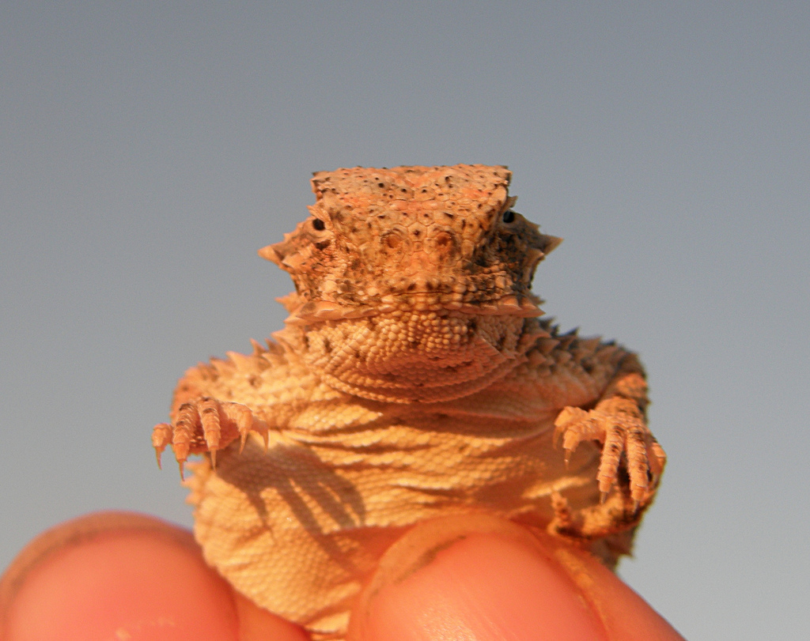

Slide 10
Horned lizards are cool

Slide 11
What caused these adaptations?

Slide 12
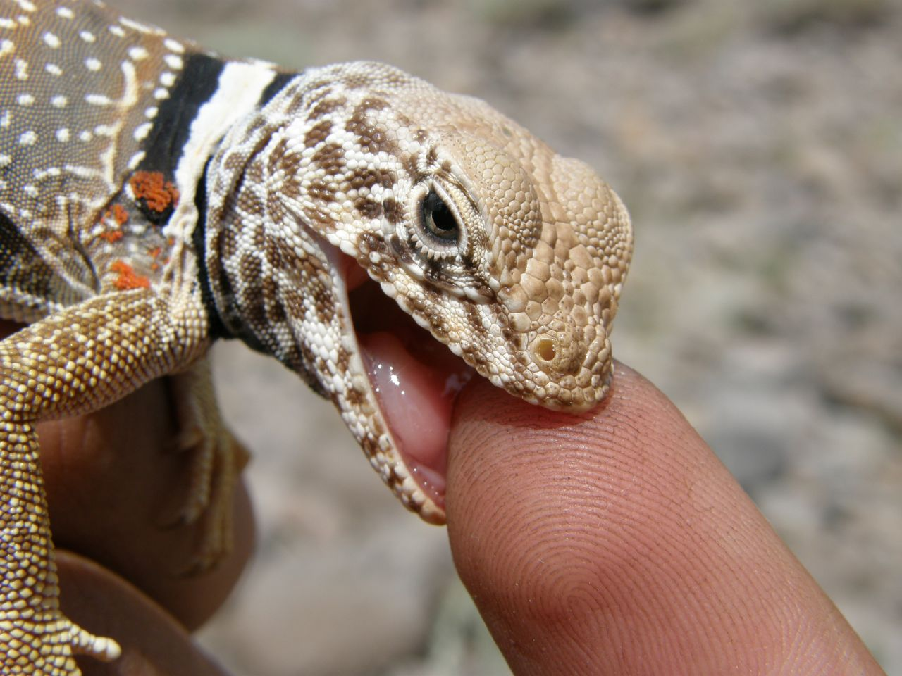
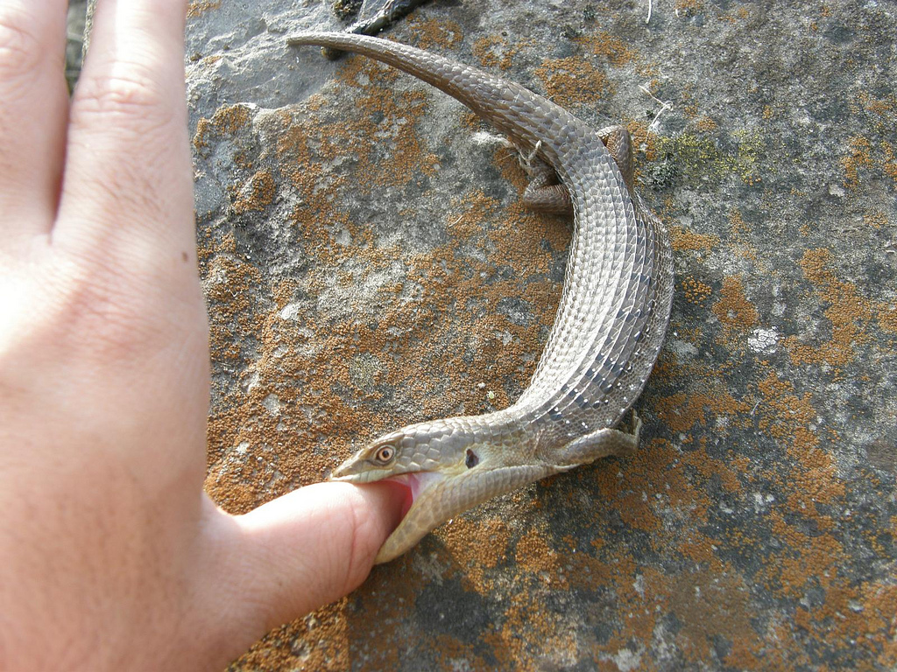
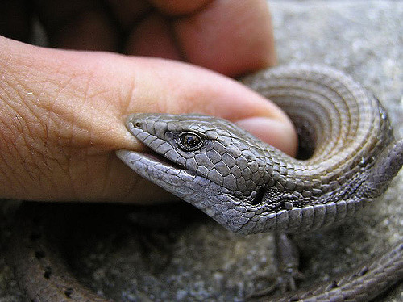

Slide 13
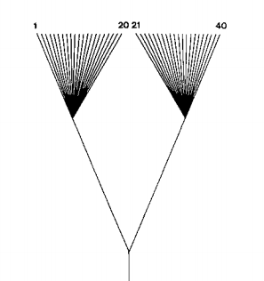
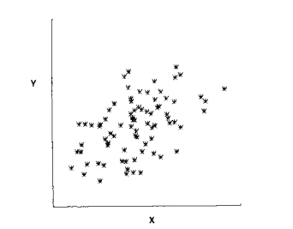
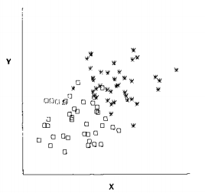
Felsenstein 1985

Slide 14
Why can’t we do “regular” linear regression again?
Non-independence
of species

Slide 15
Y ~ X
X₀
X₁
X₂
X₃
X₄
X₅
X₆
Y₃
Y₄
Y₅
Y₆

Slide 16
Why can’t we do “regular” linear regression again?
Non-independence
of residual error variation

Slide 17
Y ~ X
E₀
E₁
E₂
Pedigree/
Phylogeny
&
Model for random effects
(e.g. Mendelian inheritance or BM)
E₃
E₄
E₅
E₆
Y₅
Y₆
Y₇
Y₈
Response traits
Predictor traits/
Treatment/
Fixed effects
X₅
X₆
X₇
X₈

Slide 18
?
?
?
1/2 of
genetic
information
(Mendelian
model)
?
?
?
?

Slide 19
?
?
?
?
?
?
?
What model
do we use?
dZ/dt = ?

Slide 20
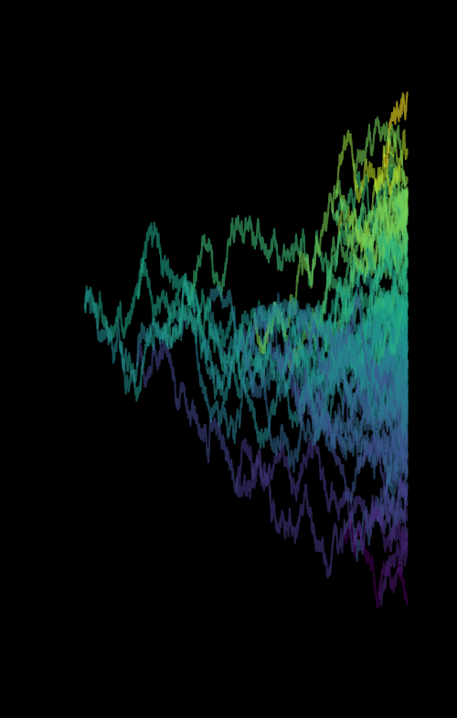
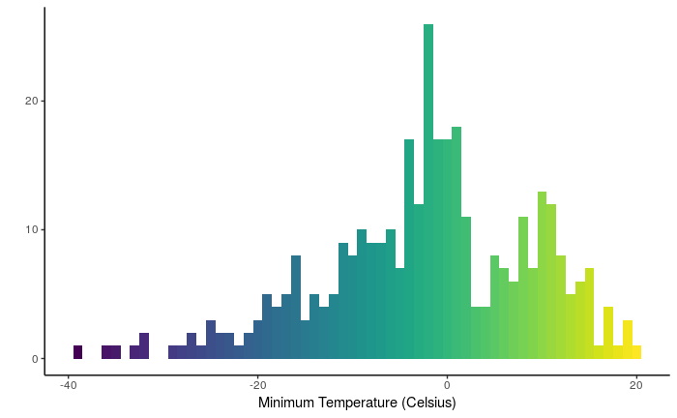
Brownian Motion

Slide 21
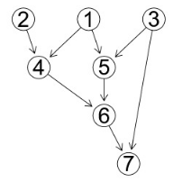

Slide 22
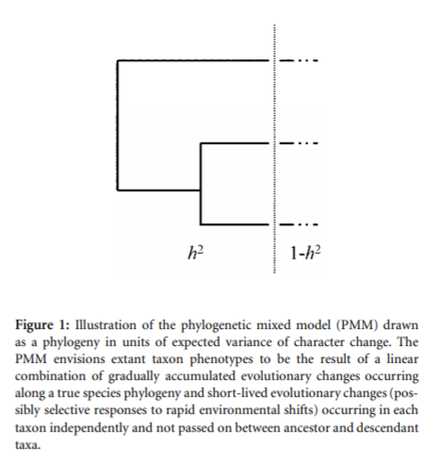
Replace individuals with species
Basic idea:
Phylogeny provides structured knowledge and expected similarity betwen relatives, allowing partitioning of phenotypic variance among species and estimation of “phylogenetic heritability” AKA phylogenetic signal

Slide 23
Species Means
Phylogenetic

Slide 24
What's different?
Entries of A in pedigrees vs. phylogenies
Mendelian laws: Coefficient of relatedness = 0.5 for parents & offspring
Assumption of constant rate Brownian Motion: Covariance proportional to branch lengths. Equally well justified?

Slide 25
What's different?
Interpretation of σ²_{a} & σ²_{e}
Additive genetic variance & Environmental variance.
Multivariate σ²_{a} = G-matrix
Brownian Motion rate & non- phylogenetic variance
Multivariate σ²_{a} = R-matrix

Slide 26
$$G = \begin{matrix}σ_{11}^{2} & σ_{12}^{2} \\ σ_{12}^{2} & σ_{22}^{2}\end{matrix}$$
Variance & covariance in Breeding Values per unit of genetic relatedness
$$R = \begin{matrix}σ_{11}^{2} & σ_{12}^{2} \\ σ_{12}^{2} & σ_{22}^{2}\end{matrix}$$
Variance & covariance in Trait divergence per unit of branch length (e.g. millions of years)

Slide 27
What would we predict about macroevolution from microevolution?

Slide 29
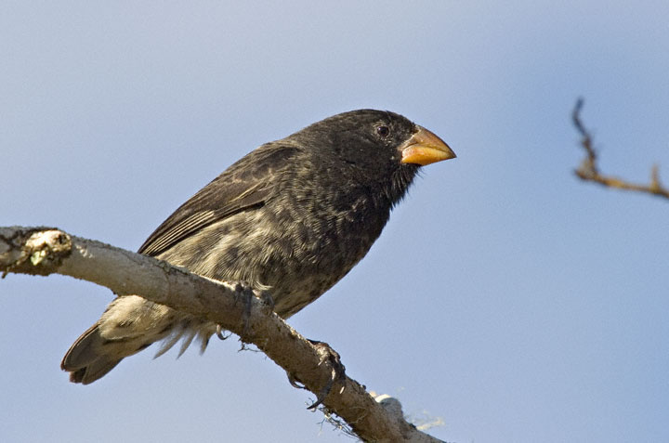
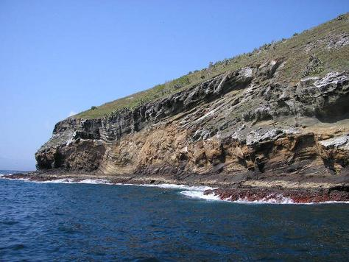
Microevolutionary patterns
We now know that we can study evolution in real time
Average weight
16.06 g
(1976)
17.13 g
(1978)
Response to selection
6.7% ∆ body size in
1 generation
(2 years)
Let’s assume only 1% is evolutionary
(Grant and Grant, 2002)

Slide 31
Let’s do the calculations:
If a population increased by 1% every generation starting from ~16 g:
In 200 years
43 g
In 500 years
193 g
In 1,000 years
2.3 kg
In 2,000 years
335 kg
In 10,000 years
6.47 x 10¹⁹ kg

Slide 32
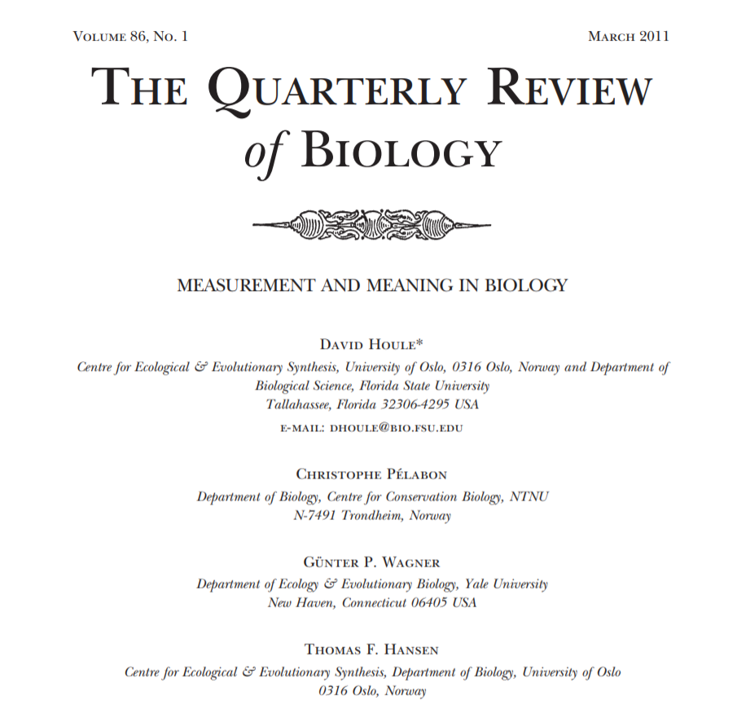
Aside: Why multiplicative increase?
Log transform size data!
Read this paper:

Slide 33
Let’s do the calculations:
If a population increased by 1% every generation starting from ~16 g:
In 200 years
43 g
In 500 years
193 g
In 1,000 years
2.3 kg
In 2,000 years
335 kg
In 10,000 years
6.47 x 10¹⁹ kg

Slide 34
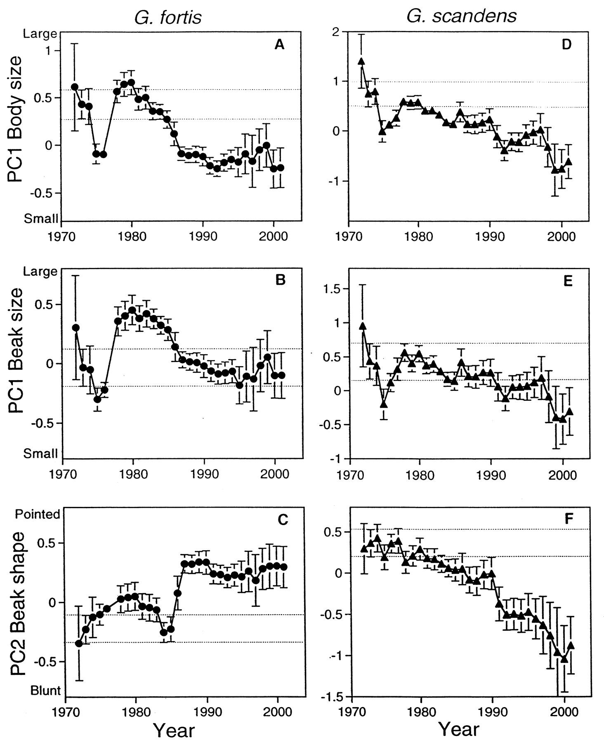
But evolution often reverses itself!
Let’s instead simulate going up or down randomly
(Brownian motion)
(Grant and Grant, 2002)

Slide 35
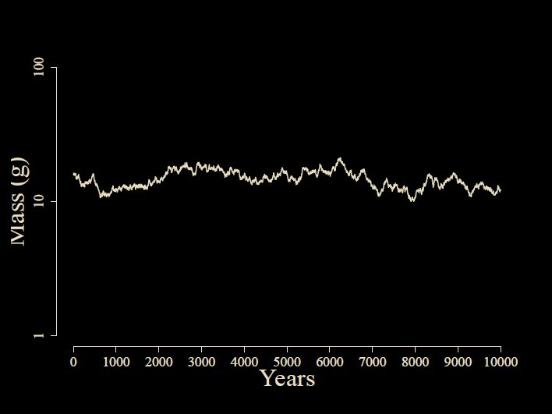
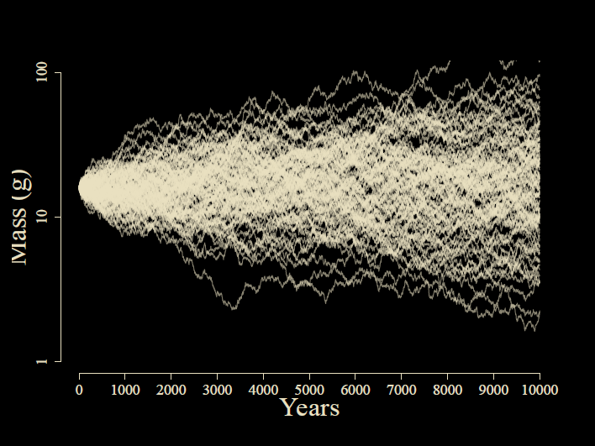
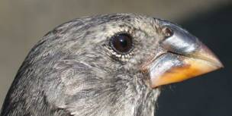

Slide 36
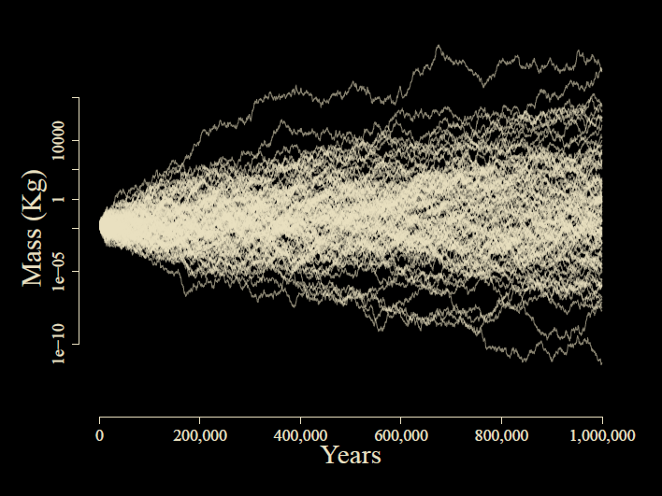

Slide 37
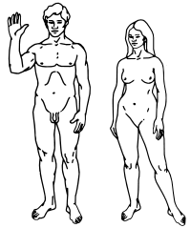

Slide 38
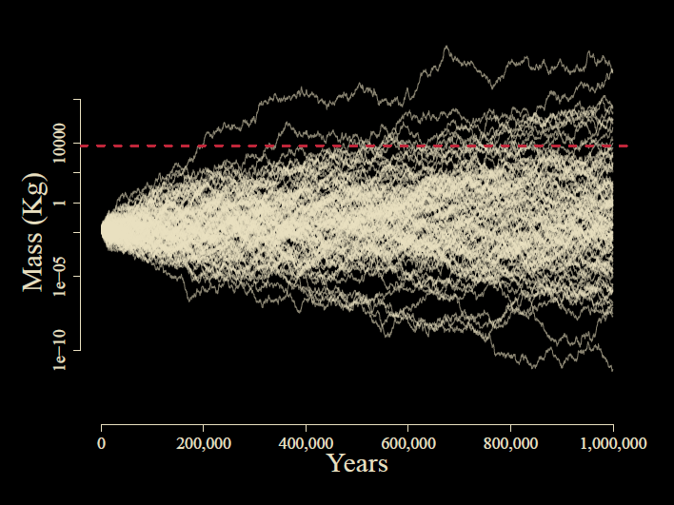
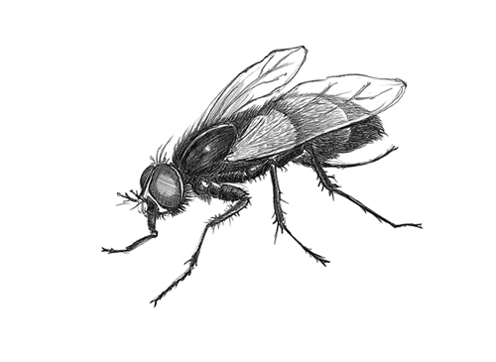

Slide 39
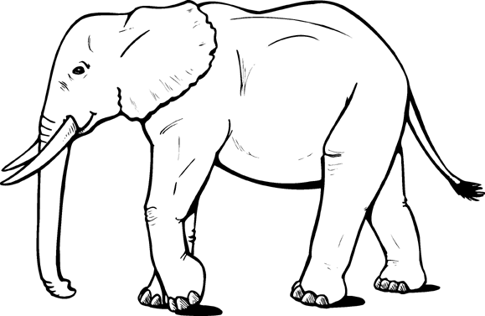

Slide 40
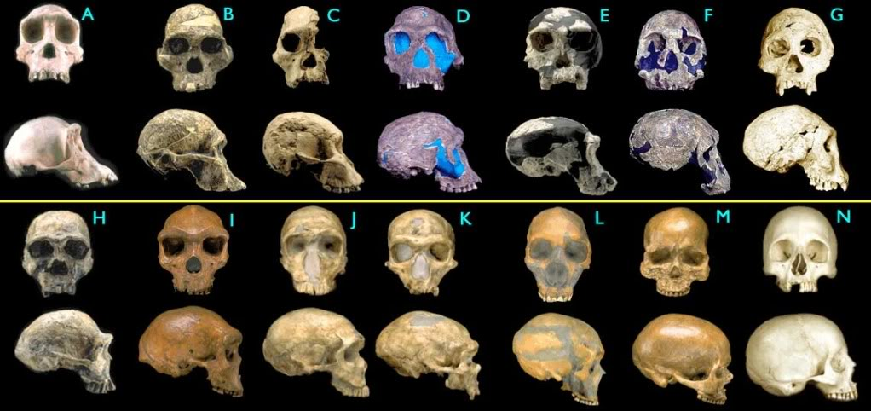
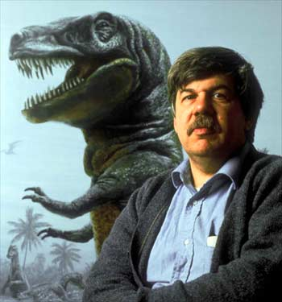
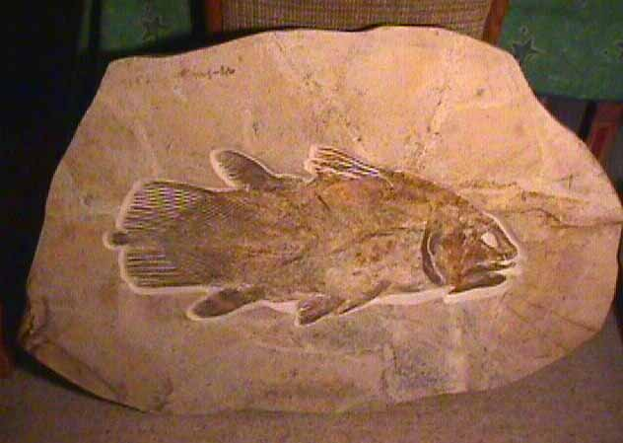
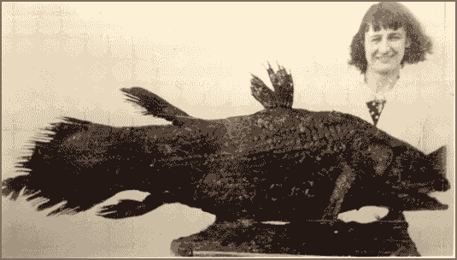
What does the fossil record say?
The pattern is stasis
Stephen Jay Gould

Slide 41
The Paradox of Stasis (Hansen & Houle 2004): Organisms seem to be able to evolve far more than they ever do
Empirical studies often find:
Strong (and often persistent) directional selection
(Hereford et al. 2004, Morrissey & Hadfield 2012)
High levels of additive genetic variance
(Mousseau & Roff 1987, Houle 1992)
Rapid evolutionary rates
(Hendry & Kinnison 1999, Kinnison & Hendry 2002)
…yet stasis in the fossil record
(Gingerich 1983, 2002)
Notes:
Perhaps headlines from Kingsolver’s paper?

Slide 42
Does microevolution even matter for long-term change?

Slide 43
“...paleontology deals with a phenomenon that belongs to it alone among the evolutionary sciences and that enlightens all its conclusions -- time.”
- Eldredge & Gould, 1972

Slide 44
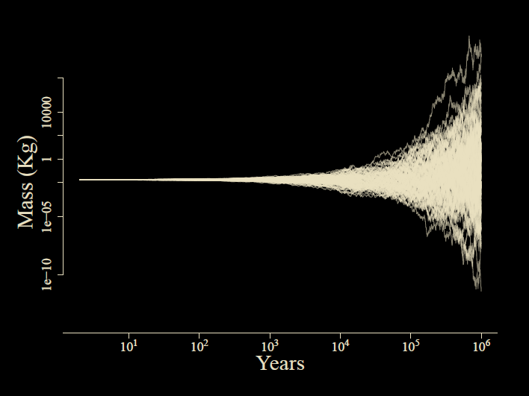

Slide 45
How can we see the pattern across scales of time?
All studies of phenotypic evolution measure comparable quantities
Time interval
Time interval
Pop A
mean(z)
Pop B
mean(z)
Pop A
mean(z)
Pop B
mean(z)
Pop X
We measure two quantities:
(1) “time for evolution”
(2) Δ mean body size
Notes:
Luckily, regardless if you are a paleontologist, a field biologist or a comparative biologist, you basically study the same thing. We have two populations, separated by time, and we measure a change in mean.

Slide 46
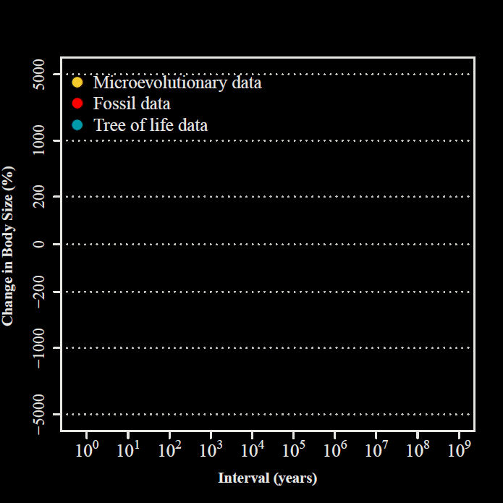
Uyeda et al.,
PNAS, 2011

Slide 47
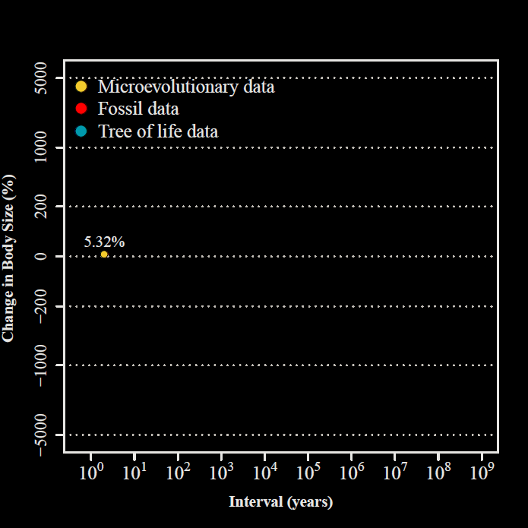
2 years
Uyeda et al.,
PNAS, 2011

Slide 48
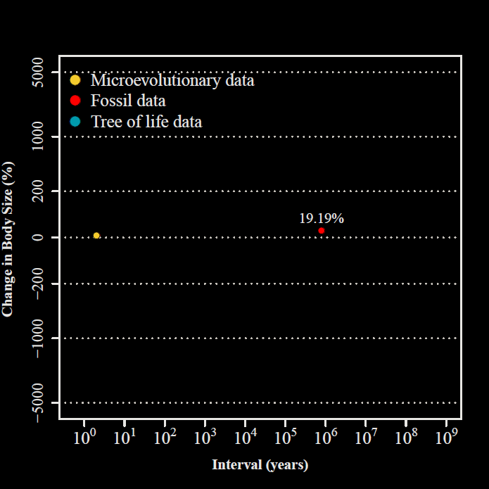
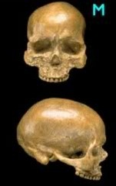
800,000 years
Uyeda et al.,
PNAS, 2011

Slide 49
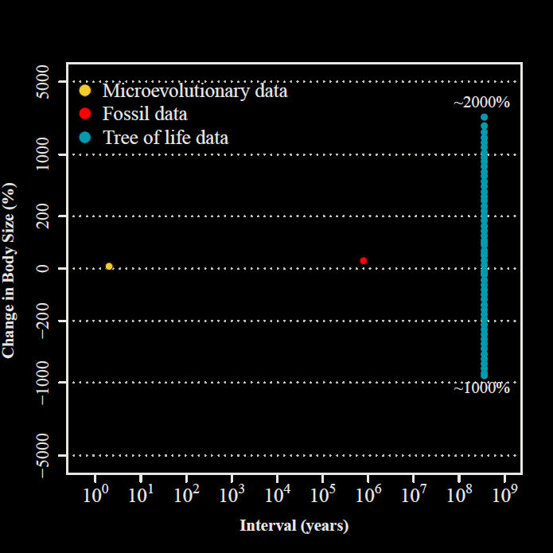
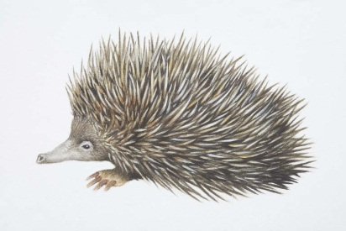
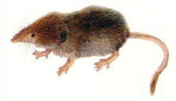
332.4 my

Slide 50
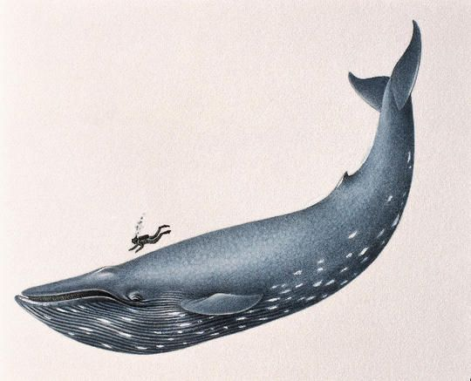
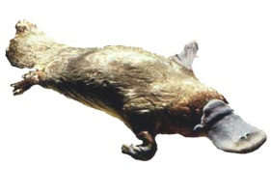
332.4 my
Uyeda et al.,
PNAS, 2011

Slide 51
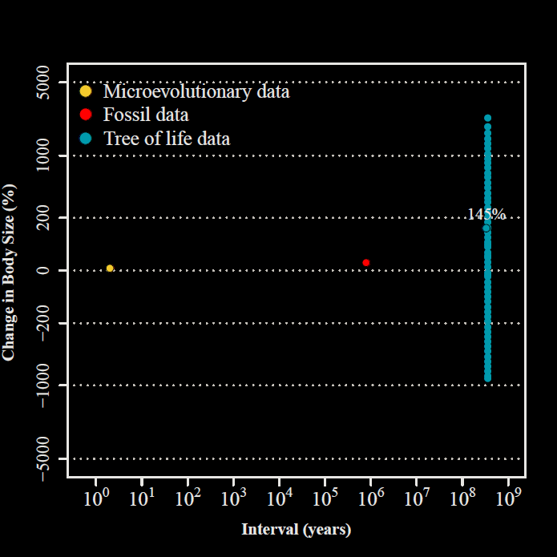
Uyeda et al.,
PNAS, 2011

Slide 52
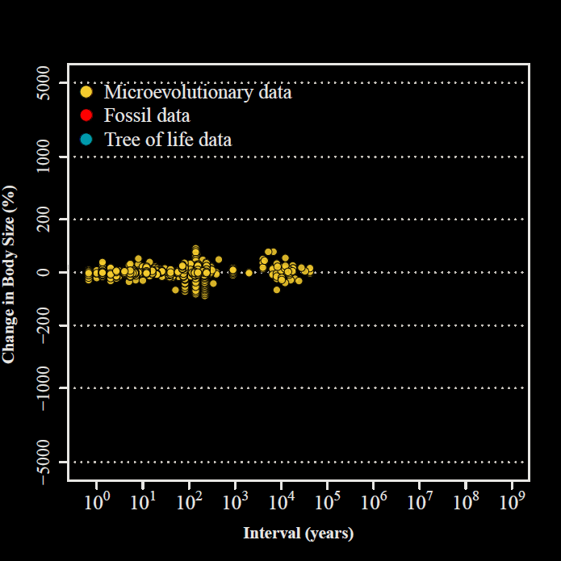
Uyeda et al.,
PNAS, 2011

Slide 53
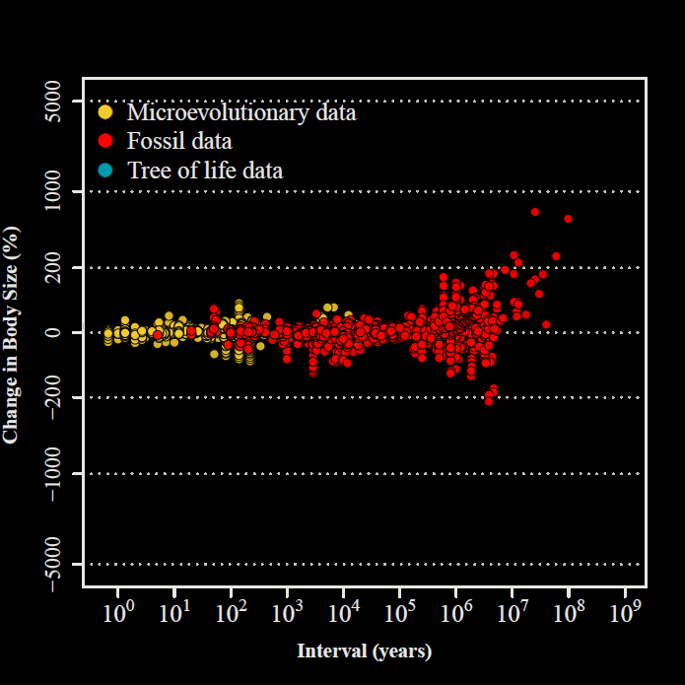
Uyeda et al.,
PNAS, 2011

Slide 54
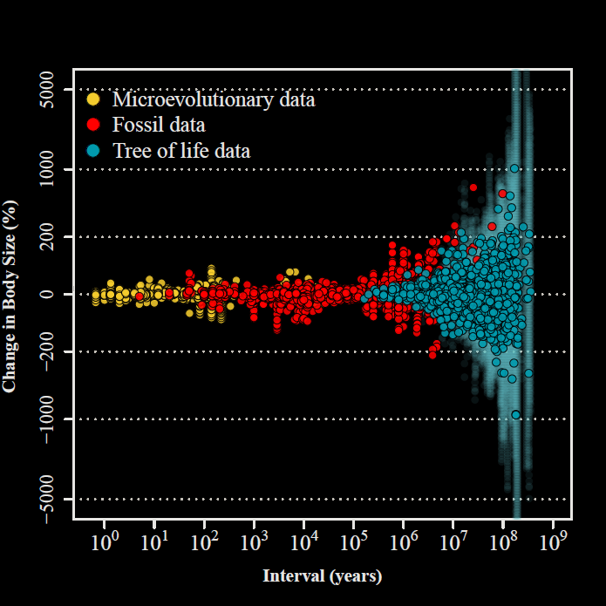
“The Evolutionary Blunderbuss”
Uyeda et al.,
PNAS, 2011

Slide 55
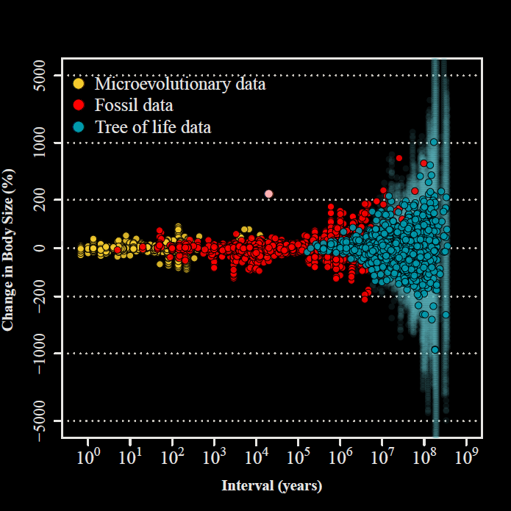
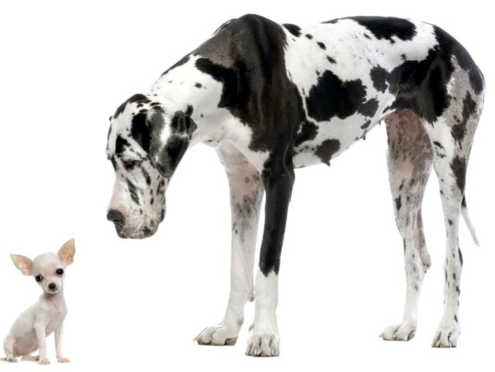
Uyeda et al.,
PNAS, 2011

Slide 56
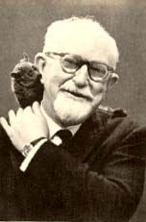
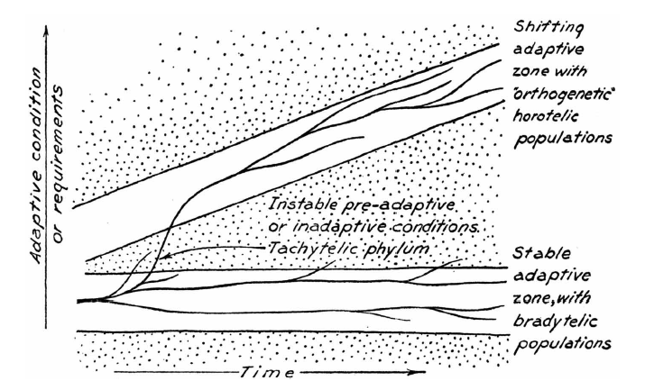
Simpson’s Adaptive Zones

Slide 57
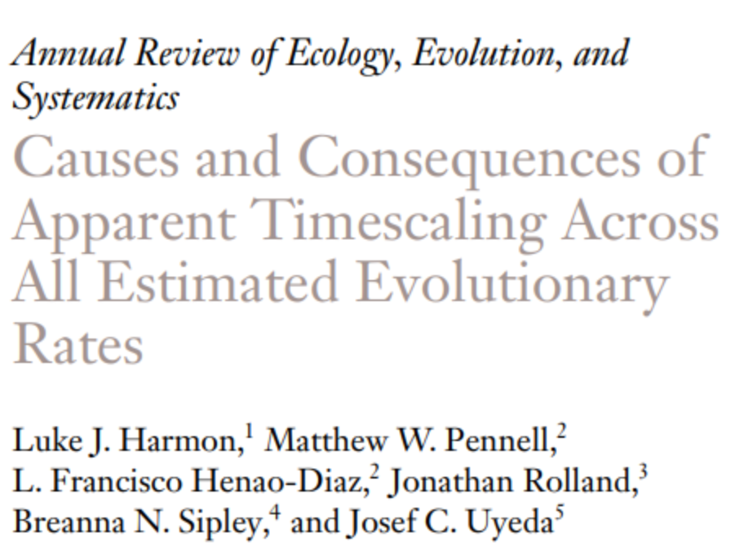
Note that this implies rate scaling
Rate = Change/Time
If the numerator doesn’t change, then rates will be fastest over short timescales!
Why this matters? Everything will look like it’s speeding up toward the present. Do we believe the past was like the present?

Slide 58
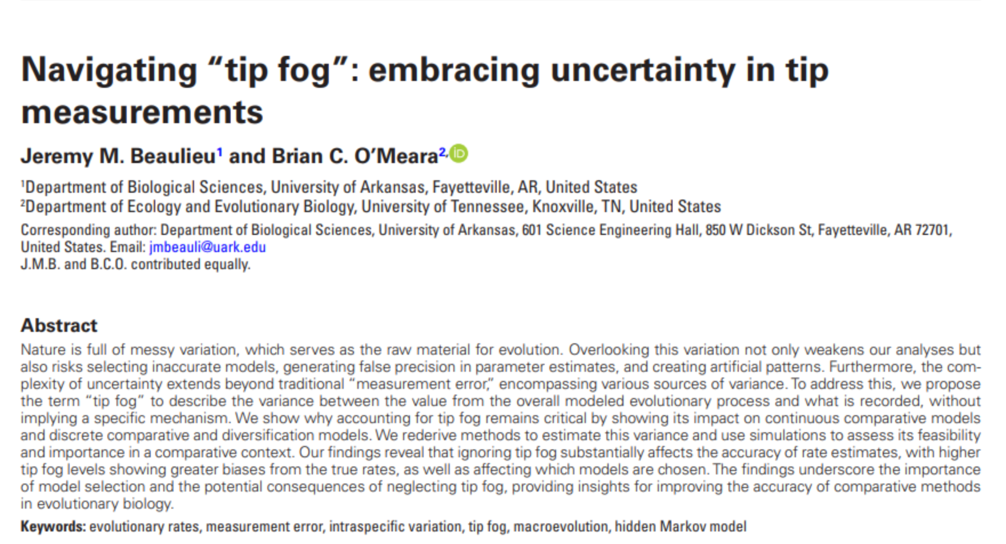

Slide 59
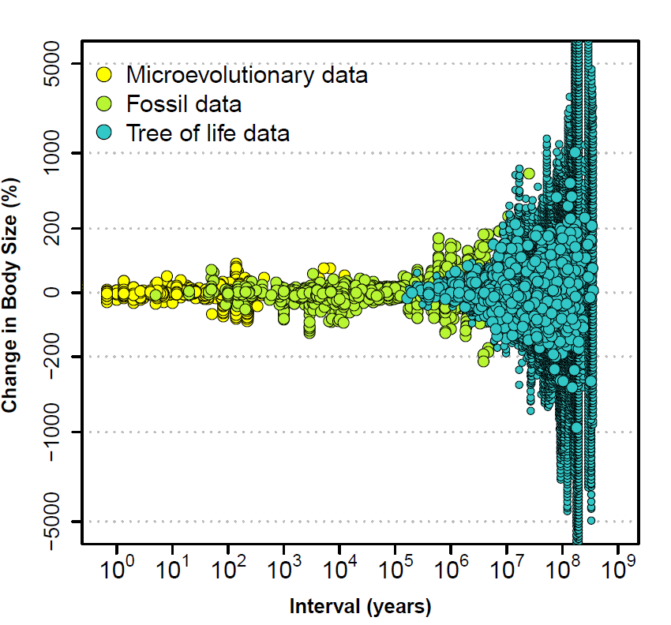
Study bias?

Slide 60
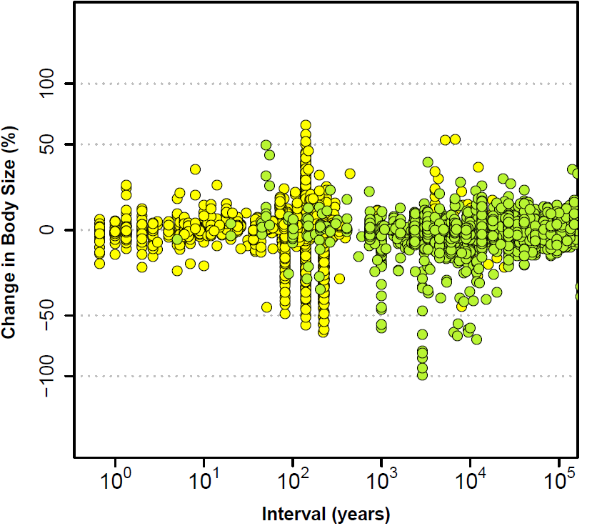

Slide 61
Some proposals

Slide 62
Populations vs. lineages
Eldredge, et al. 2005. The dynamicsof evolutionary stasis. Paleobiology.
Bartoszek et al. 2017. Using the Ornstein-Uhlenbeck process to model the evolution of interacting populations, J. of Theoretical Biology

Slide 63
Population means =
How we measure microevolution
Species means = How we measure macroevolution

Slide 64
Intraspecific competition
Haller & Hendry. 2014. Solving the paradox of stasis: Squashed stabilizing selection and the limits of detection, Evolution

Slide 65
Temperature tracking
Hunt et al. 2015. Simple vs complex models of trait evolution and stasis as a response to environmental change, PNAS

Slide 67
Randomly fluctuating selection
Holstad et al. 2024
Evolvability predicts
macroevolution under
fluctuating selection. Science.

Slide 68
Multivariate genetic constraints?
(See paradox of predicatibility lecture by Fabio)

Slide 74
The Elephant in the Dark
Each of us touches one place
And understands the whole in that way.
…
If each of us held a candle there,
And if we went in together,
We could see it.
Notes:
Many of you are probably familiar with the Indian story of the Blind men and the Elephant, or in other versions, the Elephant in the Dark. The story comes in many versions, but the common theme is that a group of men disagrees about the nature of an elephant because they are unable to perceive beyond a small portion of its body. If you will indulge me, I’d like to read a portion of one of my favorite versions of this story, but the Persian Poet Rumi.

Slide 75
Discussion:
What is the most compelling explanation for "million-year wait" and stasis?
How should we conceive of adaptive radiations and key innovations?
Does speciation matter? Does extinction?
What can we measure that predicts constraints across timescales?

Slide 76
More generally...
What happens to all the “stuff” we study at one level, when scale up to the next?
Molecular genetics: Rampant epistasis/ molecular interactions/GxE
Scale up --> Additive model of QG(?)
EQG: G-matrices/constraints/ competition/coevolution
Scale up --> Brownian Motion(?)

