Slide 1
Paradox of predictability
EQGW 2025

Slide 2
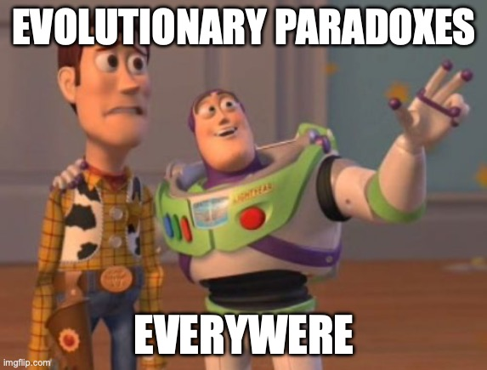
Notes:
As you probably noticed, extending micro to macro evolution can lead to some bumpy problems. Josef talked about the paradox of stasis, as this conflict between the fact that things should be able to evolve more than what we see in the fossil record.
The field of macroevolution is full of this kind of conflicts, exactly because macroevolution can involve way more complexities than we can analyse at the micro level. However, in this lecture I will discuss briefly about another kind of paradox that builds on top of the mismatch between macro and micro evolution in a slightly different way.
Different than the paradox of stasis in which we cannot predict what will happen based on microevolutionary models, the paradox of predictability focus on patterns that shouldn’t be present, but match microevolutionary prediction.

Slide 3
Is macroevolution just microevolution+time?
Notes:
As with the paradox of stasis, the paradox of predictability focus on this simple question wich we’ve been trying to address in this workshop: is macroevolution just microevolution plus time?

Slide 4
Microevolution
MACROEVOLUTION
Notes:
Just se we are on the same page: what are the distinctions of miro and macro evolutuion?

Slide 5
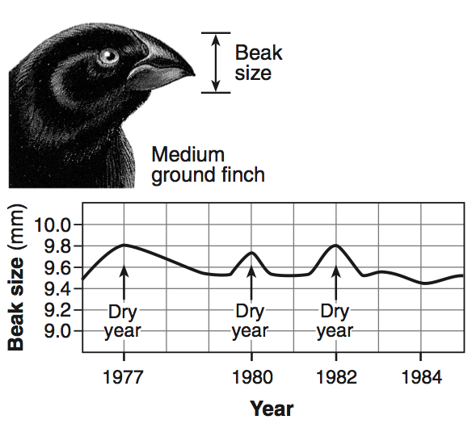
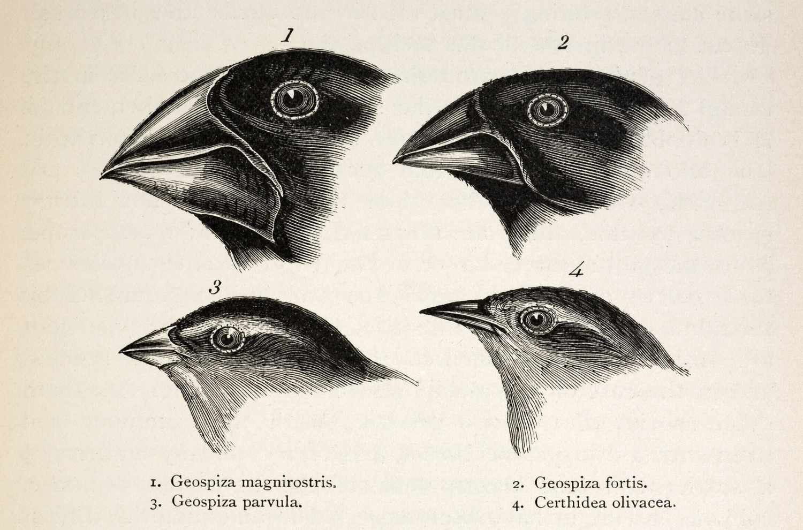
Microevolution
MACROEVOLUTION
Within species
Small time scale (ys, gens)
Reduced magnitude
Multiple species
Large time scale (mys, geological time)
Larger magnitude

Slide 6
Microevolution
MACROEVOLUTION
Within species
Small time scale (ys, gens)
Reduced magnitude
Multiple species
Large time scale (mys, geological time)
Larger magnitude
Is there a difference
(other than time)?

Slide 7
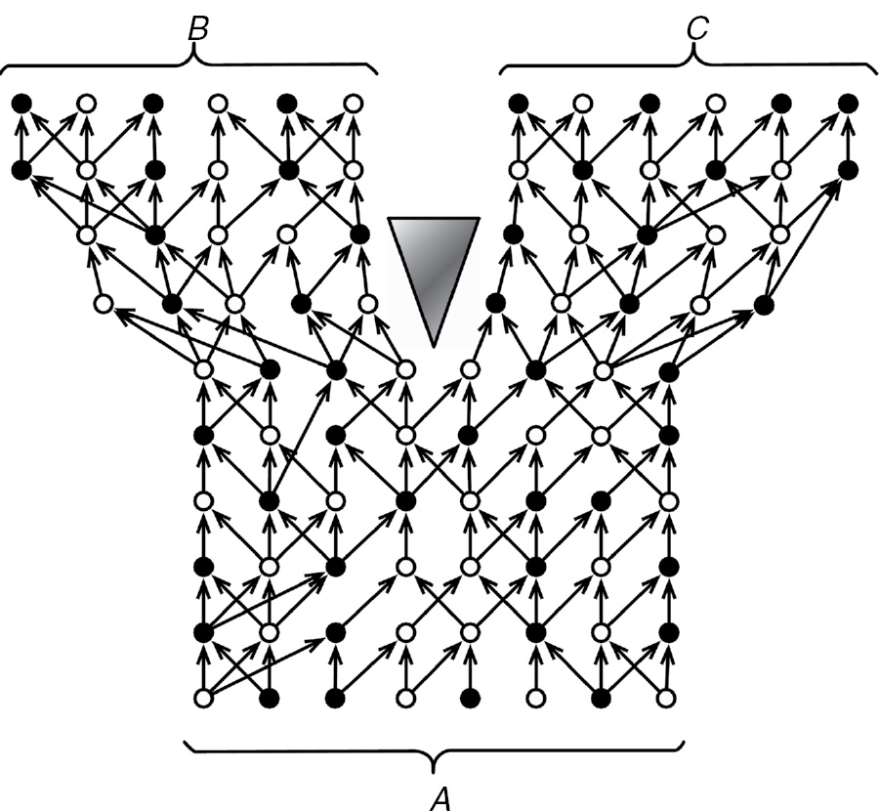
Hennig, 1966

Slide 8
Population dynamics
Hennig, 1966

Slide 9

No additional processes required
Population dynamics
Hennig, 1966
Notes:
But when we are talking about extention between micro-macro, we are talking about…

Slide 10
No additional processes required
Population dynamics
Models
Hennig, 1966

Slide 11
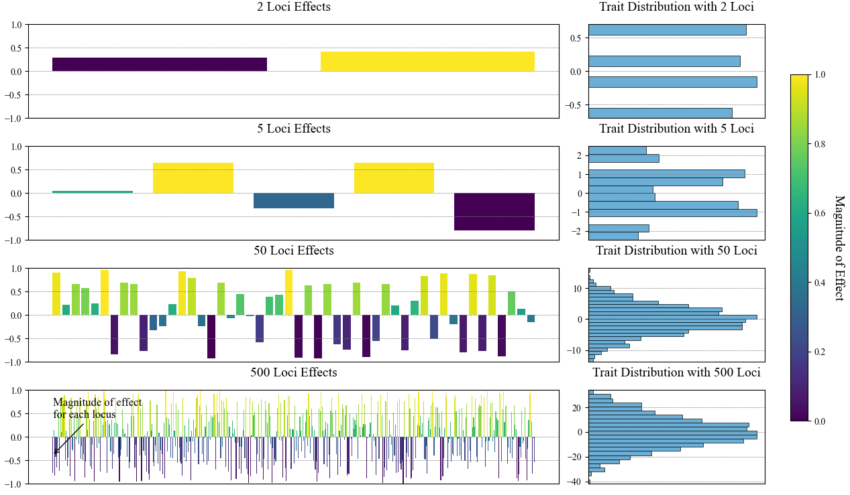
Infinitesimal model of trait variation
Allows for the statistical treatment of the evolution of continuous traits

Slide 12
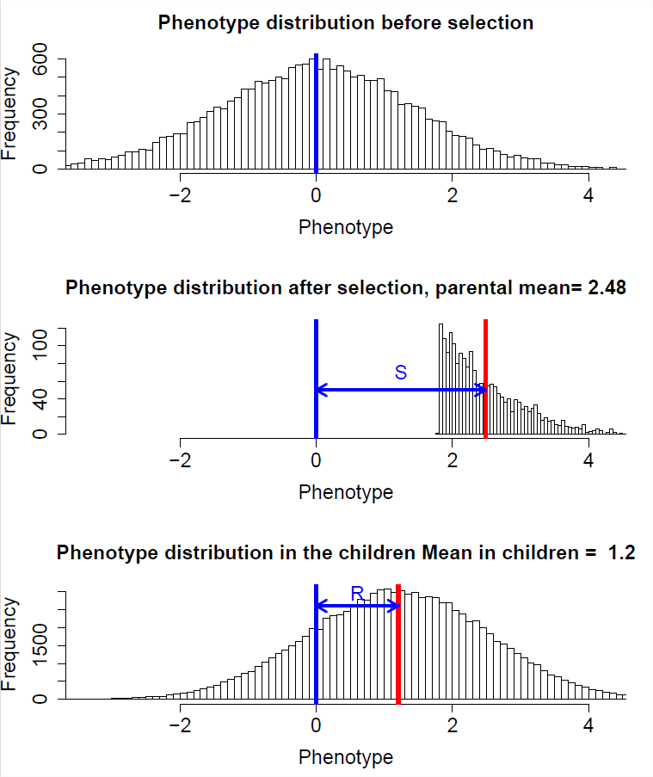

Models of trait evolution based on evolutionary processes
Directional selection
$${R=Sh}^{2}$$
$$∆\overline{z}\left(t\right)=\left[{\overline{z}}_{w}\left(t\right)−\overline{z}\left(t\right)\right] \frac{σ_{a}^{2}}{σ_{p}^{2}}$$

Slide 13
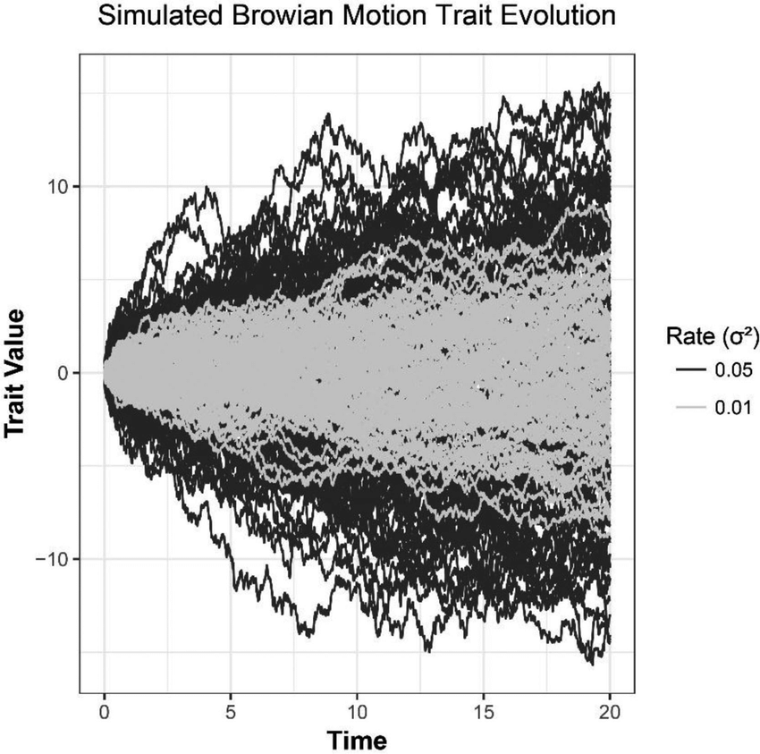

Models of trait evolution based on evolutionary processes
Directional selection
$${R=Sh}^{2}$$
$$∆\overline{z}\left(t\right)=\left[{\overline{z}}_{w}\left(t\right)−\overline{z}\left(t\right)\right] \frac{σ_{a}^{2}}{σ_{p}^{2}}$$
Genetic Drift
$$σ_{b}^{2}\left(t\right)=σ_{a}^{2}\frac{t}{N}$$

Slide 14
Models of trait evolution based on evolutionary processes
Directional selection
$${R=Sh}^{2}$$
$$∆\overline{z}\left(t\right)=\left[{\overline{z}}_{w}\left(t\right)−\overline{z}\left(t\right)\right] \frac{σ_{a}^{2}}{σ_{p}^{2}}$$
Genetic Drift
$$σ_{b}^{2}\left(t\right)=σ_{a}^{2}\frac{t}{N}$$
Can we use any of these models in macroevolution?

Slide 15
Models of trait evolution based on evolutionary processes
Directional selection
$${R=Sh}^{2}$$
$$∆\overline{z}\left(t\right)=\left[{\overline{z}}_{w}\left(t\right)−\overline{z}\left(t\right)\right] \frac{σ_{a}^{2}}{σ_{p}^{2}}$$
Genetic Drift
$$σ_{b}^{2}\left(t\right)=σ_{a}^{2}\frac{t}{N}$$
Null model

Slide 16

Using genetic drift as a null model of macroevolution
$$σ_{b}^{2}\left(t\right)=σ_{a}^{2}\frac{t}{N}$$
Make assumptions of quantitative genetic traits
Generate null expectation under drift
Calculate empirical rates of evolution
Confront them
Slower than drift
Faster than drift
drift
Rates of evolution

Slide 17
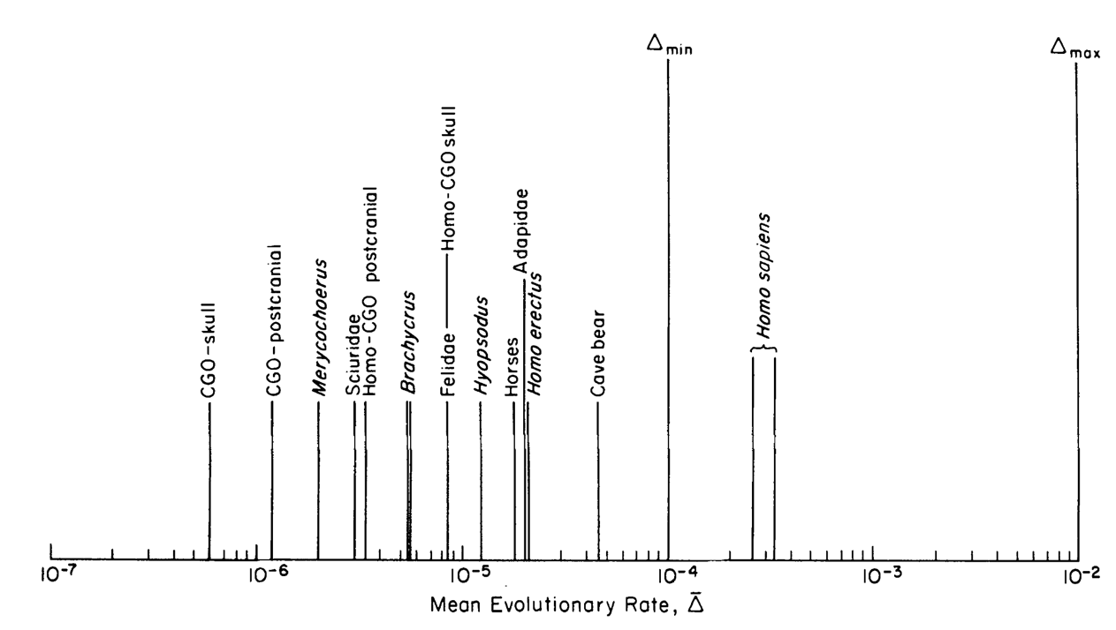
Lynch, 1990

Slide 18
Drift
Lynch, 1990

Slide 19
Drift
Consistent with …?
Lynch, 1990

Slide 20
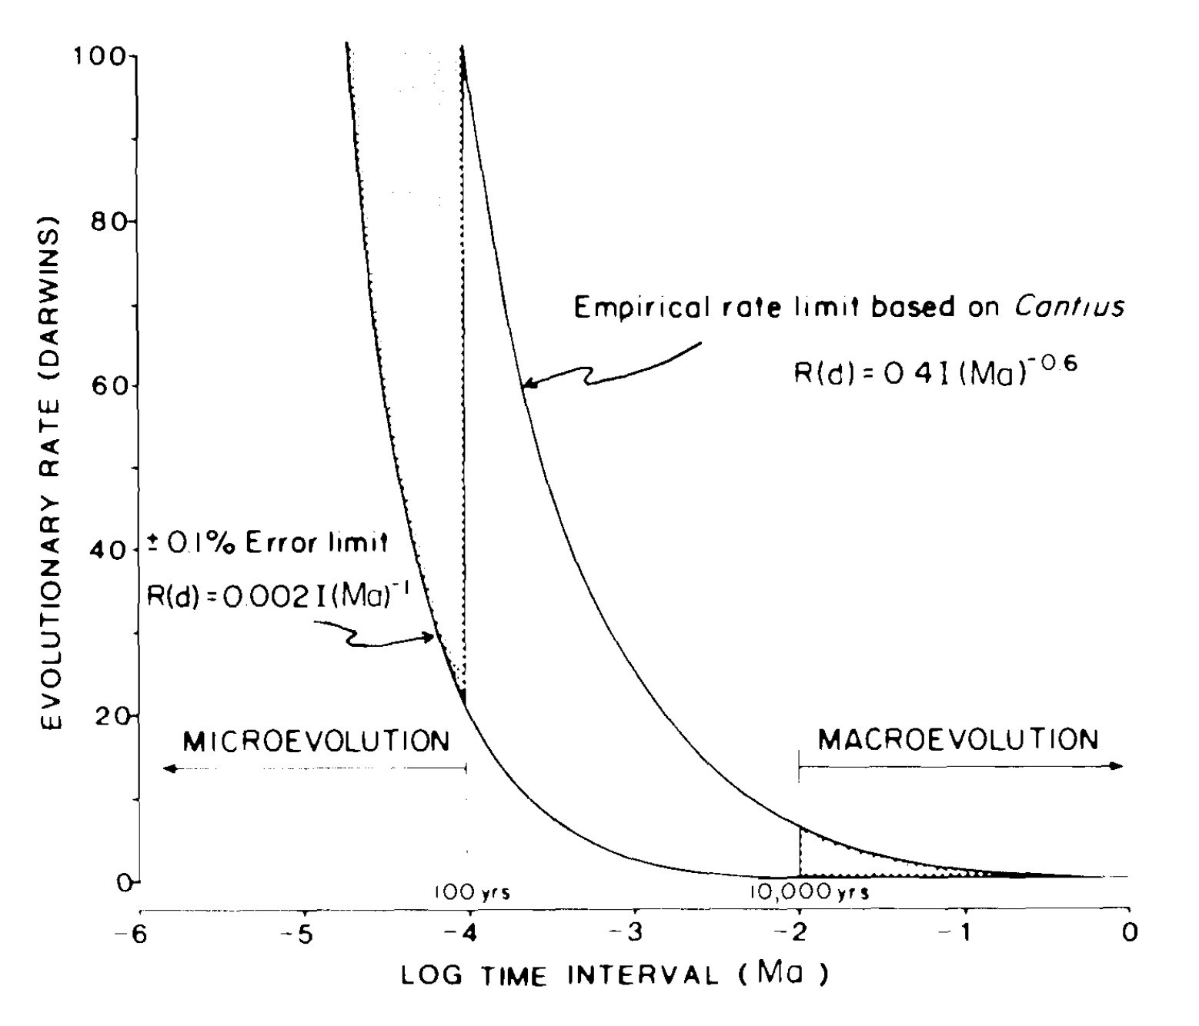
Gingerich, 1987

Slide 21
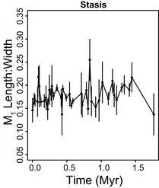
Clyde and Gingerich 1994

Slide 22
Clyde and Gingerich 1994

Slide 23
Low
High
Clyde and Gingerich 1994

Slide 24
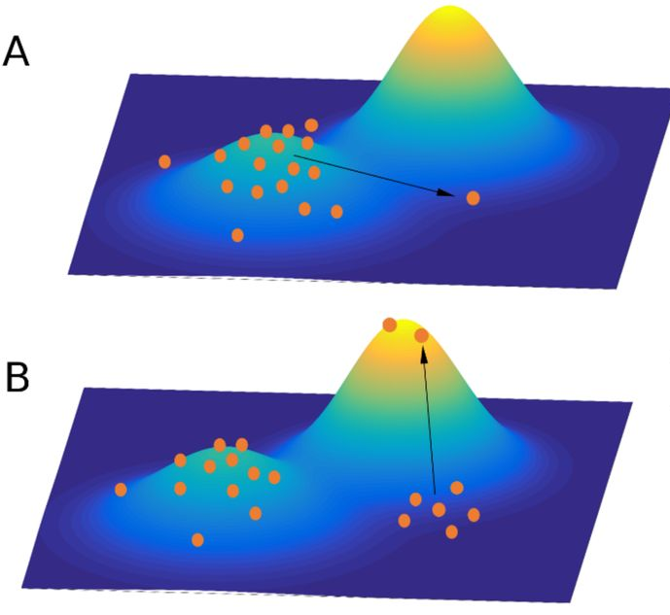
Climbing new peaks is very fast
(given the availability of additive genetic variance), so large scale macroevolutionary dynamics are the result of peak dynamics

Slide 25
Is macroevolution just microevolution+time?
Notes:
yes

Slide 26
Is macroevolution just microevolution+time?
YES. Well, sort of. But in a practical sense, not really… But maybe?
Notes:
yes

Slide 27
Is macroevolution just microevolution+time?
YES. Well, sort of. But in a practical sense, not really… But maybe?
Notes:
Well, sort of.

Slide 28
Is macroevolution just microevolution+time?
YES. Well, sort of. But in a practical sense, not really… But maybe?
Notes:
But in a practical sense, not really…

Slide 29
Is macroevolution just microevolution+time?
YES. Well, sort of. But in a practical sense, not really… But maybe?
Notes:
But in a practical sense, not really…

Slide 30
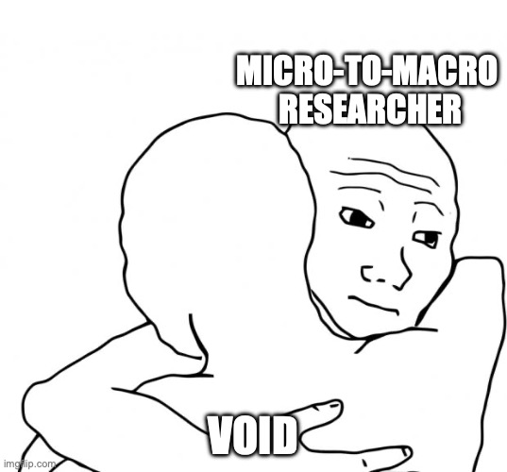
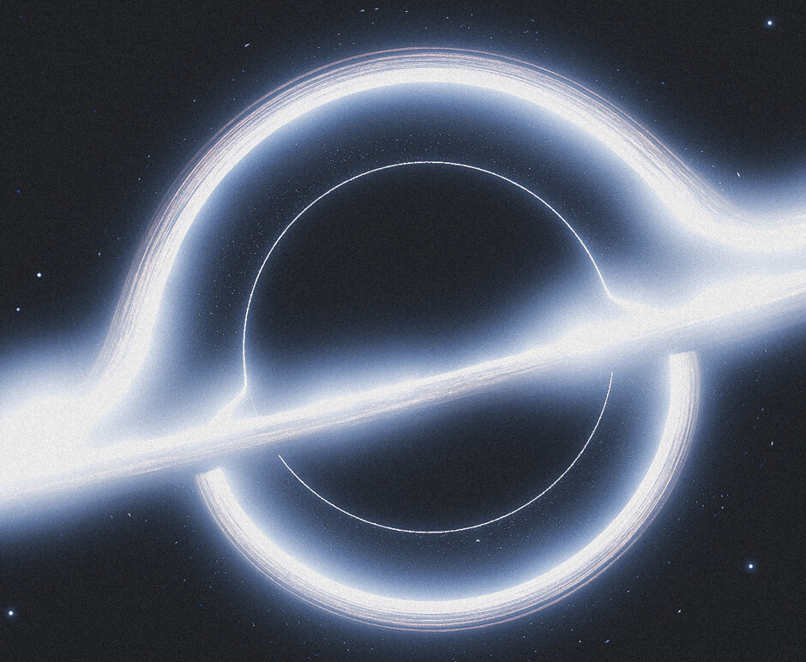

Slide 31


Genetic Drift
Univariate case - rate of evolution is a function of additive genetic variance and a constant
Multivariate case- rates of evolution are a function of additive genetic variance for each trait and a constant (t/Ne)
$$σ_{b}^{2}\left(t\right)=σ_{a}^{2}\frac{t}{N}$$
Univariate
Σ
$$Σ\left(t\right)=G\frac{t}{N}$$
G
Multivariate
Divergence should be proportional to the amount of intraspecific variation

Slide 32
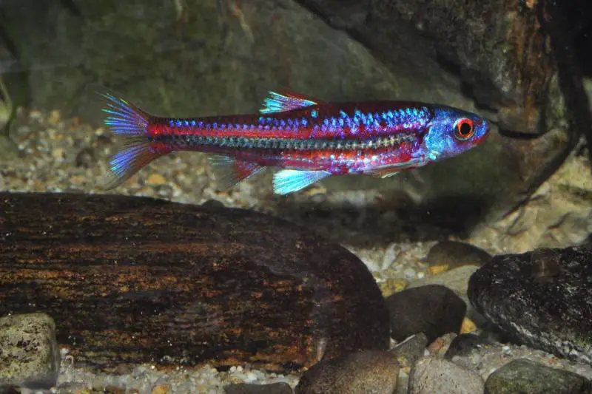
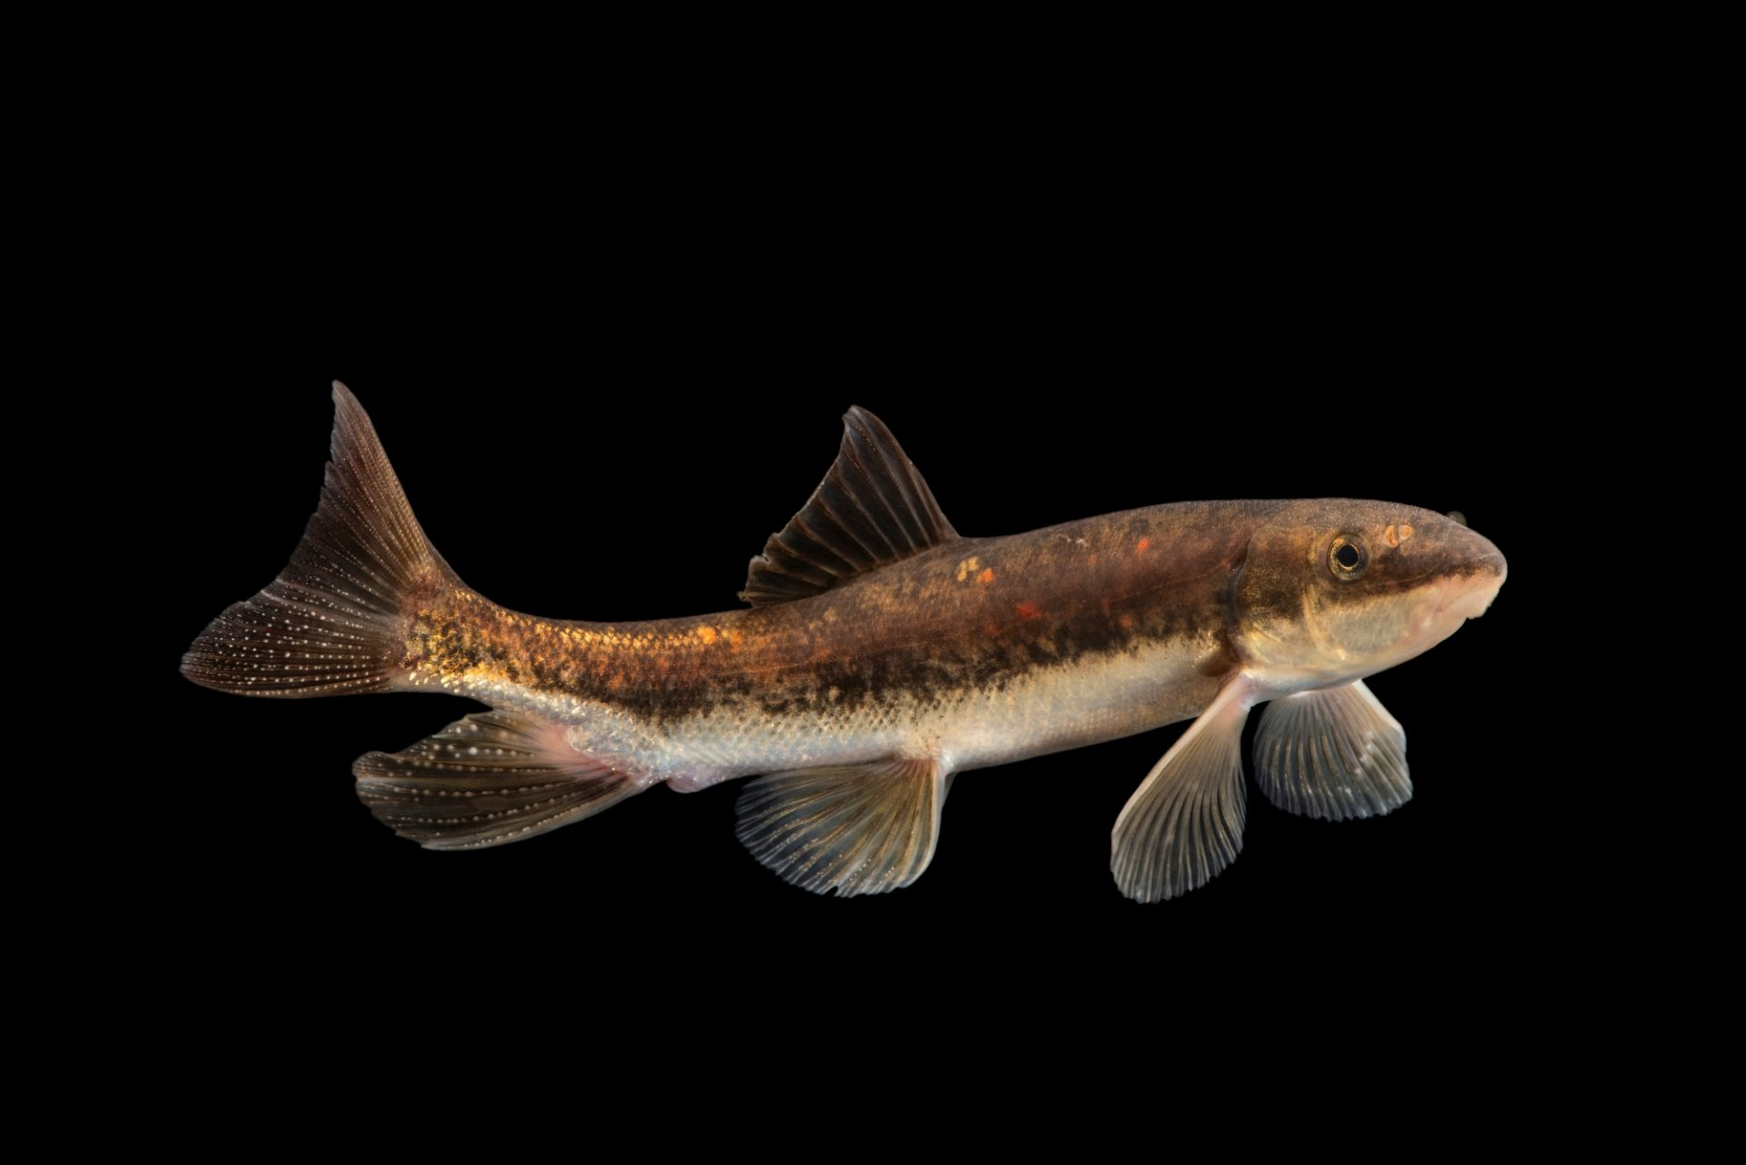
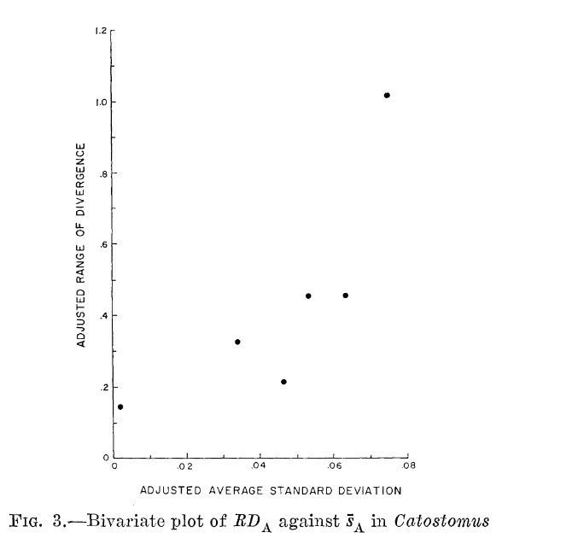
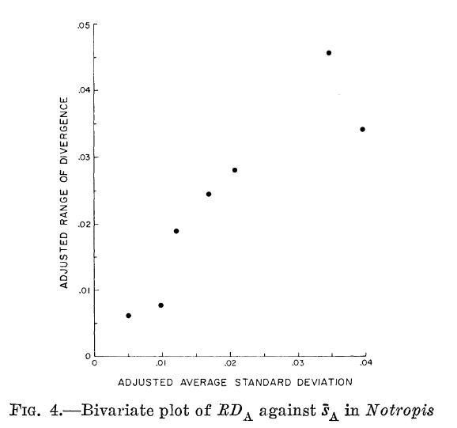
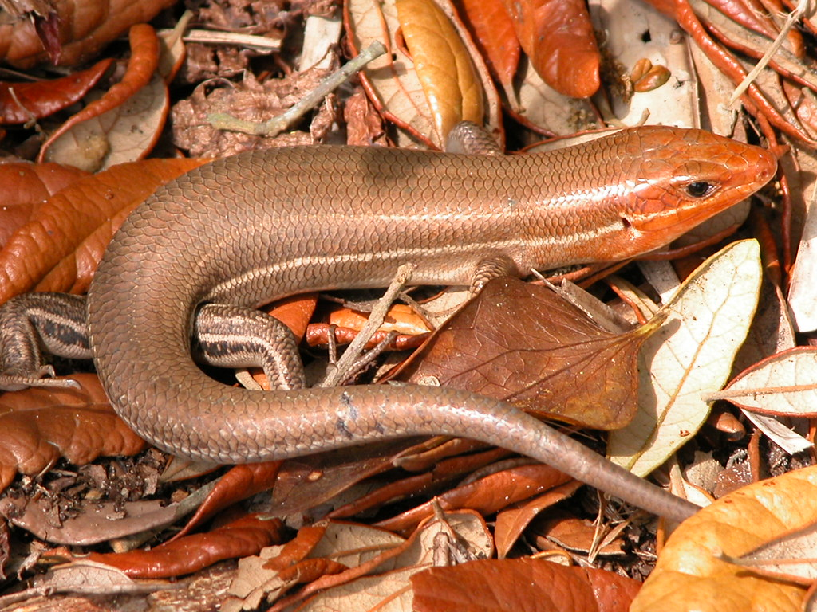
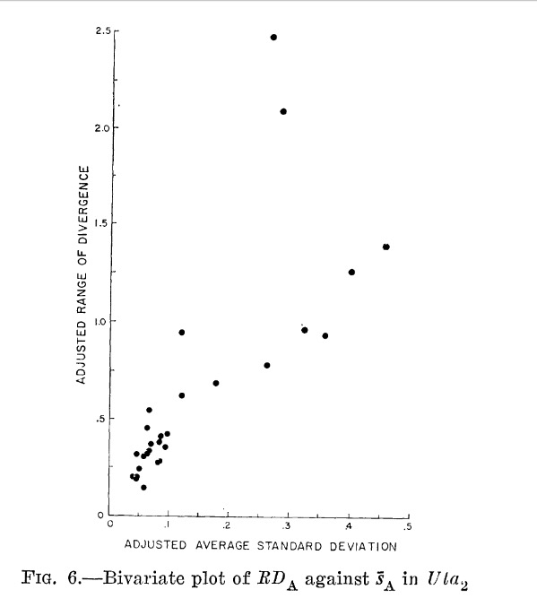
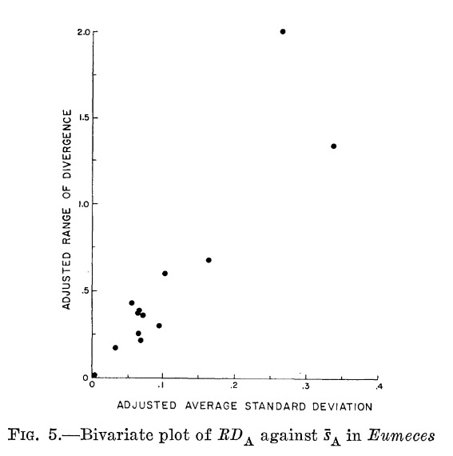
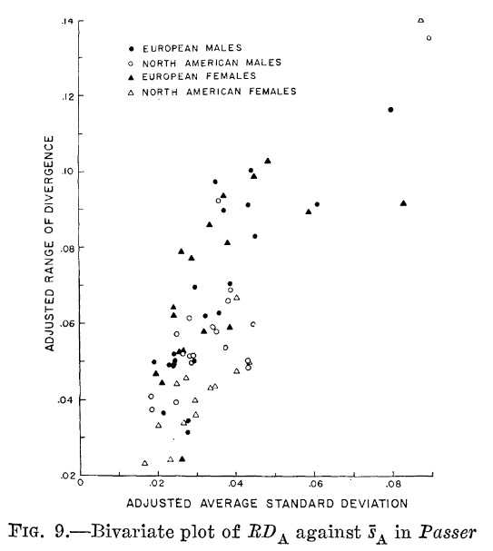
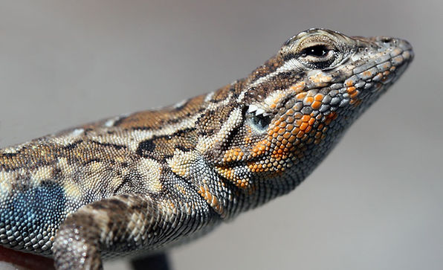
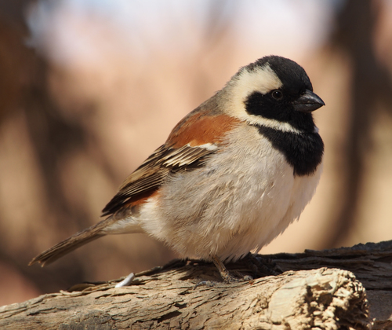
Kluge & Kerfoot (1976)

Slide 33
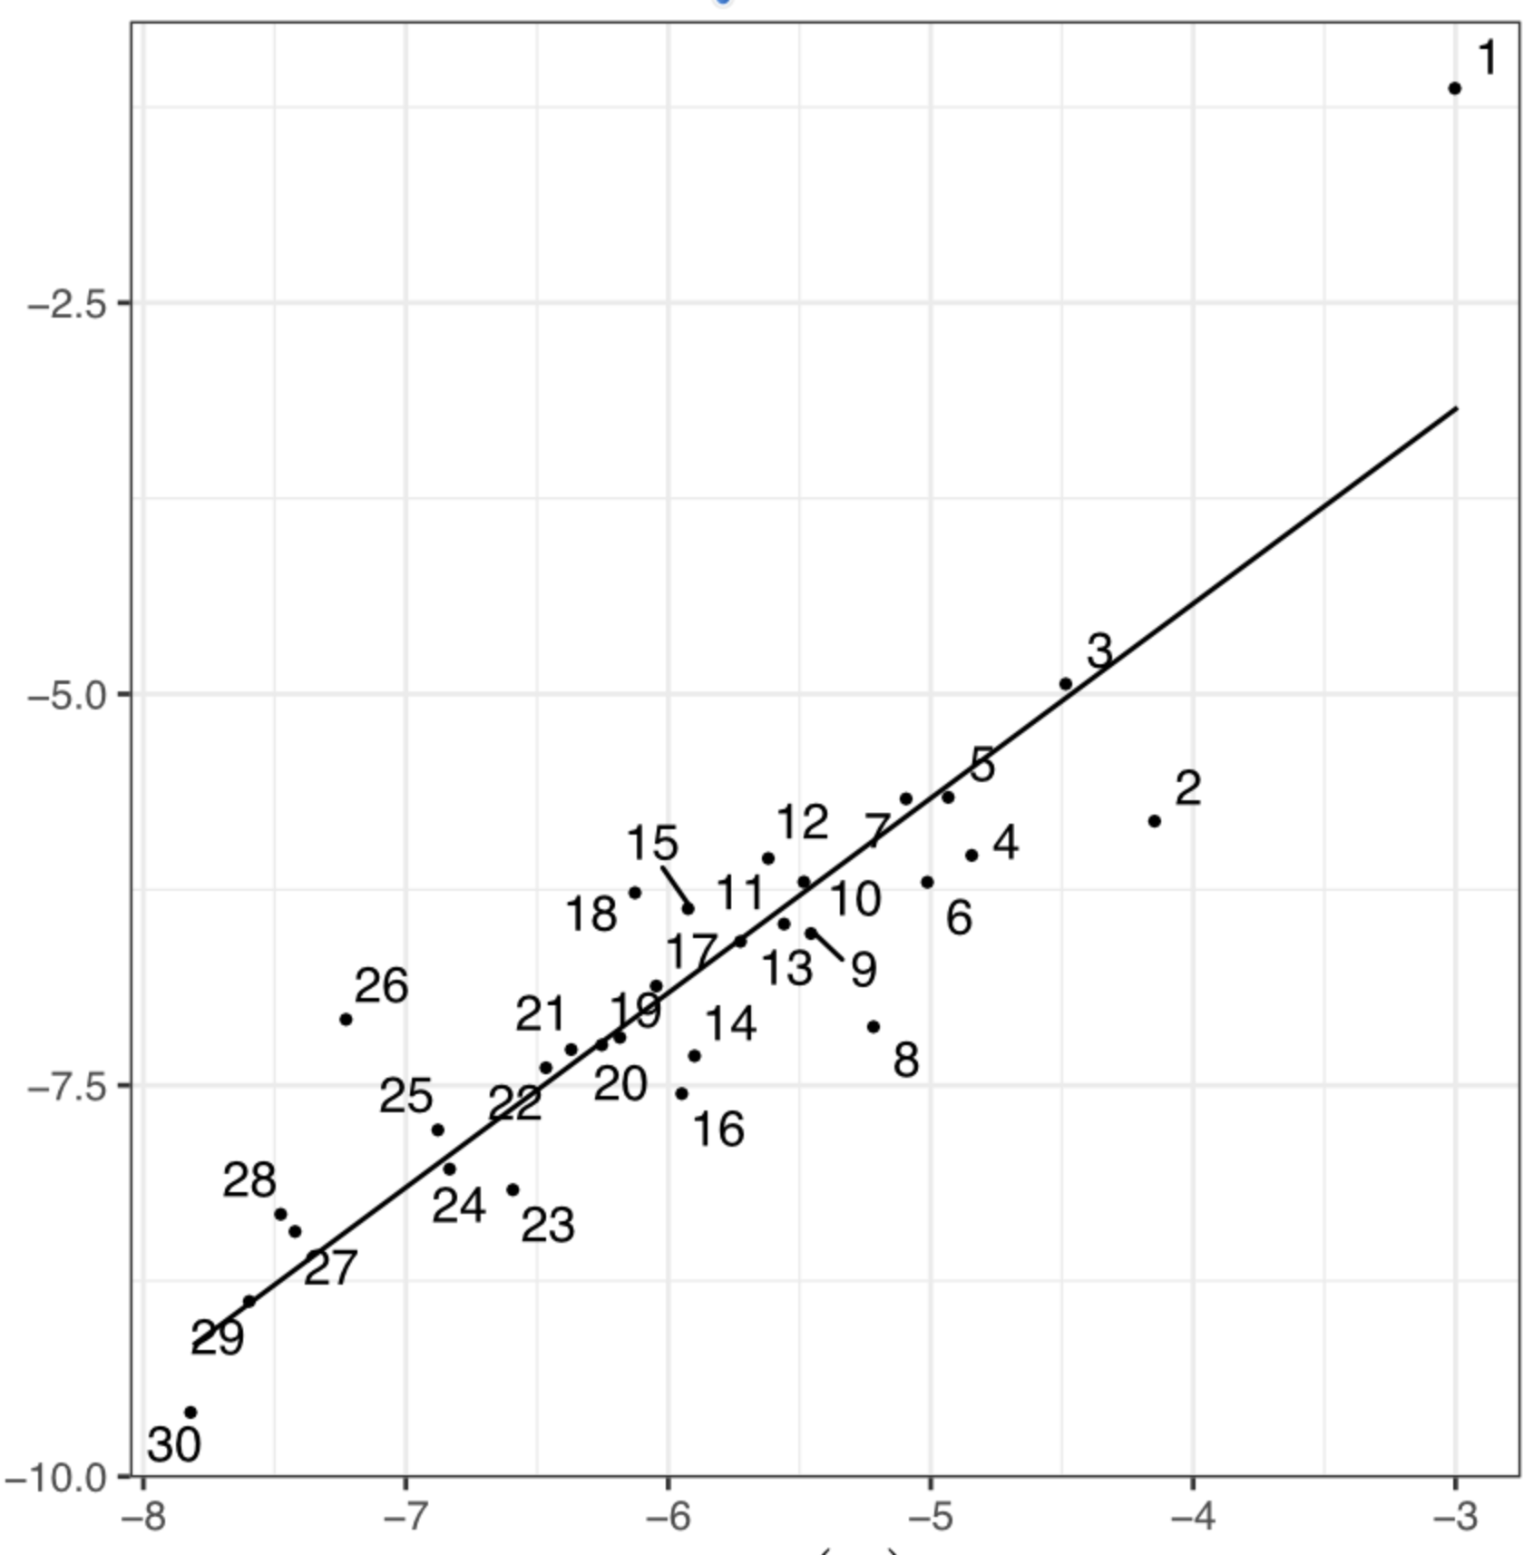
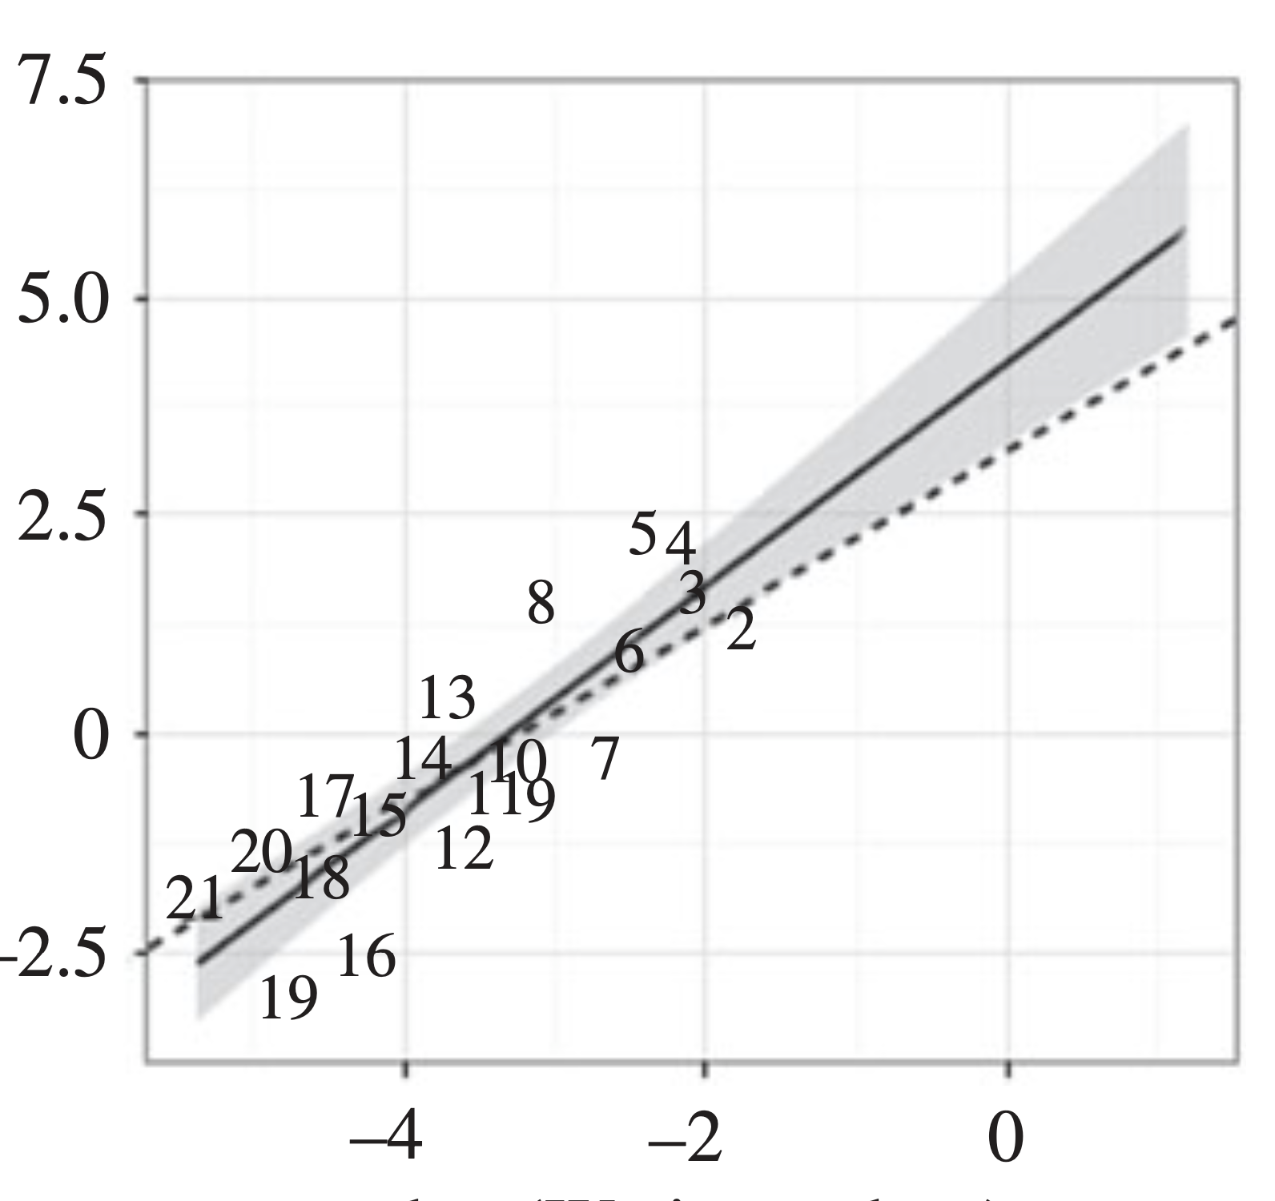
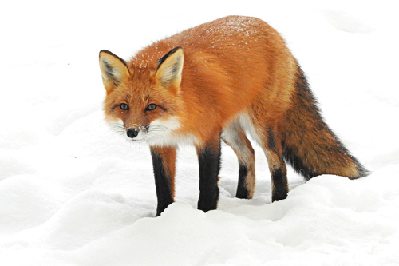
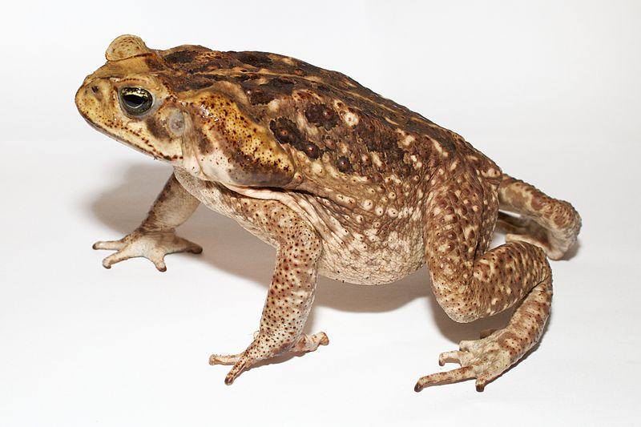
Rate of evolution
Rate of evolution
Trait variation
Trait variation
Machado. 2020
Simon, Machado, Marroig, 2016
13 mya
9 mya

Slide 34
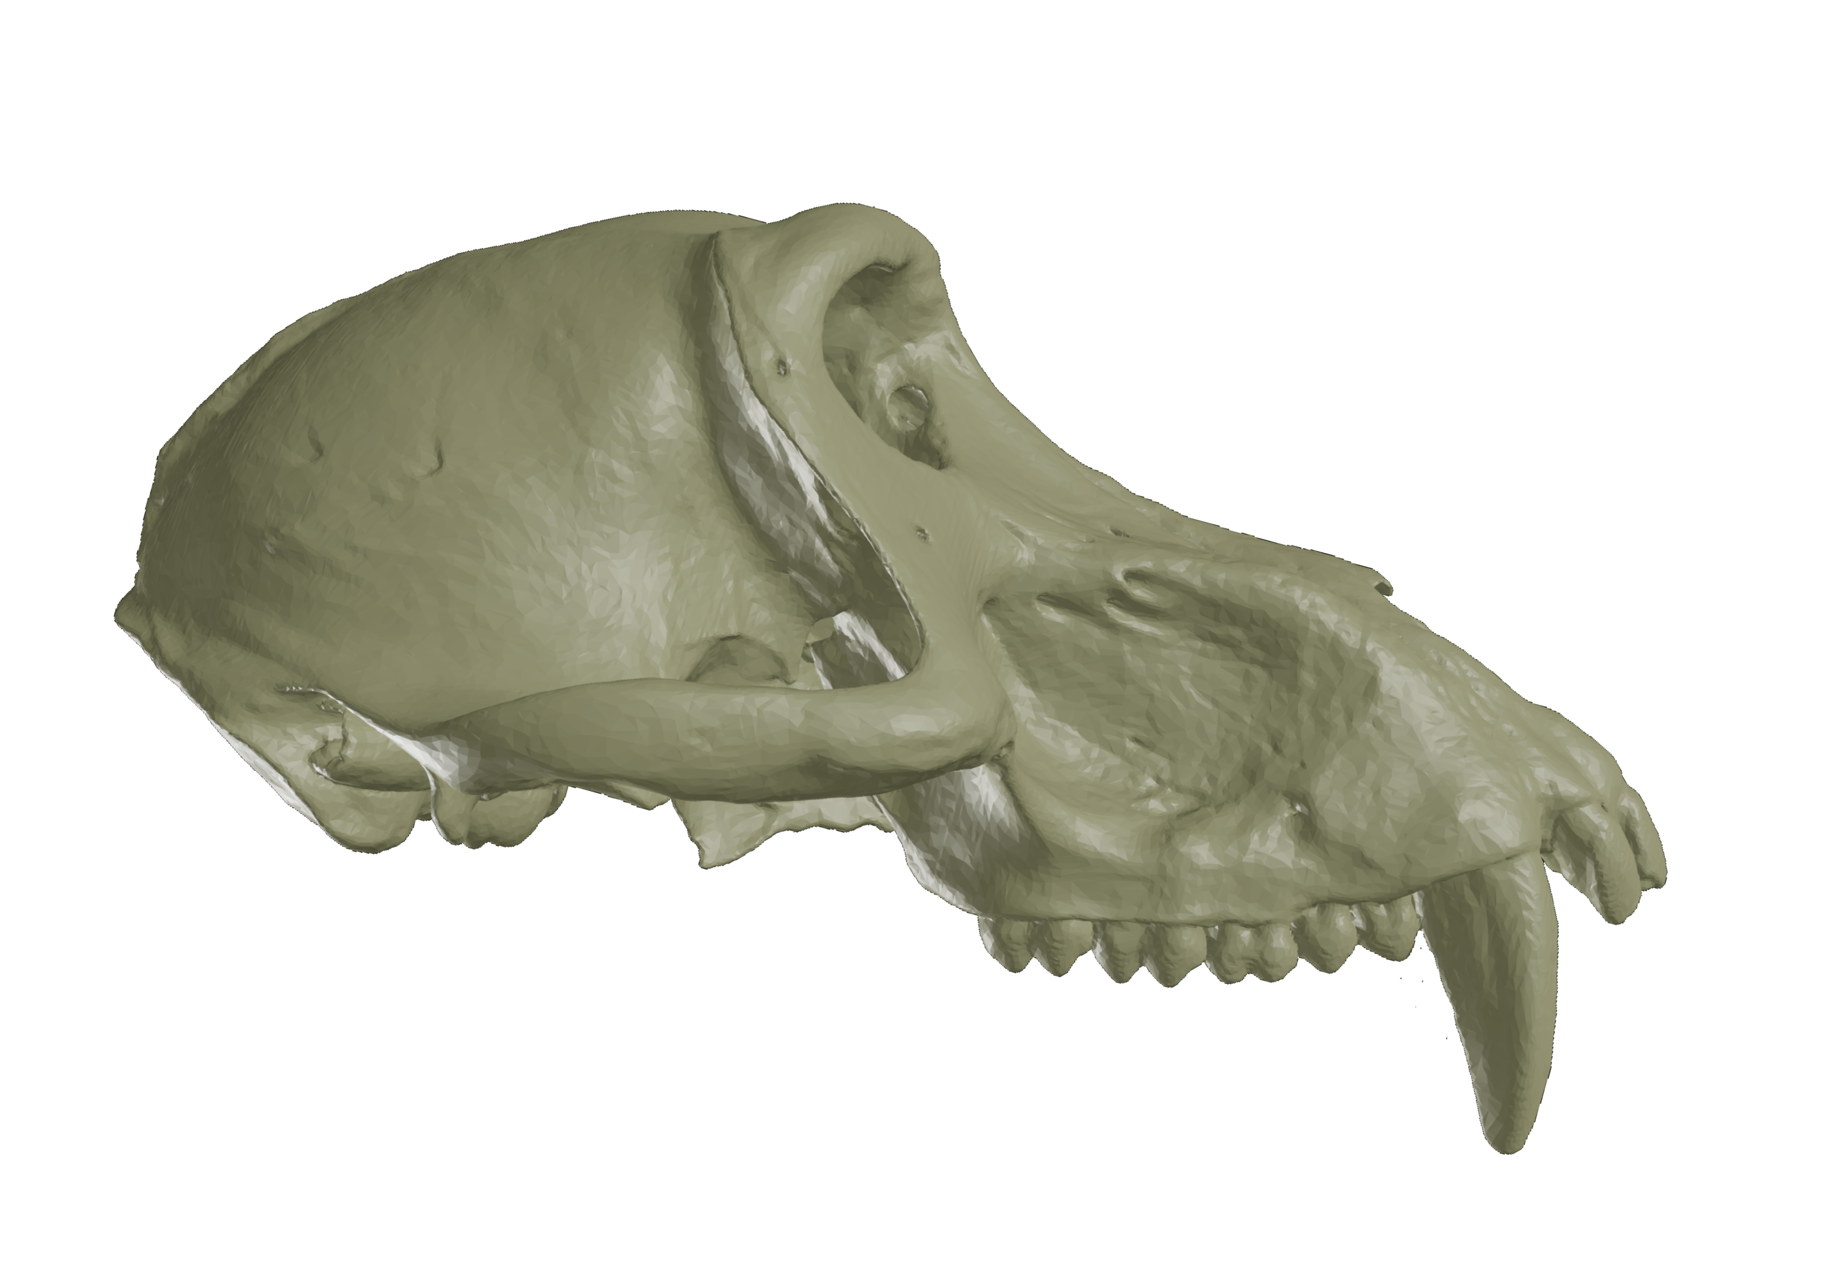
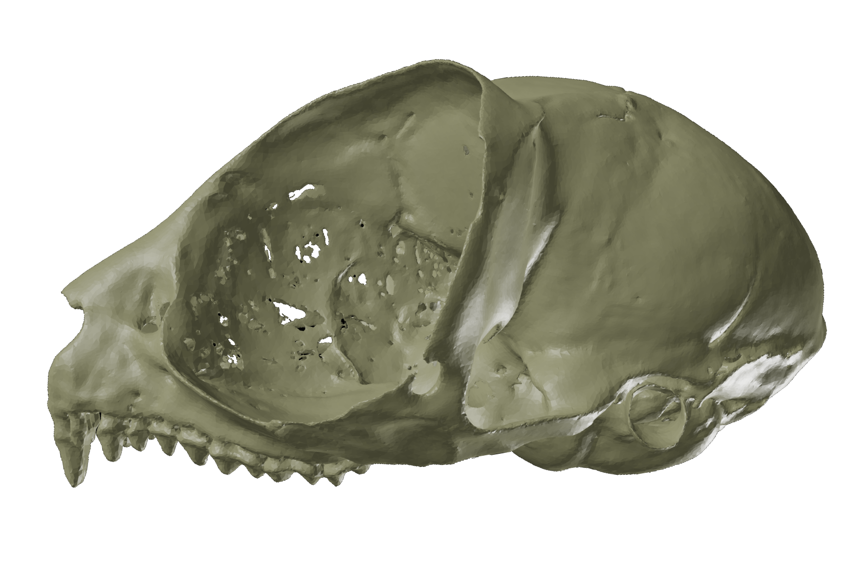
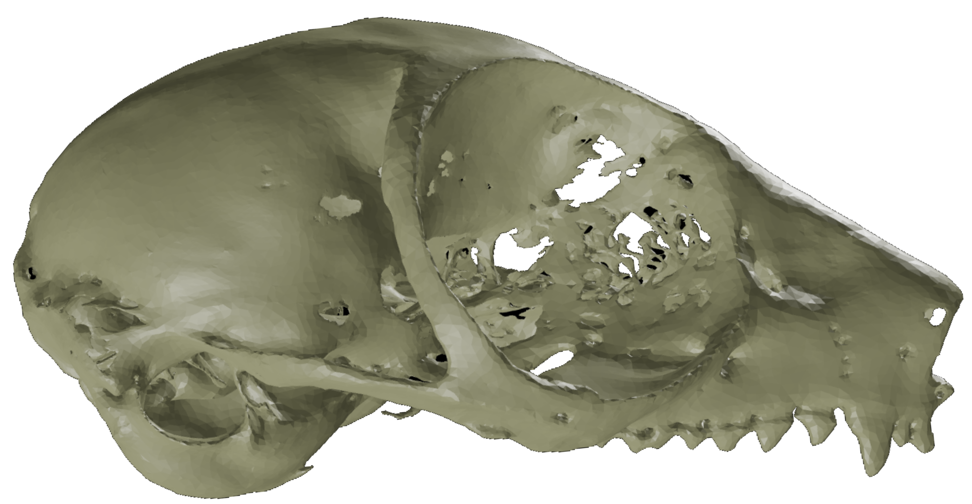
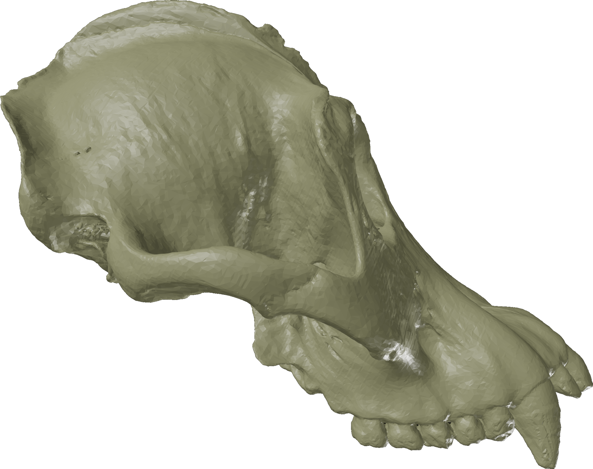
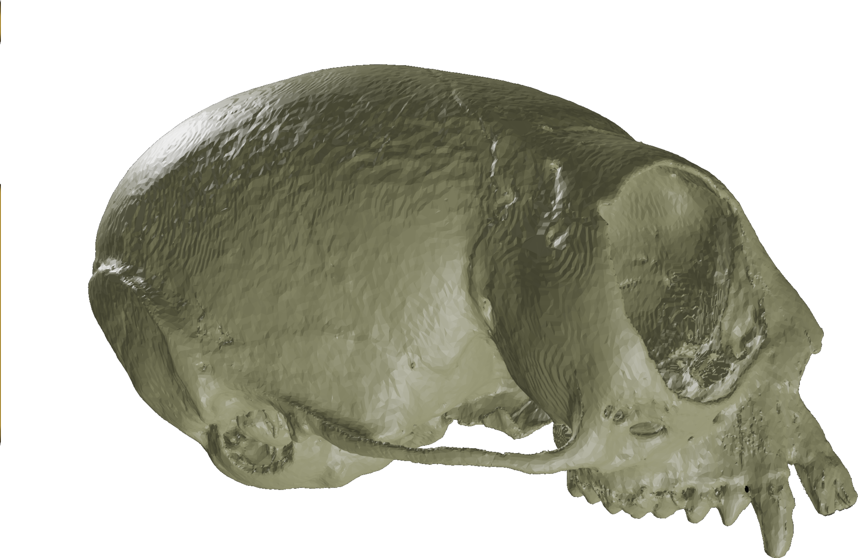
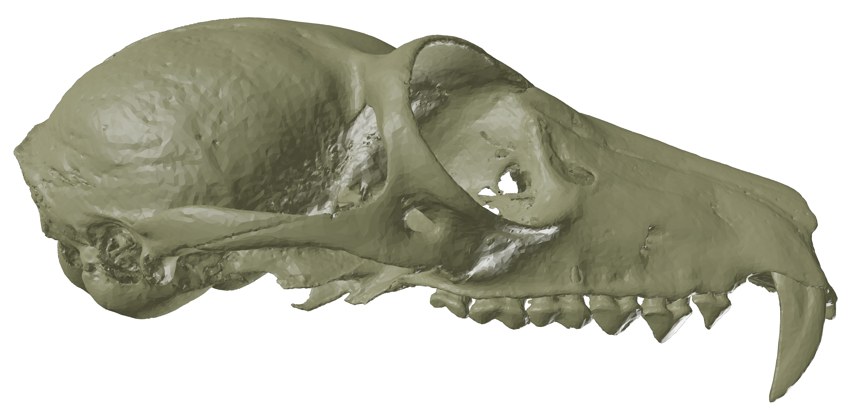
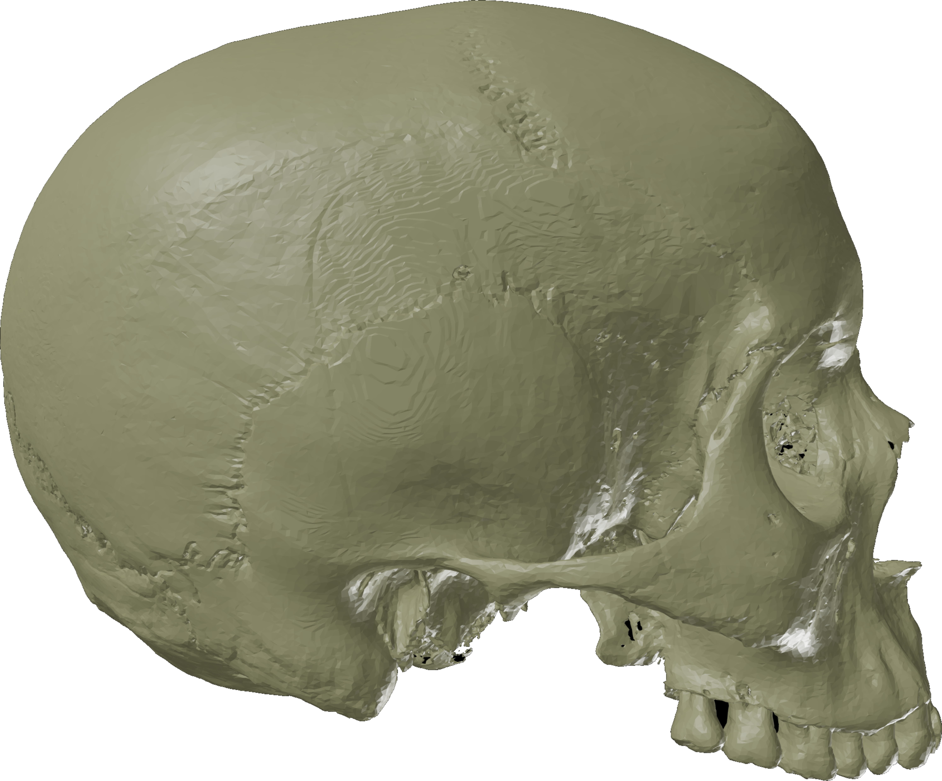
65 mya
Penna et al., Machado in prep

Slide 35
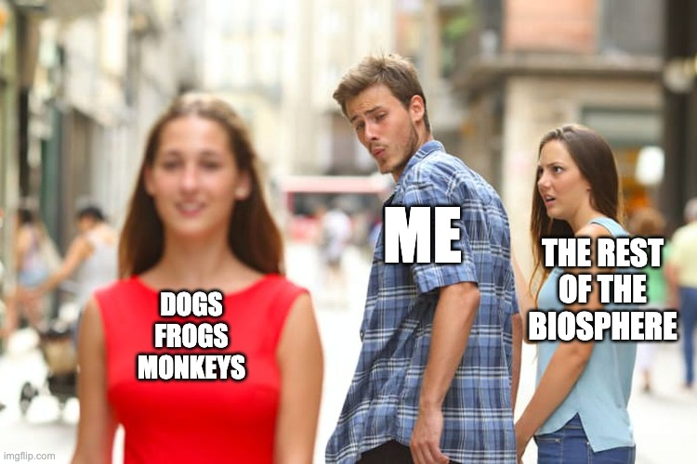

Slide 36
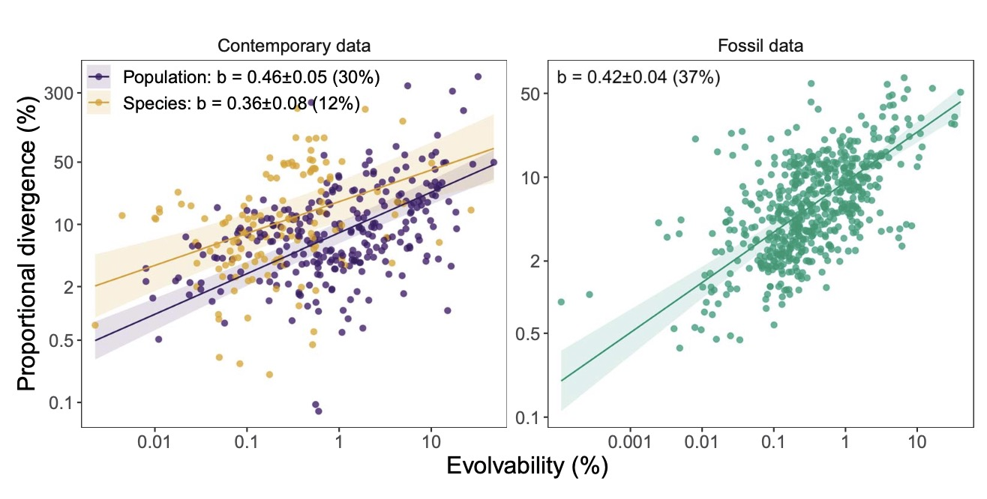
But why?
Holstad et al. 2024

Slide 37

Genetic Drift
$$Σ\left(t\right)=G\frac{t}{N}$$
Σ
Under genetic drift divergence should be proportional to the amount of intraspecific variation
Variation and divergence are proportional
It's possible that traits are evolving neutrally
G

Slide 38
Drift
Drift seams unlikely
Lynch, 1990
Notes:
BUT in practical sense, when we apply microevolutionary models to macroevolutionary data, then we start to see some conflict. This graph shows how most macroevolutionary change is actually slower than the rates that would be expected under drift, suggesting that an absence of directional selection in shaping large scale trends.

Slide 39
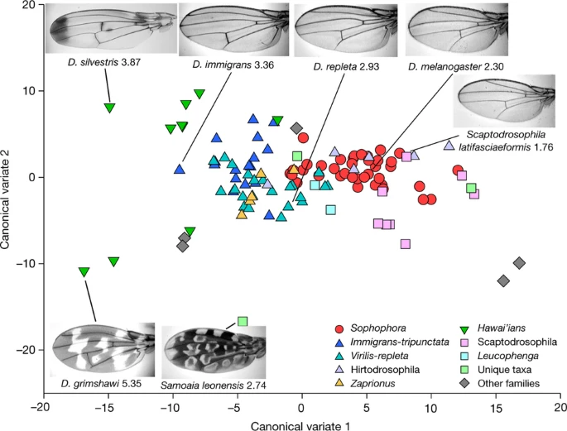
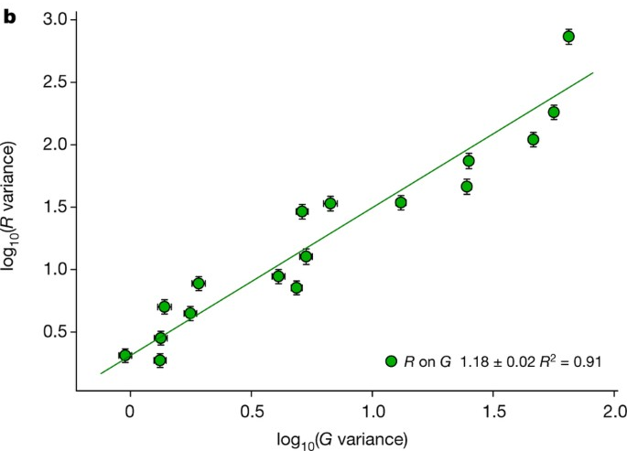
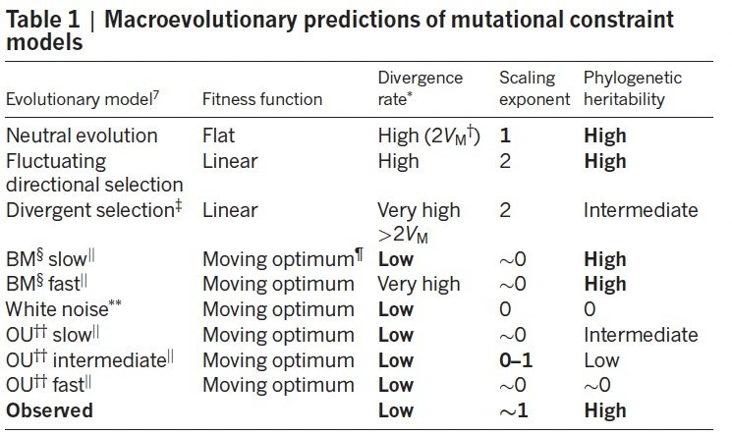
Houle et al. 2017

Slide 40
“paradox of predictability”
Tsuboi et al. 2024
Species can reach peaks rapidly (unlikely to be maladapted)
Rates of evolution are too slow, implying strong influence of stabilizing selection
Evolution is likely dominated by peak distribution and stabilizing selection
Peak distribution should have no relation to phenotypic variation
Still, the amount of trait variation predicts how traits will evolve on large time scales.

Slide 41
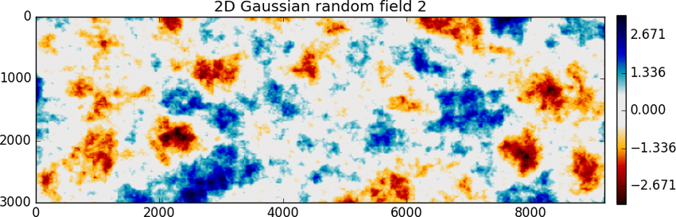
divergence
divergence
evolvability
evolvability
Why?

Slide 42
Potential explanations
Drift in fact , governs (Ackerman & Cheverud 2004)
Constraints
Development defines directions of variation (Rohner & Berger, 2023)
Random selection interacts with G (Holstad et al. 2024)
Structure
Selection
Selection aligns G and divergence (Schluter, 1996)
Development governs scaling of traits at both levels (Gould & Lewontin, 1979)
Selection shapes variation (imitative epigenotype, Riedl, 1978)

Slide 43
Potential explanations
Drift in fact , governs (Ackerman & Cheverud 2004)
Constraints
Development defines directions of variation (Rohner & Berger, 2023)
Random selection interacts with G (Holstad et al. 2024)
Structure
Selection
Selection aligns G and divergence (Schluter, 1996)
Development governs scaling of traits at both levels (Gould & Lewontin, 1979)
Selection shapes variation (imitative epigenotype, Riedl, 1978)

Slide 44
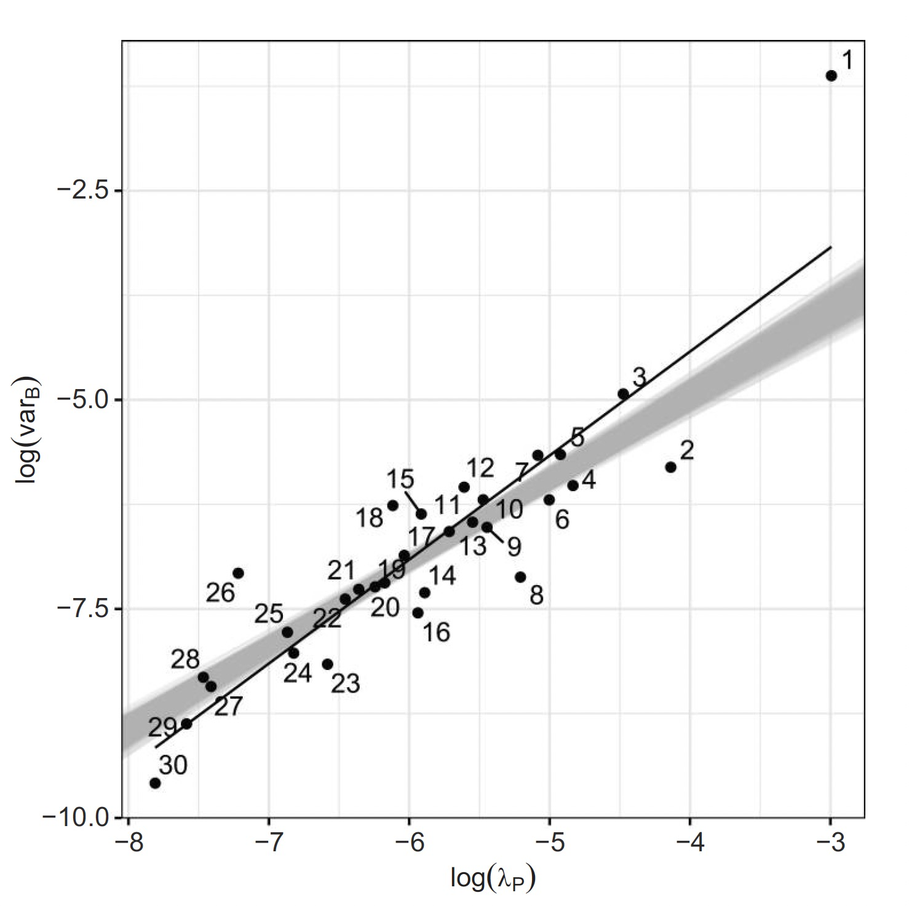
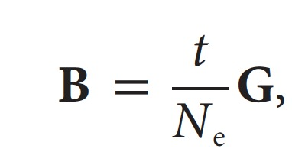
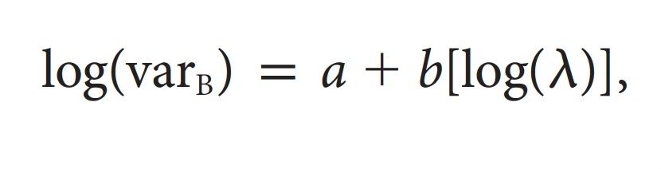
t/Ne -> Nuisance parameter
Machado 2020
Ackerman & Cheverud 2004
Problems?

Slide 45
Potential explanations
Drift in fact , governs (Ackerman & Cheverud 2004)
Constraints
Development defines directions of variation (Rohner & Berger, 2023)
Random selection interacts with G (Holstad et al. 2024)
Structure
Selection
Selection aligns G and divergence (Schluter, 1996)
Development governs scaling of traits at both levels (Gould & Lewontin, 1979)
Selection shapes variation (imitative epigenotype, Riedl, 1978)

Slide 46
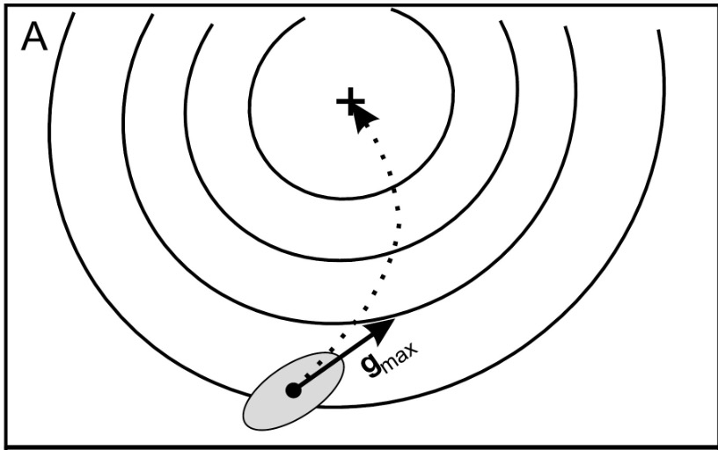

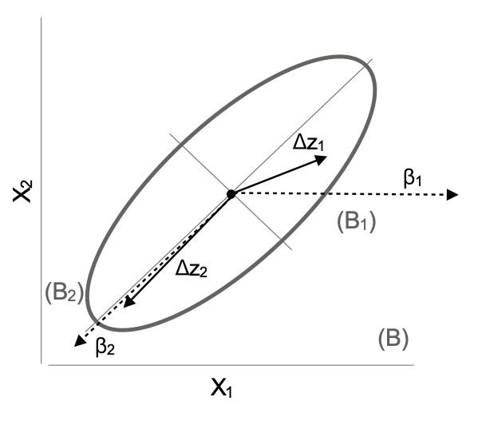
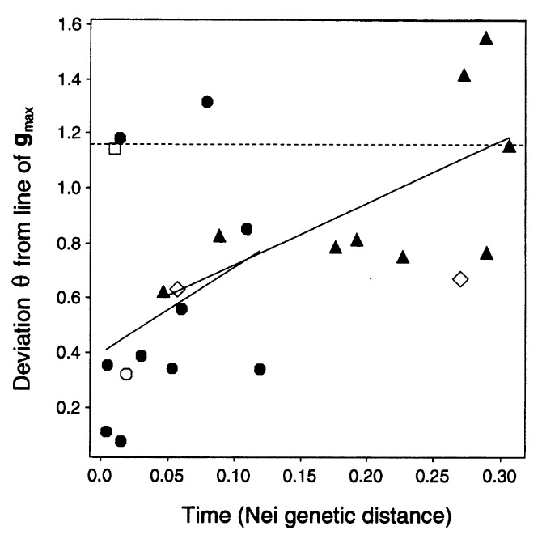
Problems?
Machado 2020
Schluter 1996

Slide 47
Potential explanations
Drift in fact , governs (Ackerman & Cheverud 2004)
Constraints
Development defines directions of variation (Rohner & Berger, 2023)
Random selection interacts with G (Holstad et al. 2024)
Structure
Selection
Selection aligns G and divergence (Schluter, 1996)
Development governs scaling of traits at both levels (Gould & Lewontin, 1979)
Selection shapes variation (imitative epigenotype, Riedl, 1978)

Slide 48
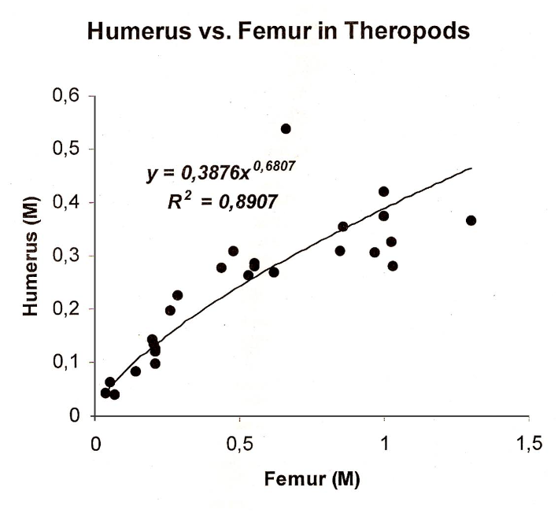
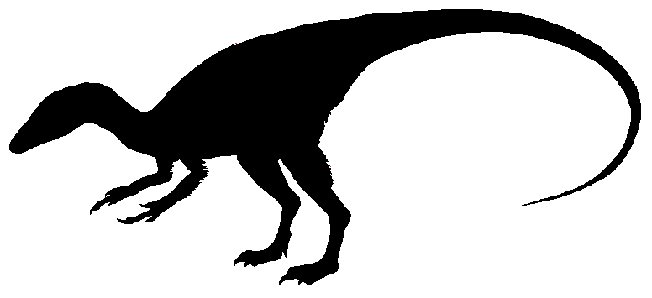
Vargas, 1999
Gould & Lewontin, 1979

Slide 49
Potential explanations
Drift in fact , governs (Ackerman & Cheverud 2004)
Constraints
Development defines directions of variation (Rohner & Berger, 2023)
Random selection interacts with G (Holstad et al. 2024)
Structure
Selection
Selection aligns G and divergence (Schluter, 1996)
Development governs scaling of traits at both levels (Gould & Lewontin, 1979)
Selection shapes variation (imitative epigenotype, Riedl, 1978)

Slide 50
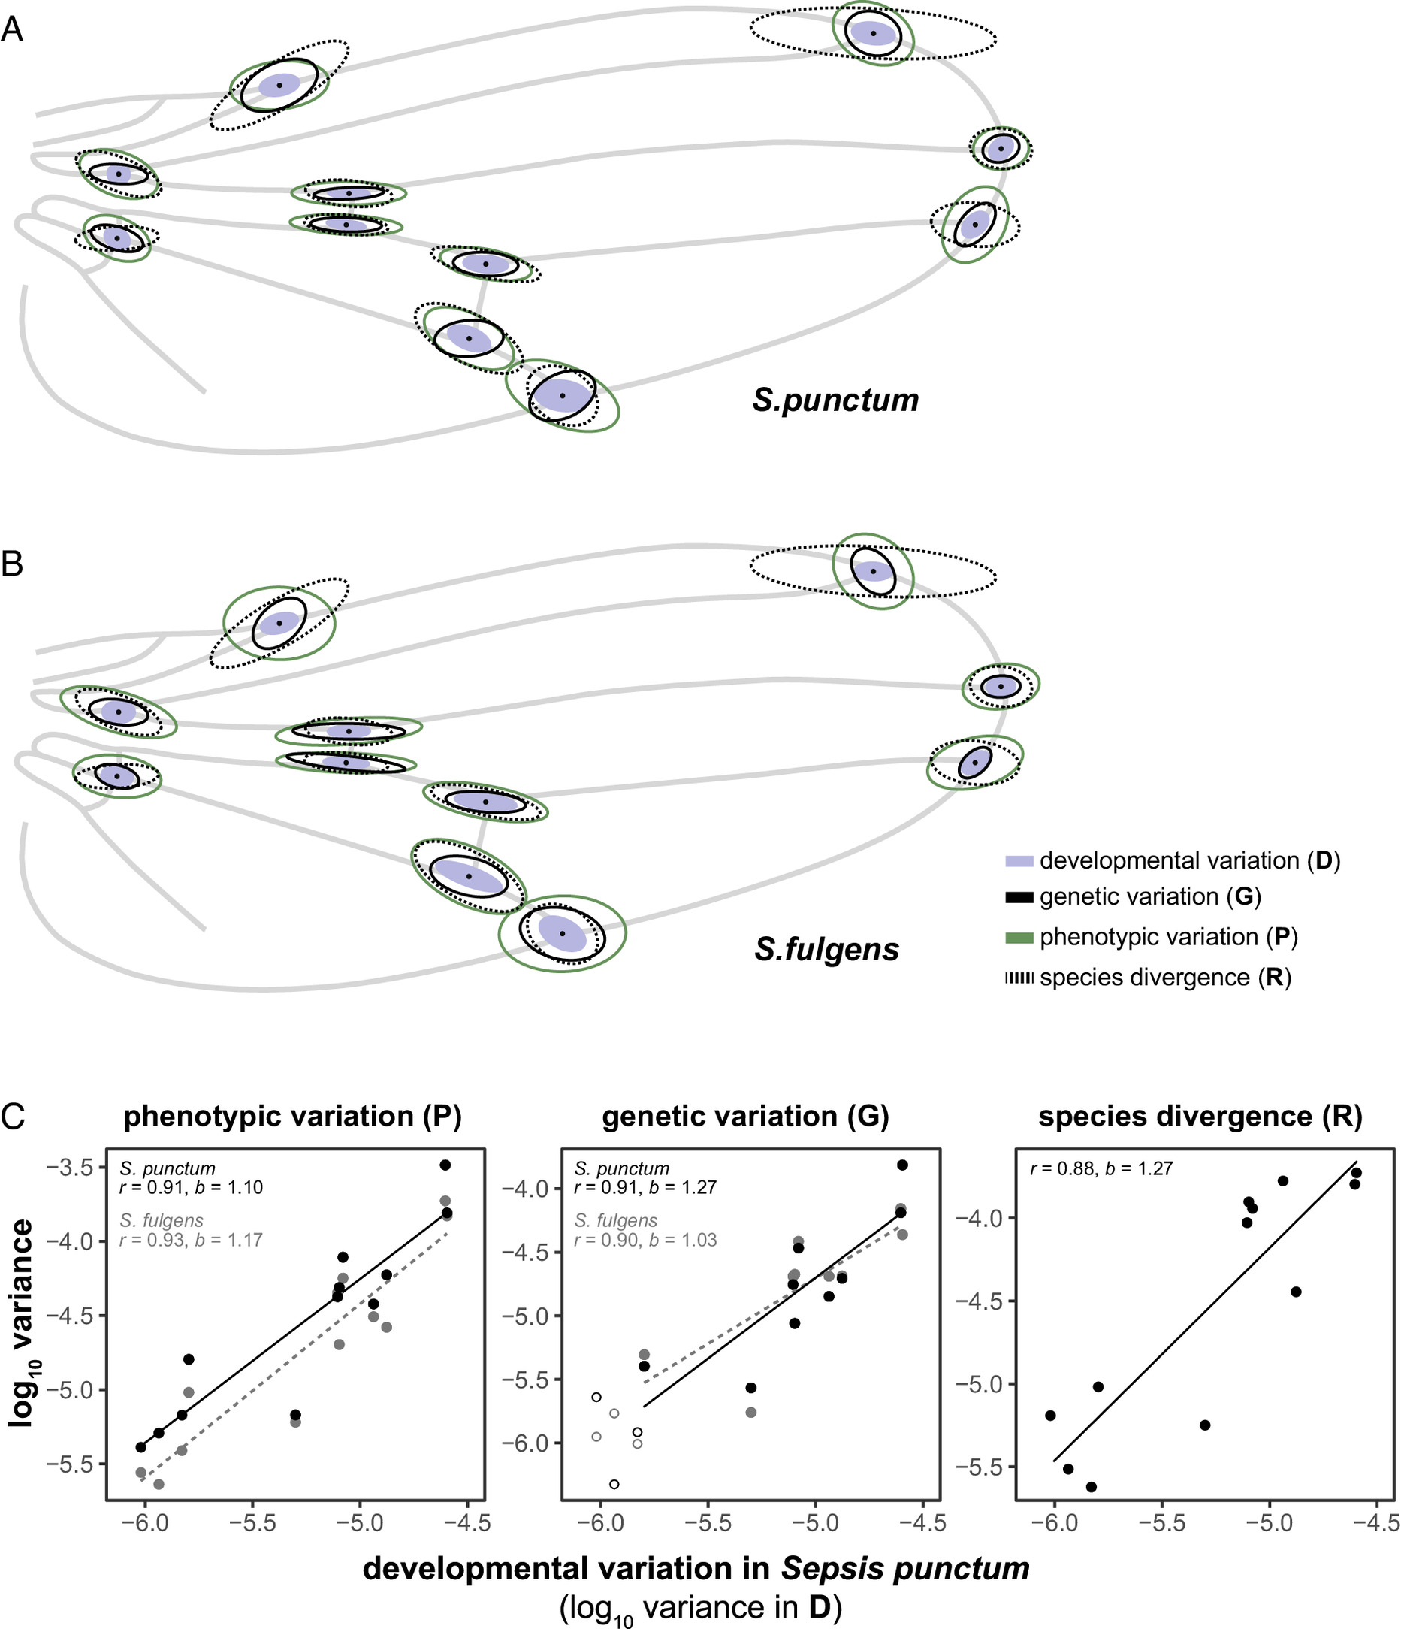
Rohner & Berger, 2023

Slide 51
Potential explanations
Drift in fact , governs (Ackerman & Cheverud 2004)
Constraints
Development defines directions of variation (Rohner & Berger, 2023)
Random selection interacts with G (Holstad et al. 2024)
Structure
Selection
Selection aligns G and divergence (Schluter, 1996)
Development governs scaling of traits at both levels (Gould & Lewontin, 1979)
Selection shapes variation (imitative epigenotype, Riedl, 1978)

Slide 52
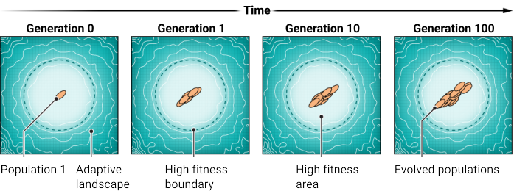

Uyeda & McGlothin, 2024
Holstad et al. 2024

Slide 53
Potential explanations
Drift in fact , governs (Ackerman & Cheverud 2004)
Constraints
Development defines directions of variation (Rohner & Berger, 2023)
Random selection interacts with G (Holstad et al. 2024)
Structure
Selection
Selection aligns G and divergence (Schluter, 1996)
Development governs scaling of traits at both levels (Gould & Lewontin, 1979)
Selection shapes variation (imitative epigenotype, Riedl, 1978)

Slide 54

Svensoon 2022
Riedl, 1978

