Slide 1
Discrete & Categorical data & models
....and how they connect to continuous data and models

Slide 2
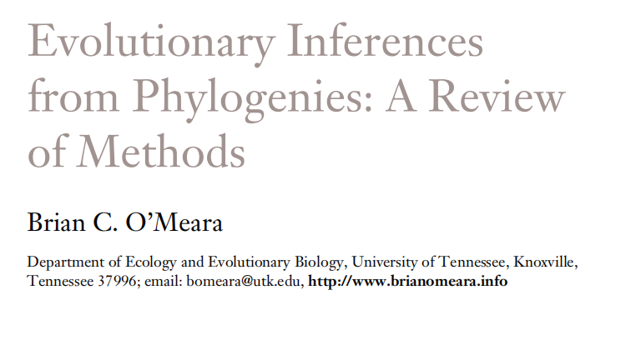

Slide 3
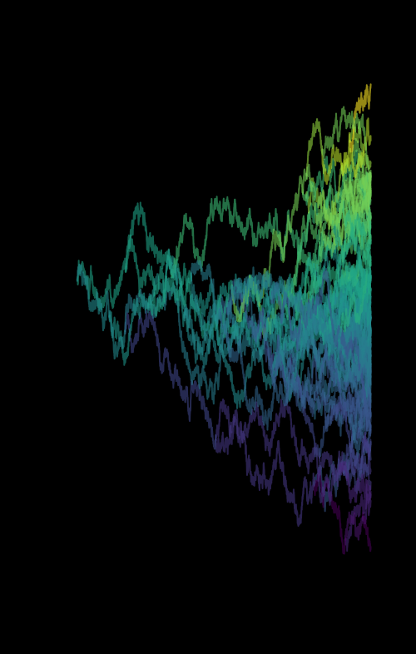
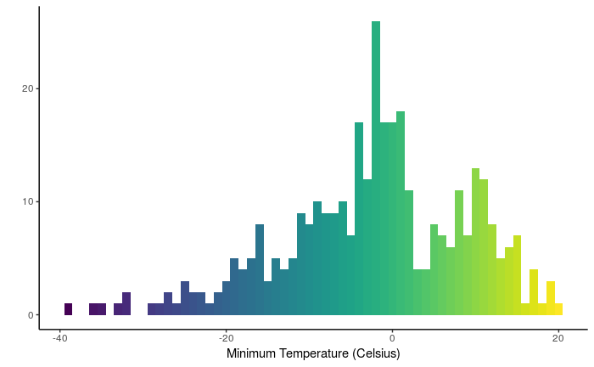
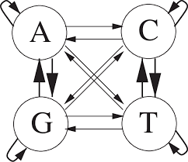
Markov Models
Gaussian Models

Slide 4
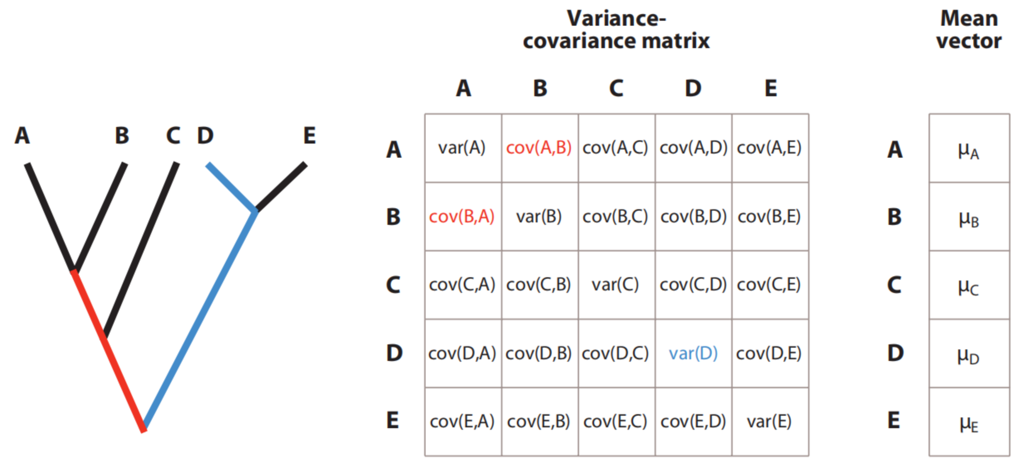

Slide 5
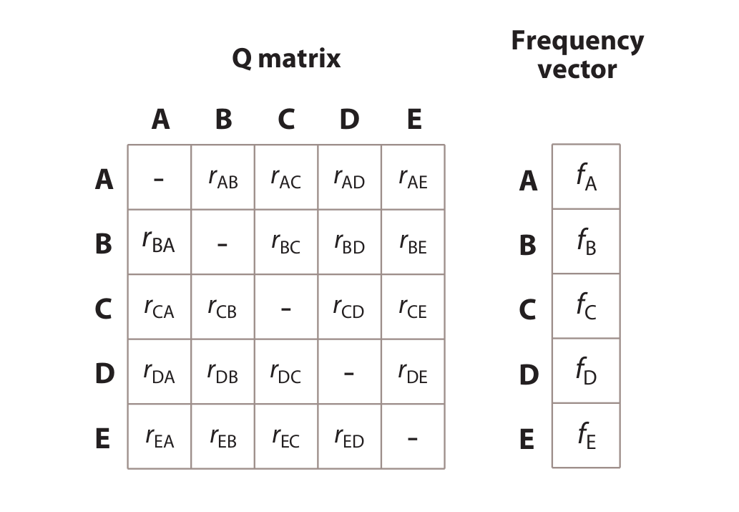
Our general CTMC model:
This model can be use to estimate rates of transition, ancestral states, and perform a variety of hypothesis testing questions (and is the model we use to estimate phylogenies)
Frequency vector: For sequence evolution, frequency vectors will show up as base frequencies.
For time-irreversible models, they are primarily used as a “prior” on the root state.

Slide 6
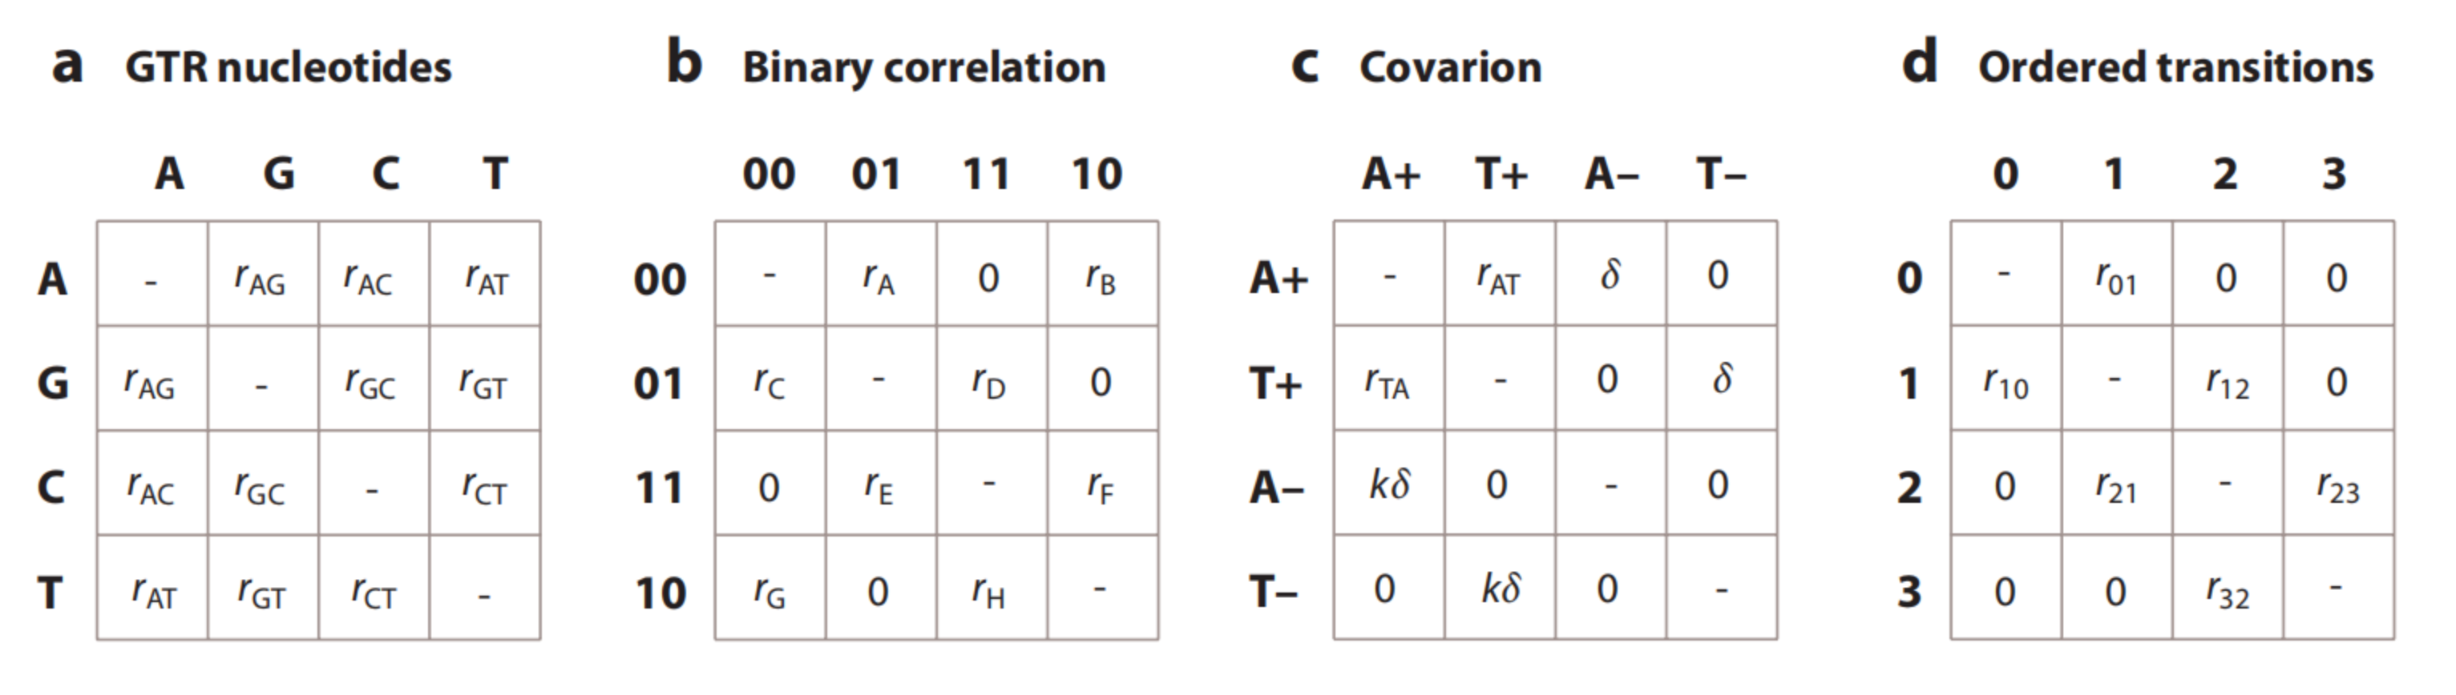
What do these models mean?

Slide 7
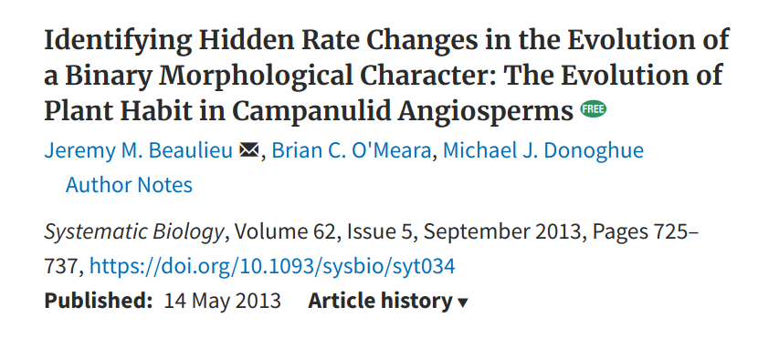
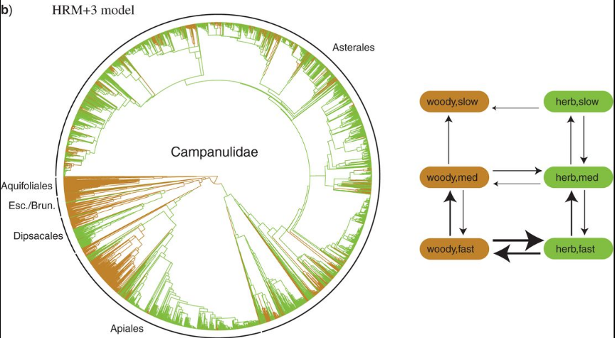
Hidden state models

Slide 8
But what are the “Hidden states”?
Annual
herbs
States with unobserved variation - Not all woody plants are the same
Different transition rates
Tall trees
Shrubs

Slide 9
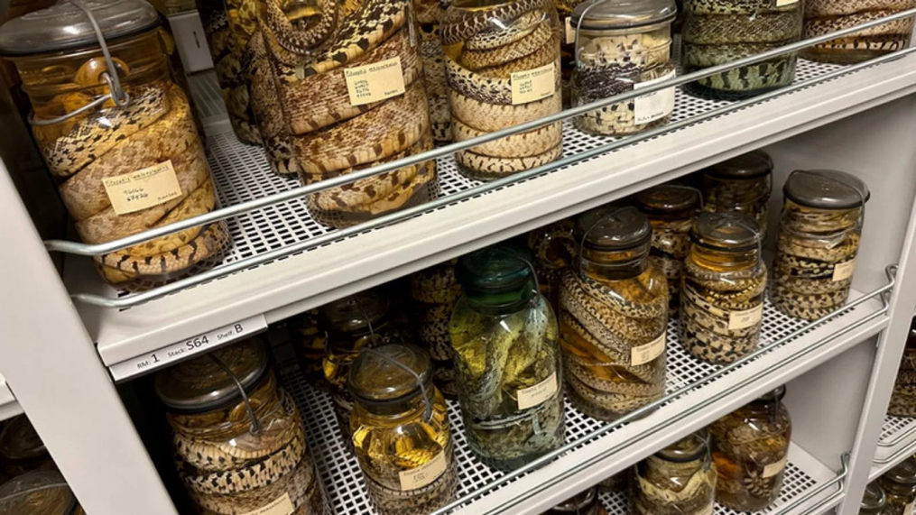
Systematics & Biodiversity Science

Slide 10
Character construction:
The “hidden work” of phylogenetics & comparative methods

Slide 11
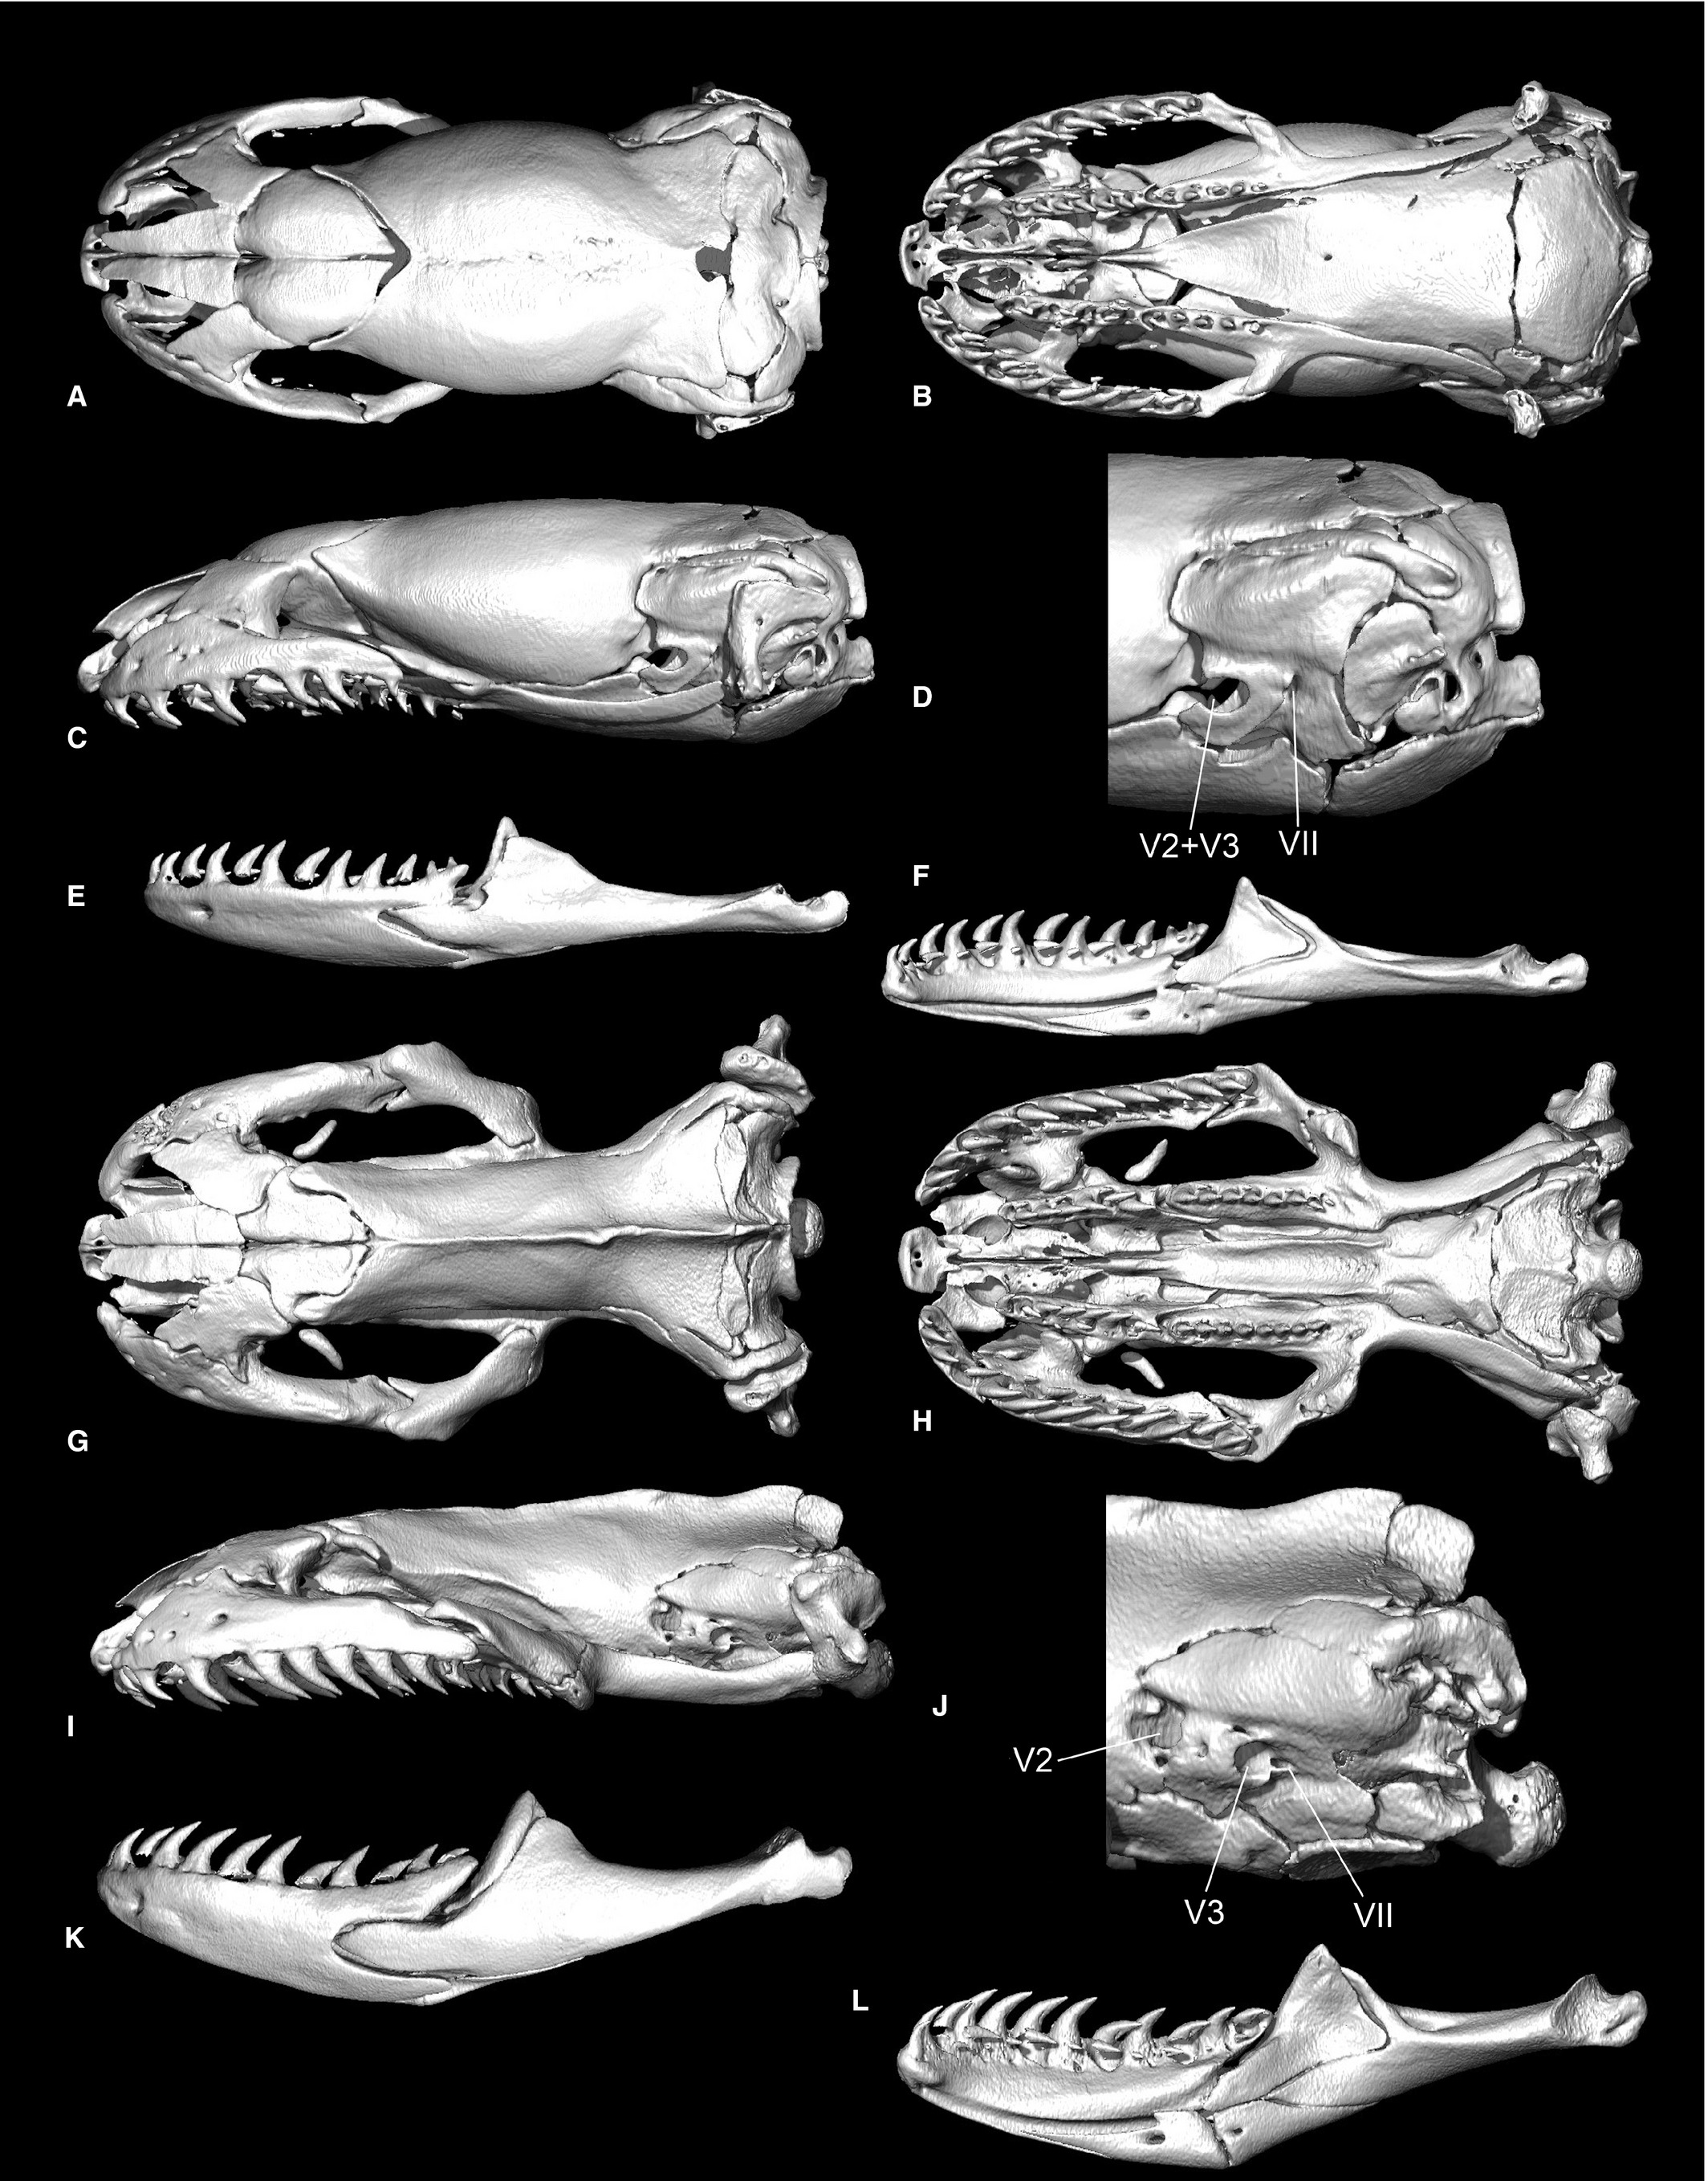
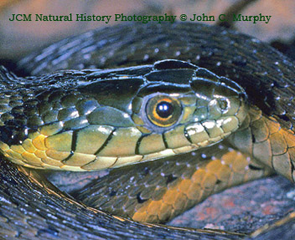
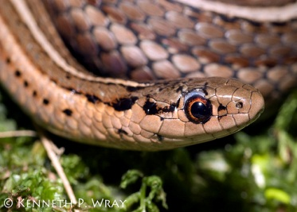
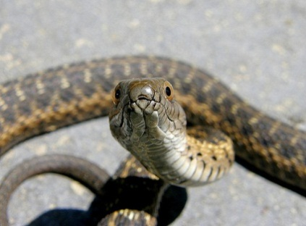
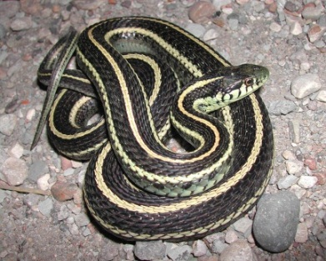
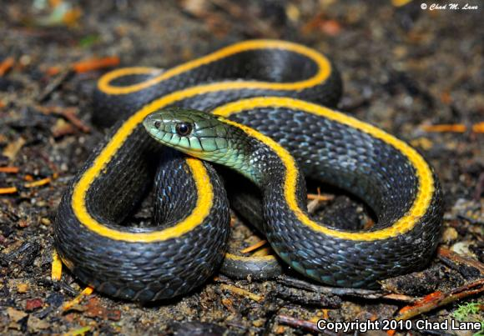
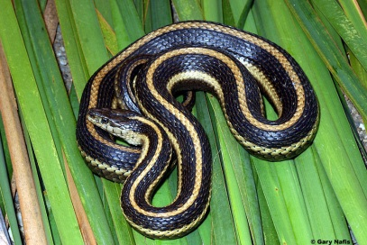
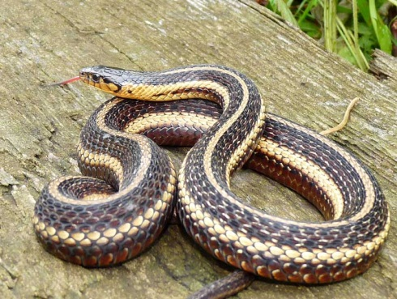

Slide 12
Genomes | Phenomes
Well-defined nucleotide state space (ACGT) amenable to automation | Many possible ways to represent through measurements
Which leads to:
High reproducibility, big data | Reliance upon/ conflict among experts, data bottleneck
Independence among homologous sites (e.g. mutation & substition) | High integration and dependency among traits
Which leads to:
Allows tractable statistical computation by enabling assumptions of independence among sites | Challenges in dimensionality reduction, statistical modeling, and hypothesis testing

Slide 13
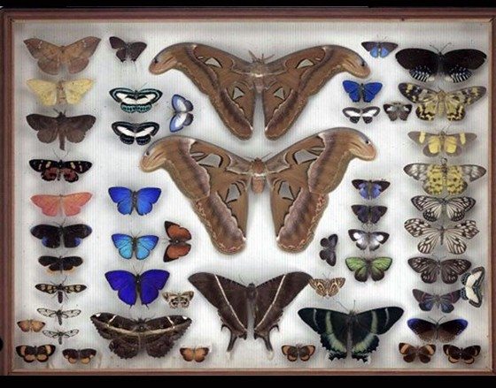
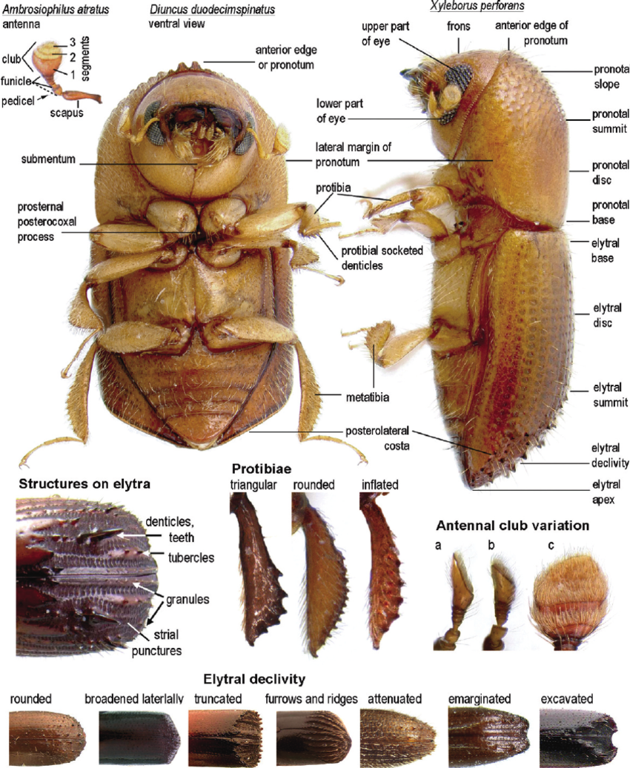

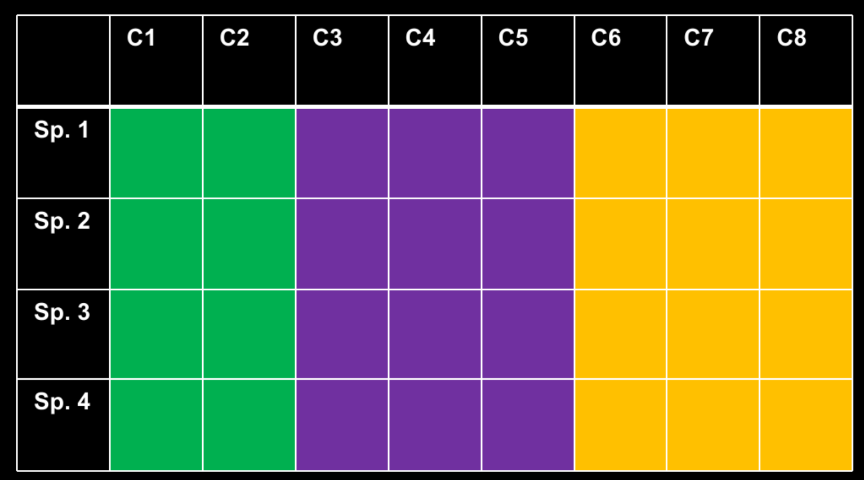
Biodiversity science is uniquely reliant on expert knowledge to quantify its primary data sources: species & trait measurements
The systematists “black-box”
of character construction

Slide 14
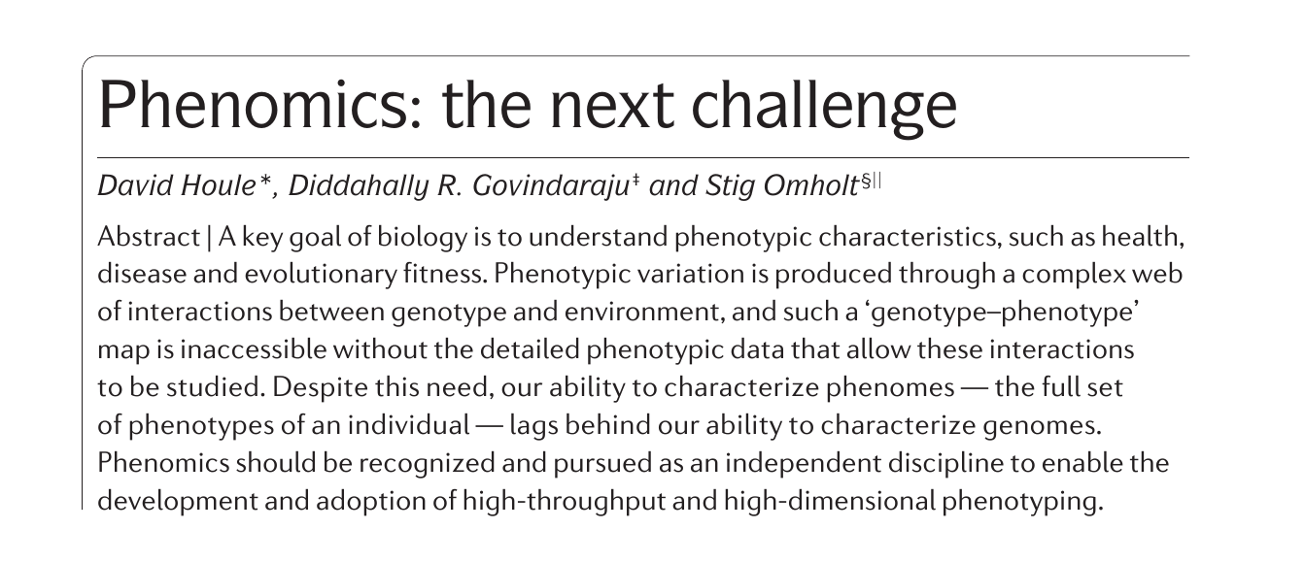
Rapid progress on any biological problem rests on the hope that there is at least one viewpoint to each problem that makes causation relatively simple.
- Houle et al 2010, Phenomics: The Next Challenge

Slide 15
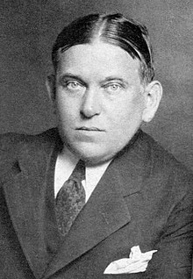
For every complex problem there is a solution which is clear, simple, and wrong
- Often attributed to H.L. Mencken, reporter and supporter of teaching evolution in the “Scopes Monkey Trial”

Slide 16
What happens when we get the traits “wrong”?
(And what can we do about it)

Slide 17
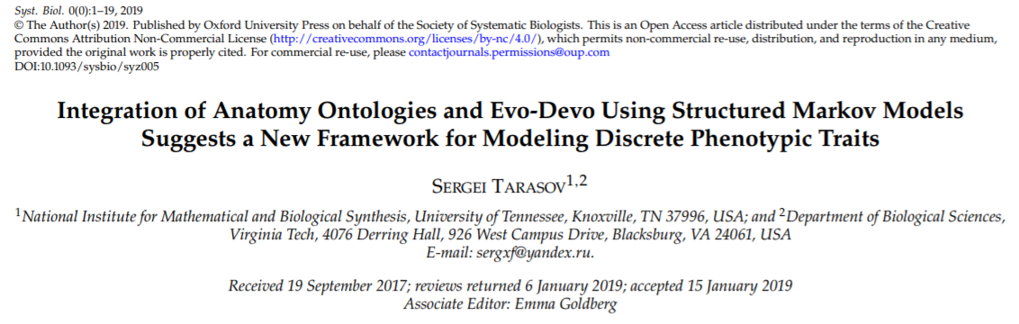
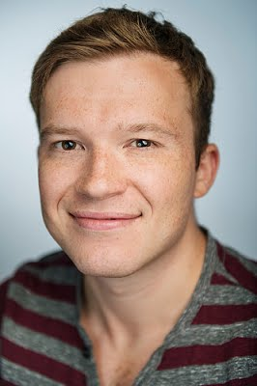
Sergei Tarasov
Finnish Museum of Natural History

Slide 18
Two-Scientist Paradox (Tarasov, 2018)

Slide 19
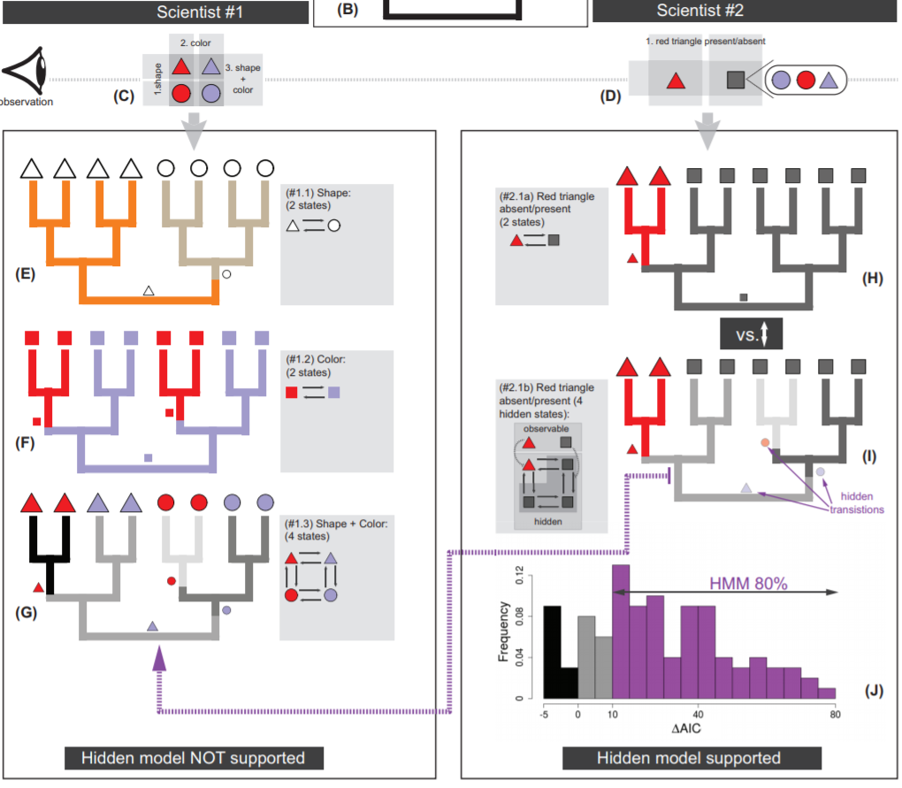
Scientist #2 supports HIdden State Model
(Rate heterogeneity)

Slide 20
Truth is no rate heterogeneity, the true state space was misrepresented

Slide 21
Many comparative questions can be recast as questions about the state space of evolution

Slide 22
Framing questions as rates vs. states
Unequal rates
equal state spaces
Equal rates
Unequal state spaces
“Macroevolutionary Architecture of Traits”

Slide 23
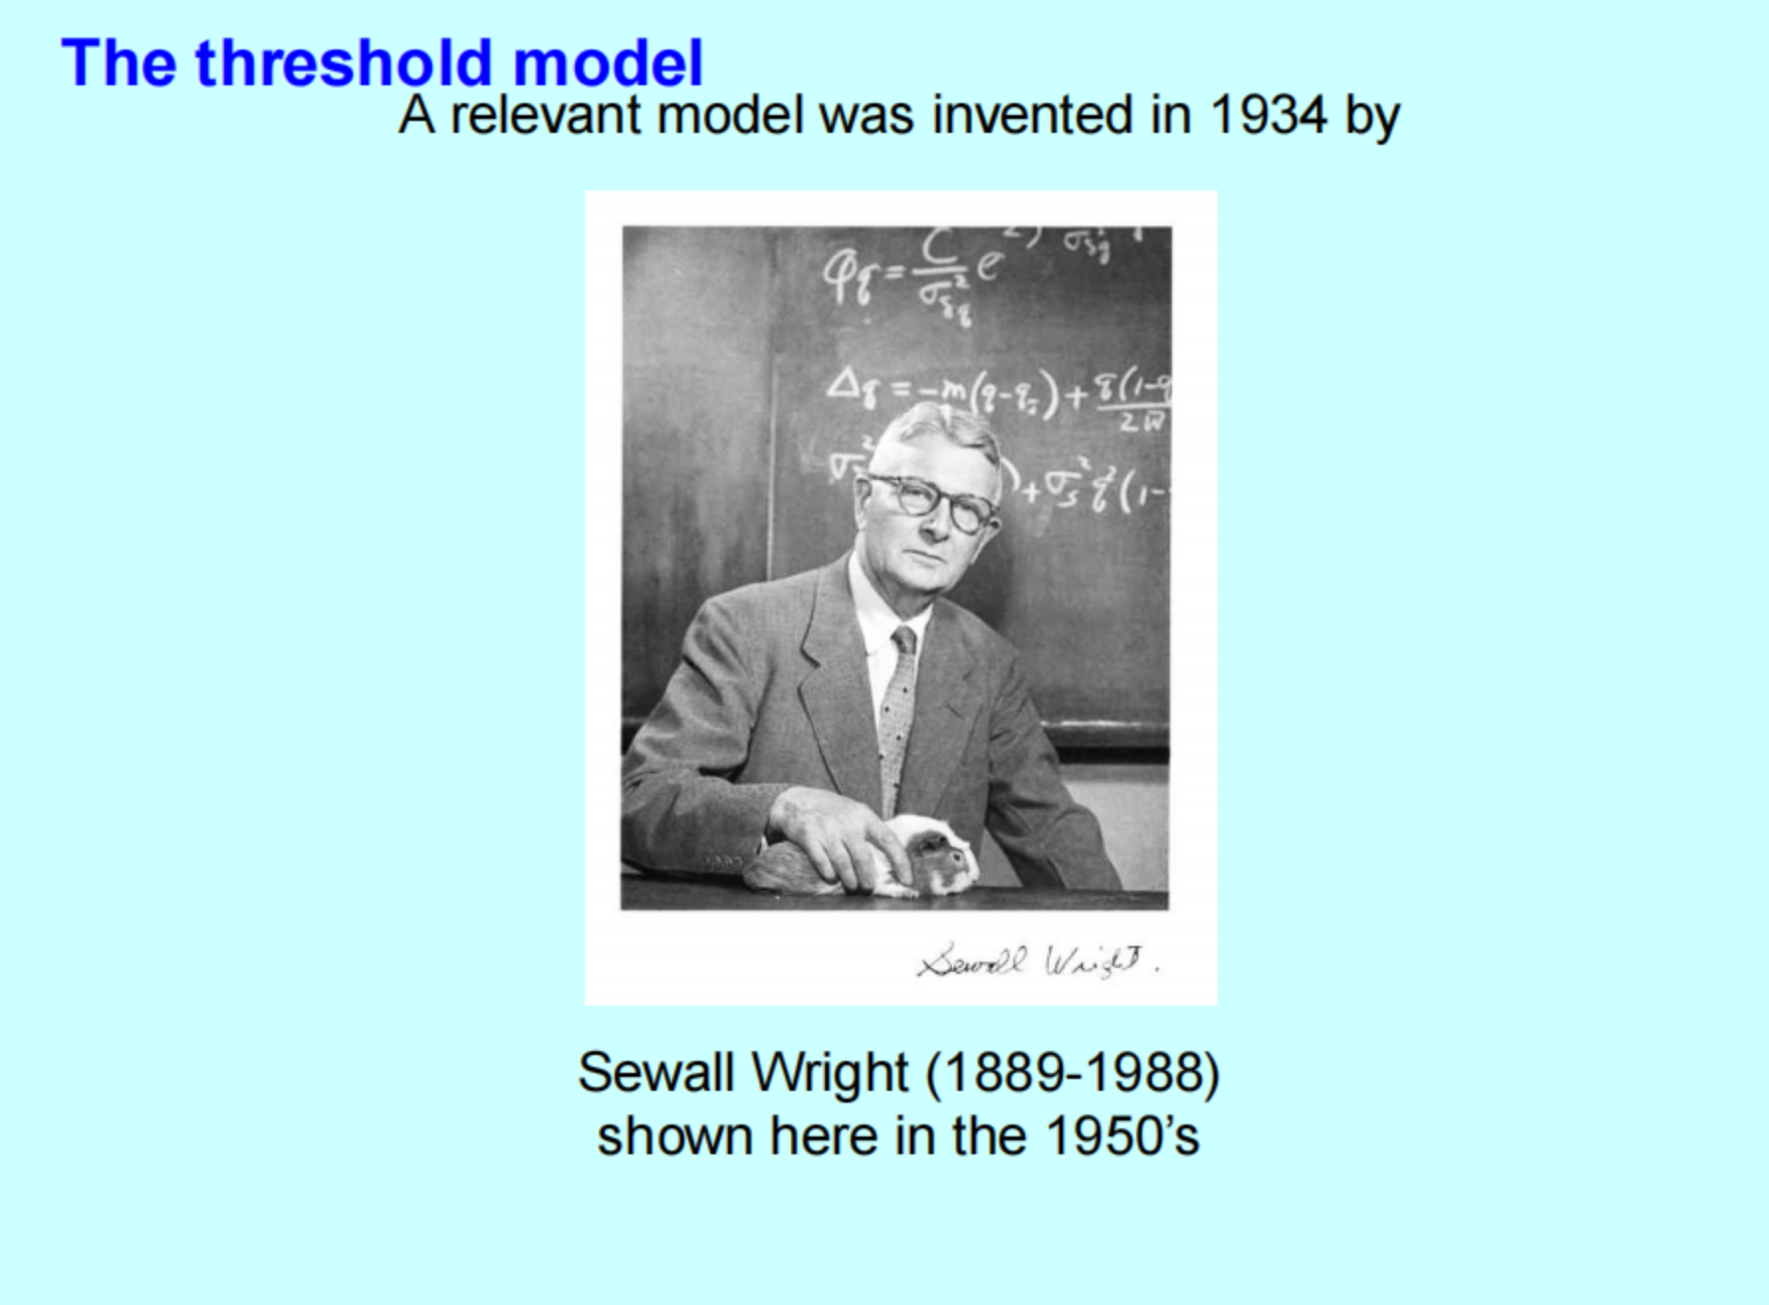

Slide 24
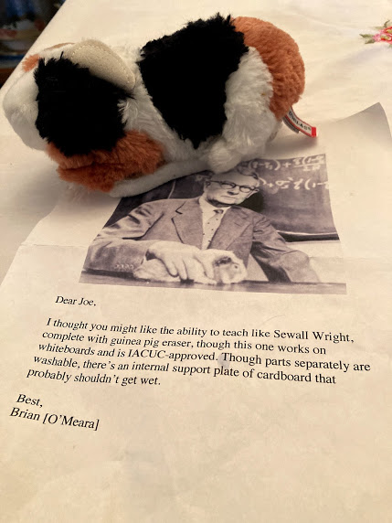

Dear Joe,
I thought you might like the ability to teach like Sewall Wright, complete with guinea pig eraser, though this one works on whiteboards and is IACUC-approved. Though parts separately are washable, there’s an internal support plate of cardboard that probably shouldn’t get wet.
Best,
Brian [O’Meara]

Slide 25
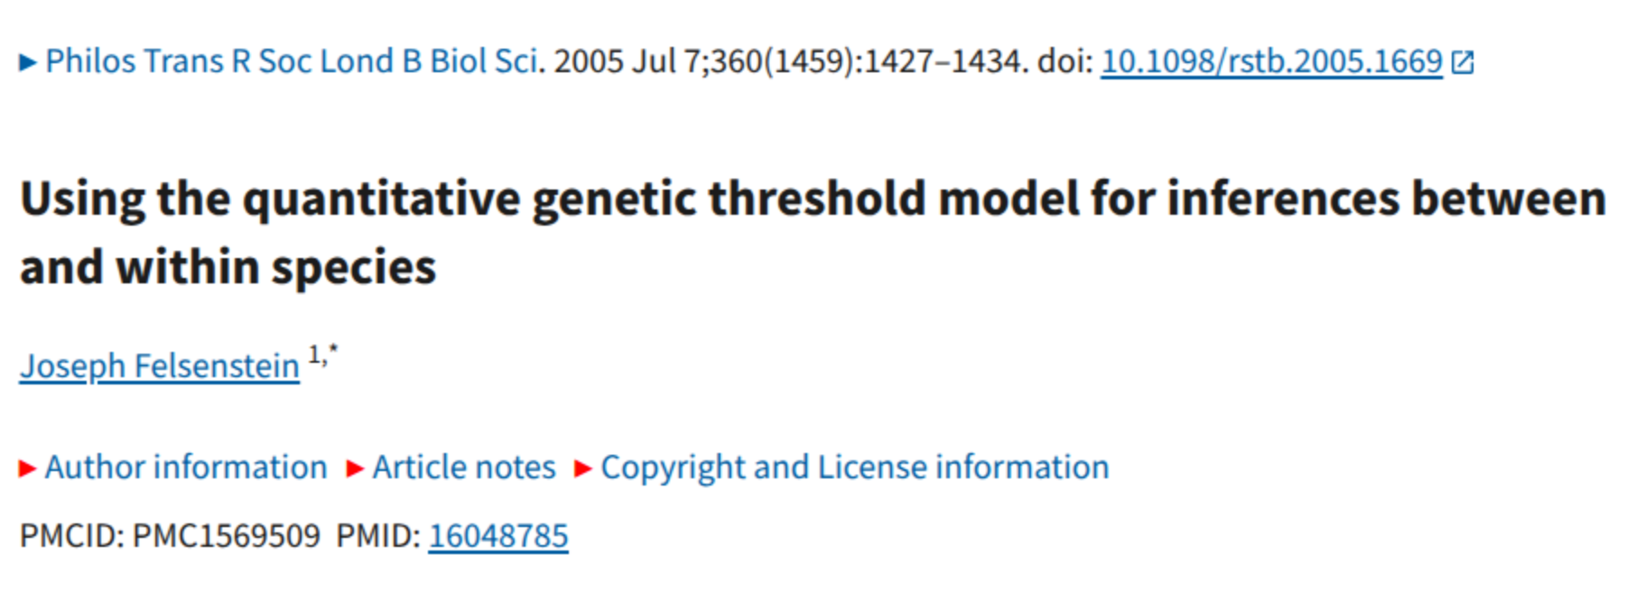
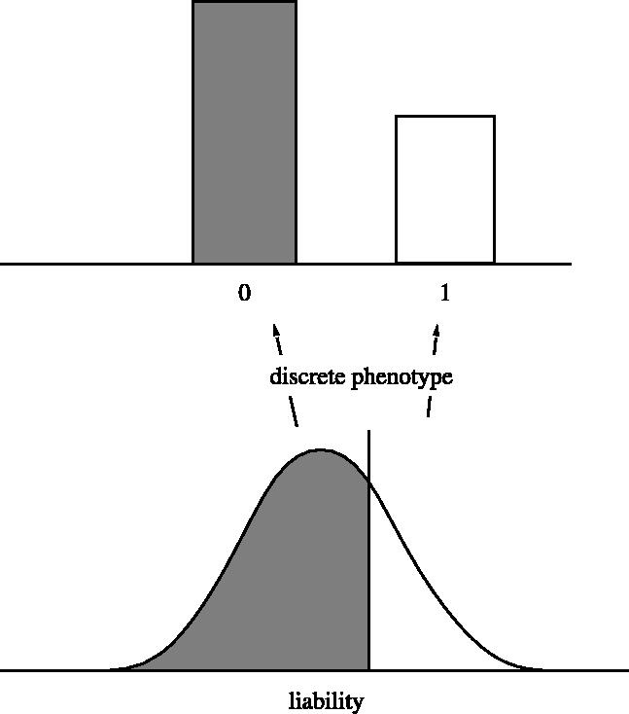
What is a liability?
How is the behavior of a threshold trait on a phylogeny different than a standard Markov trait?

Slide 26
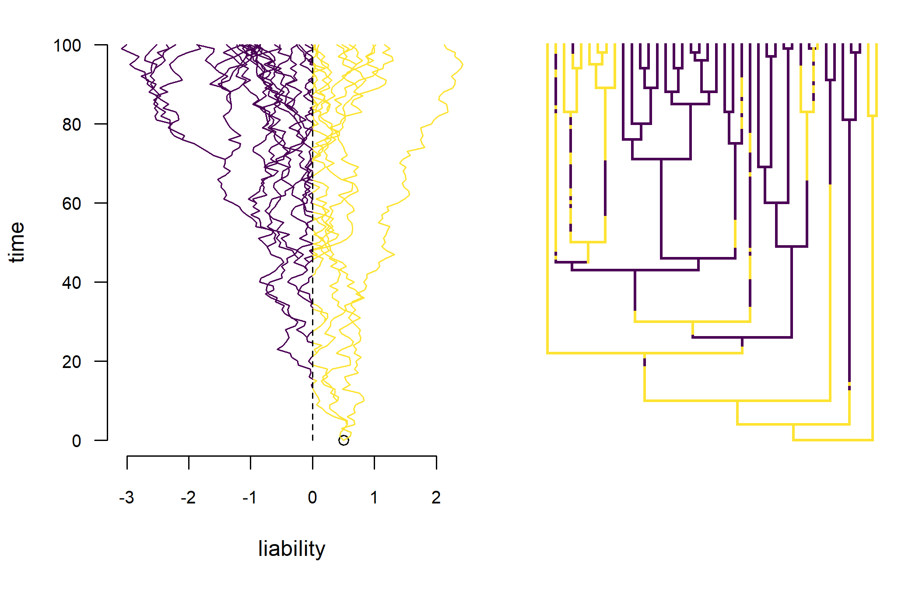

Slide 27
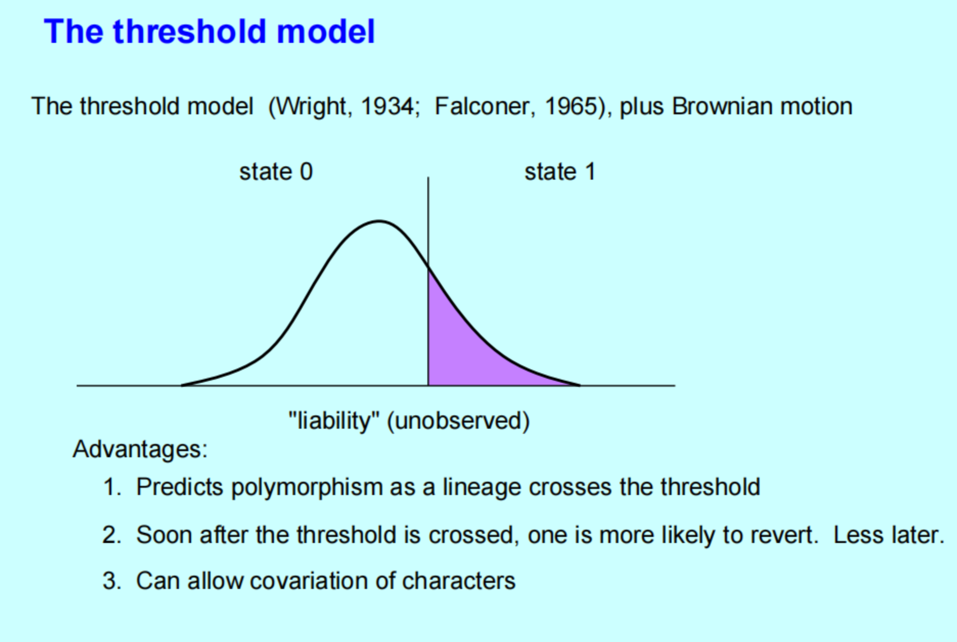

Slide 28
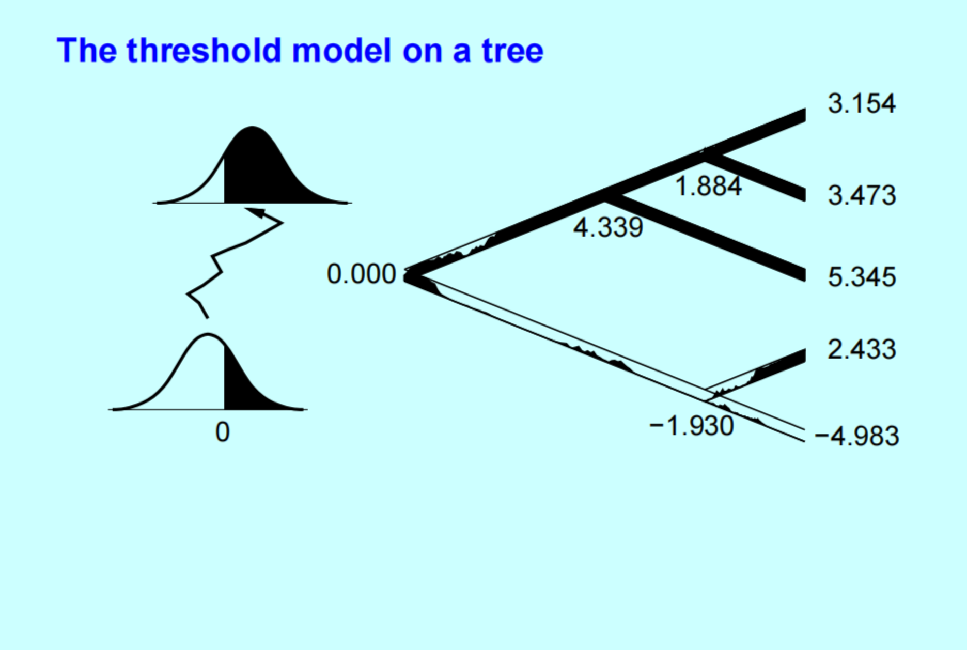

Slide 29
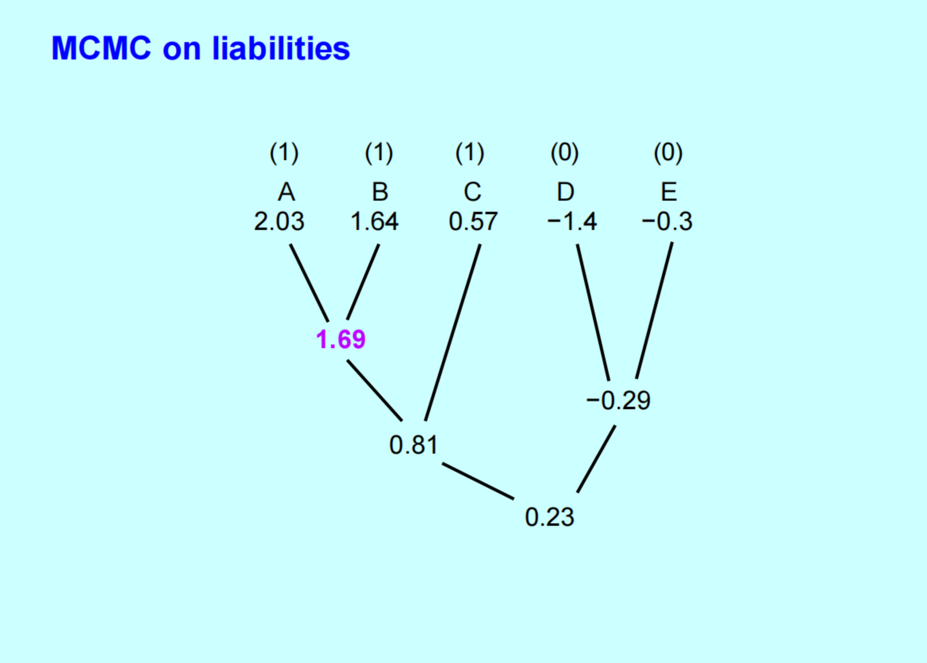

Slide 30
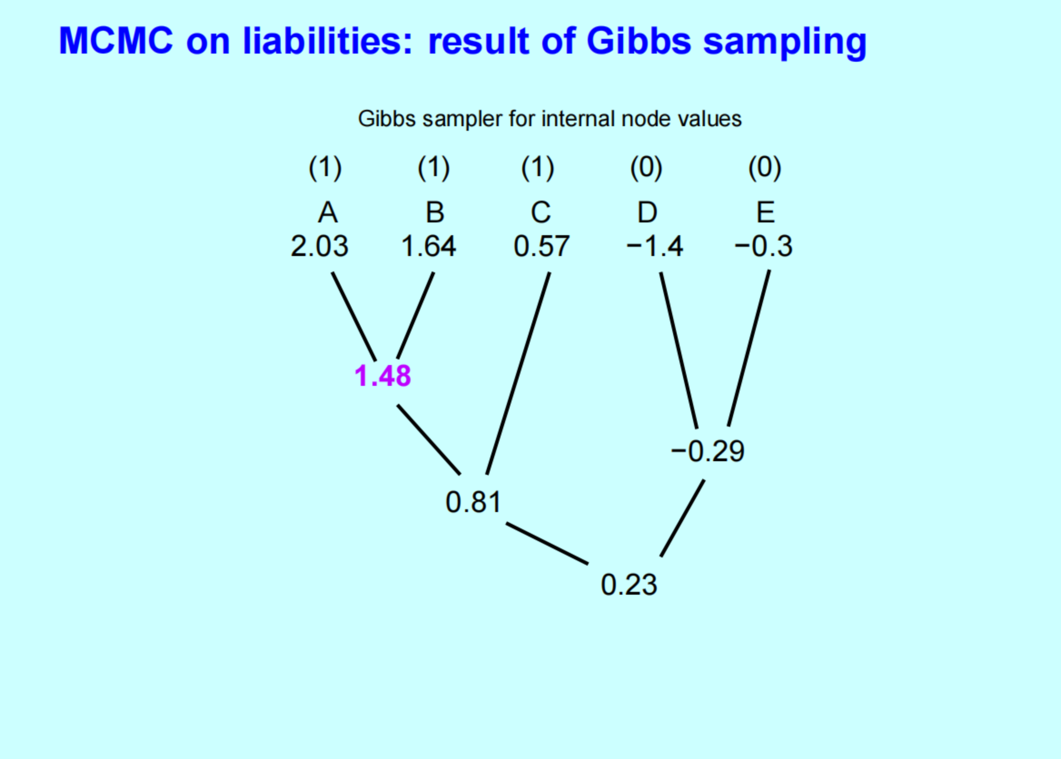

Slide 31
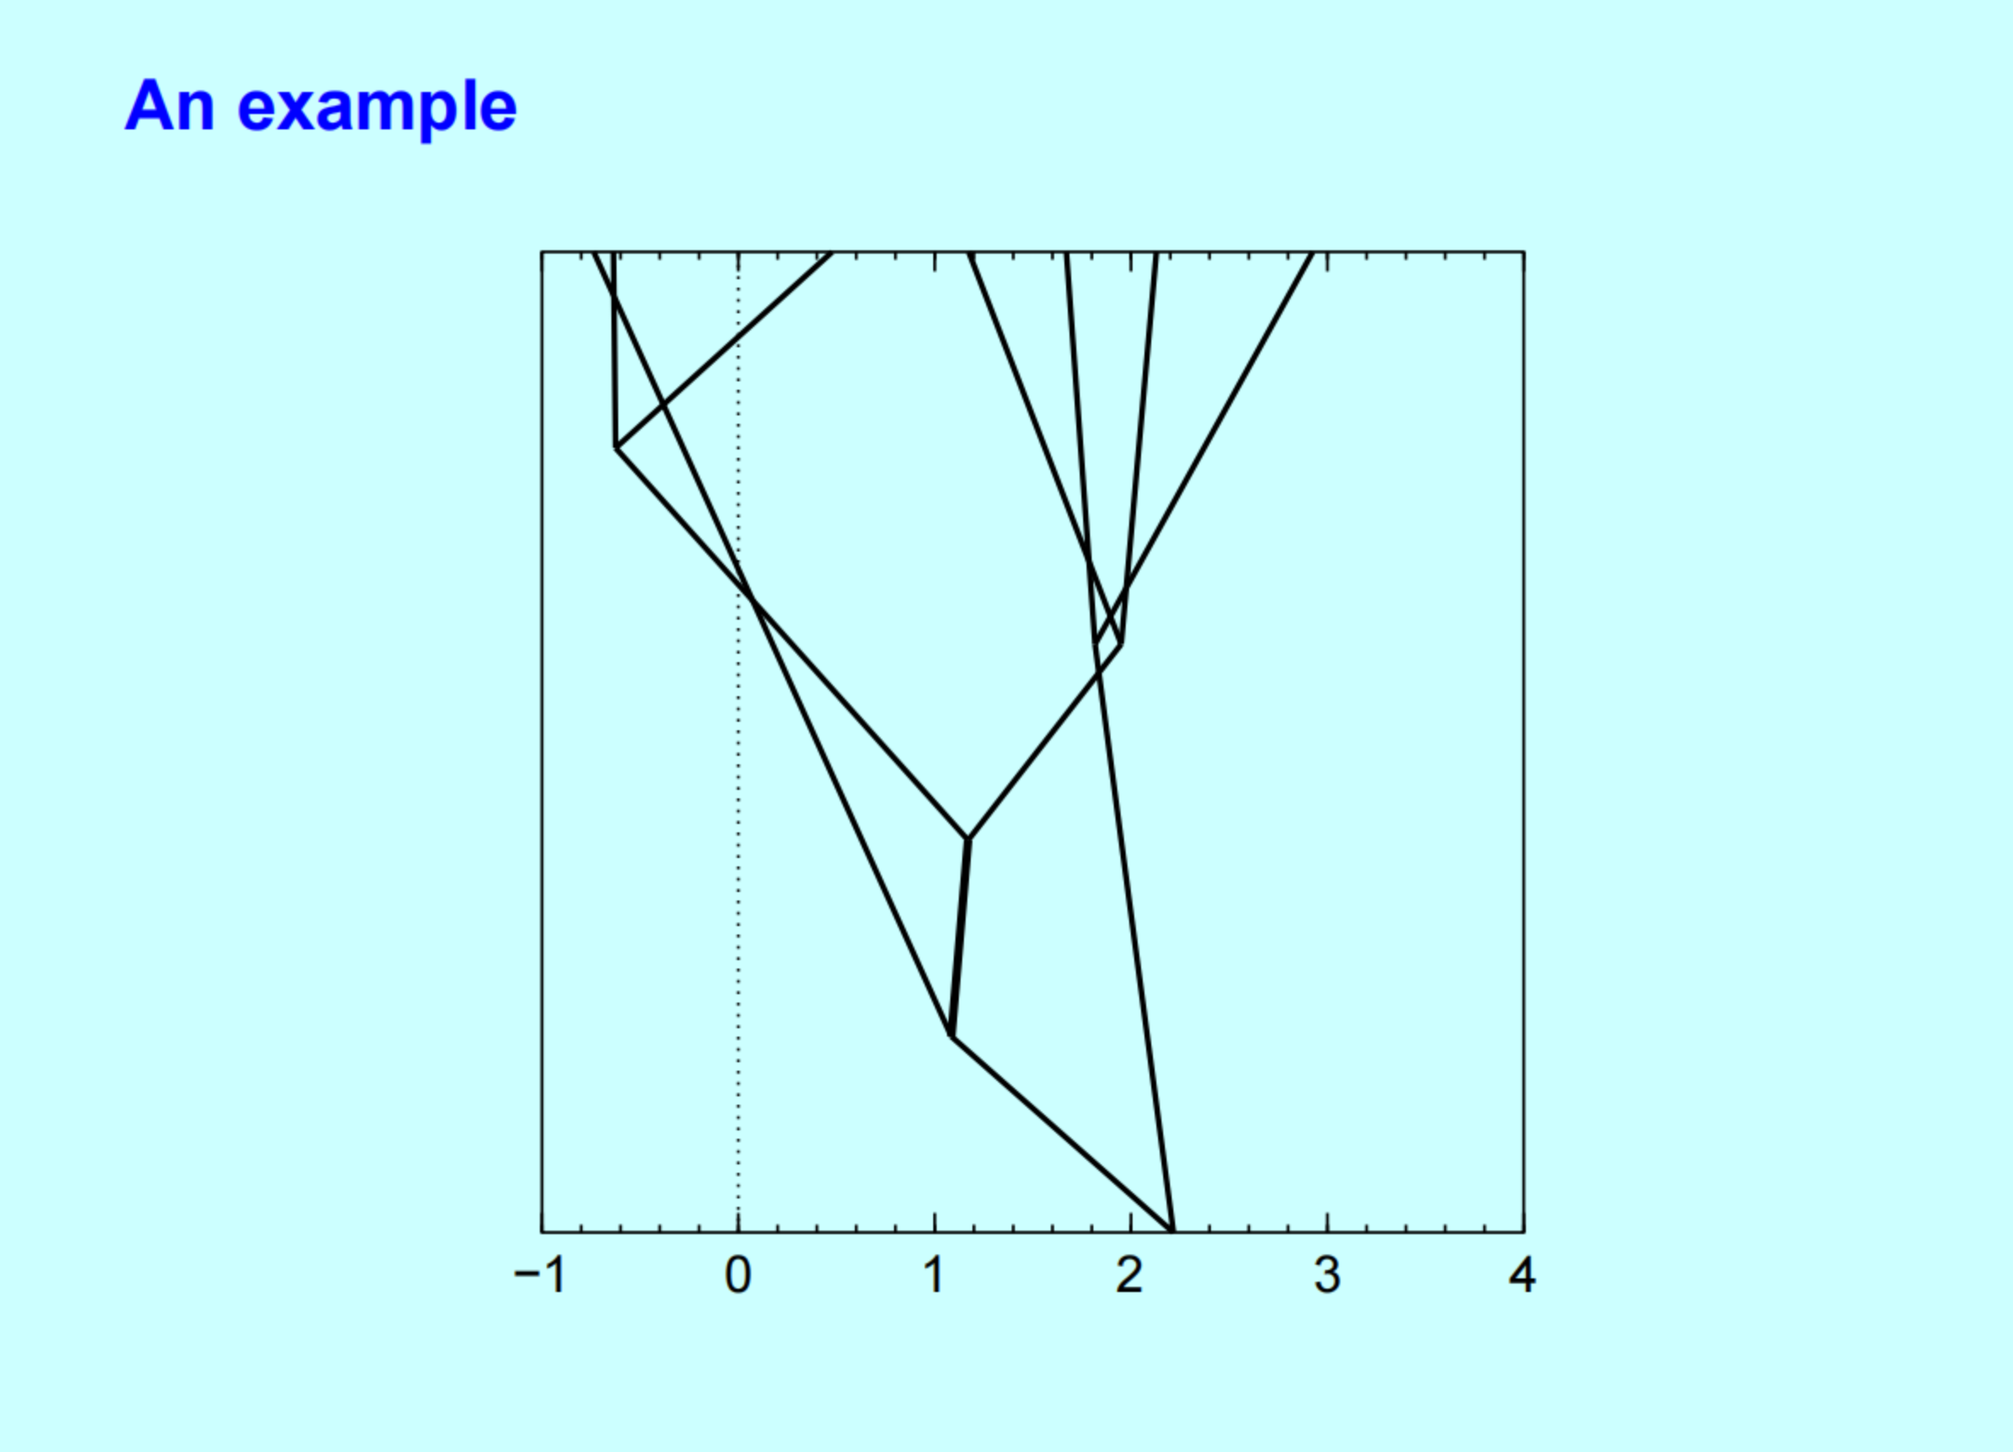

Slide 32
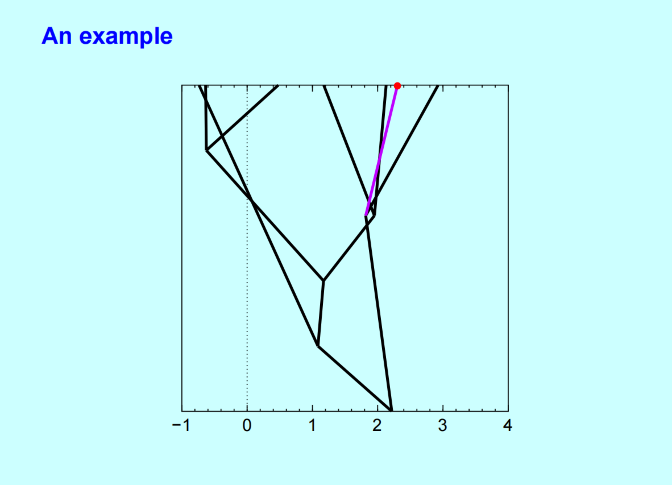

Slide 33
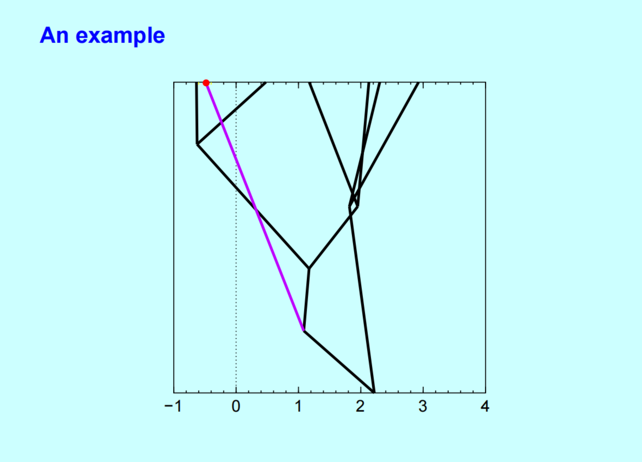

Slide 34
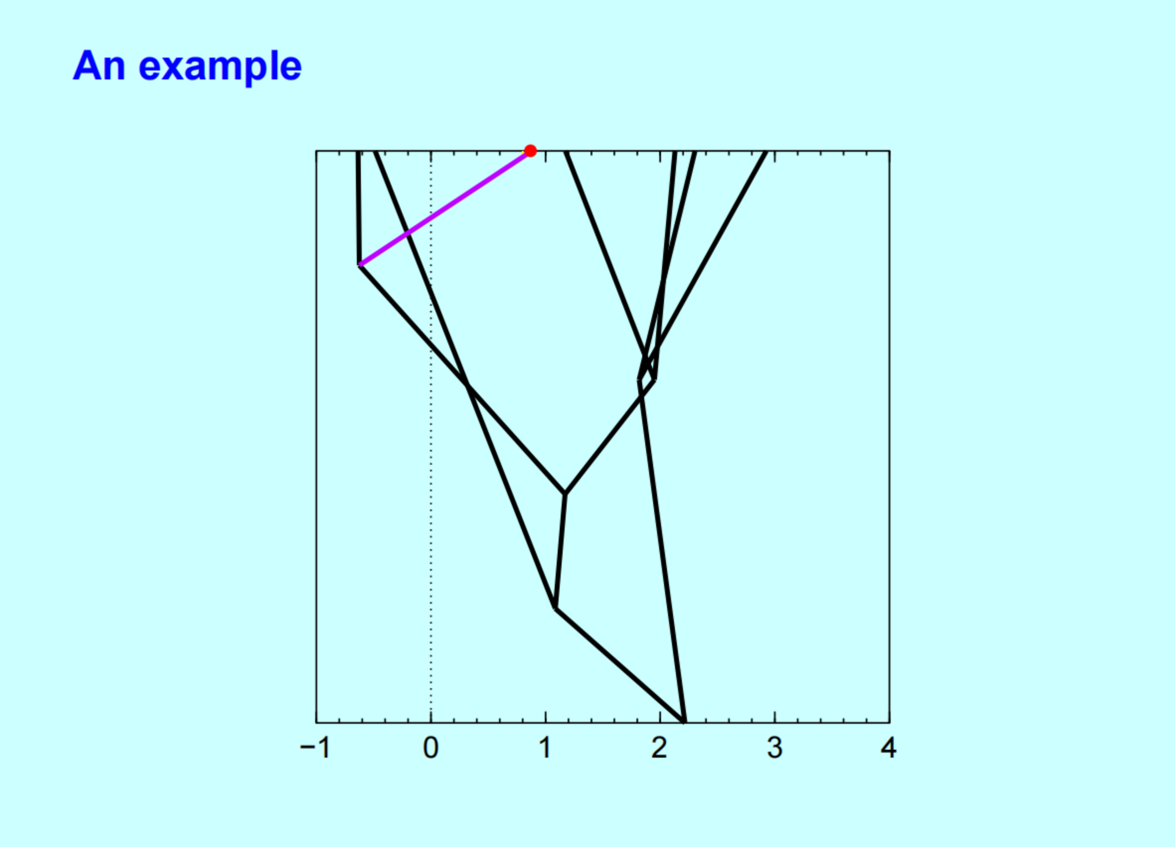

Slide 35
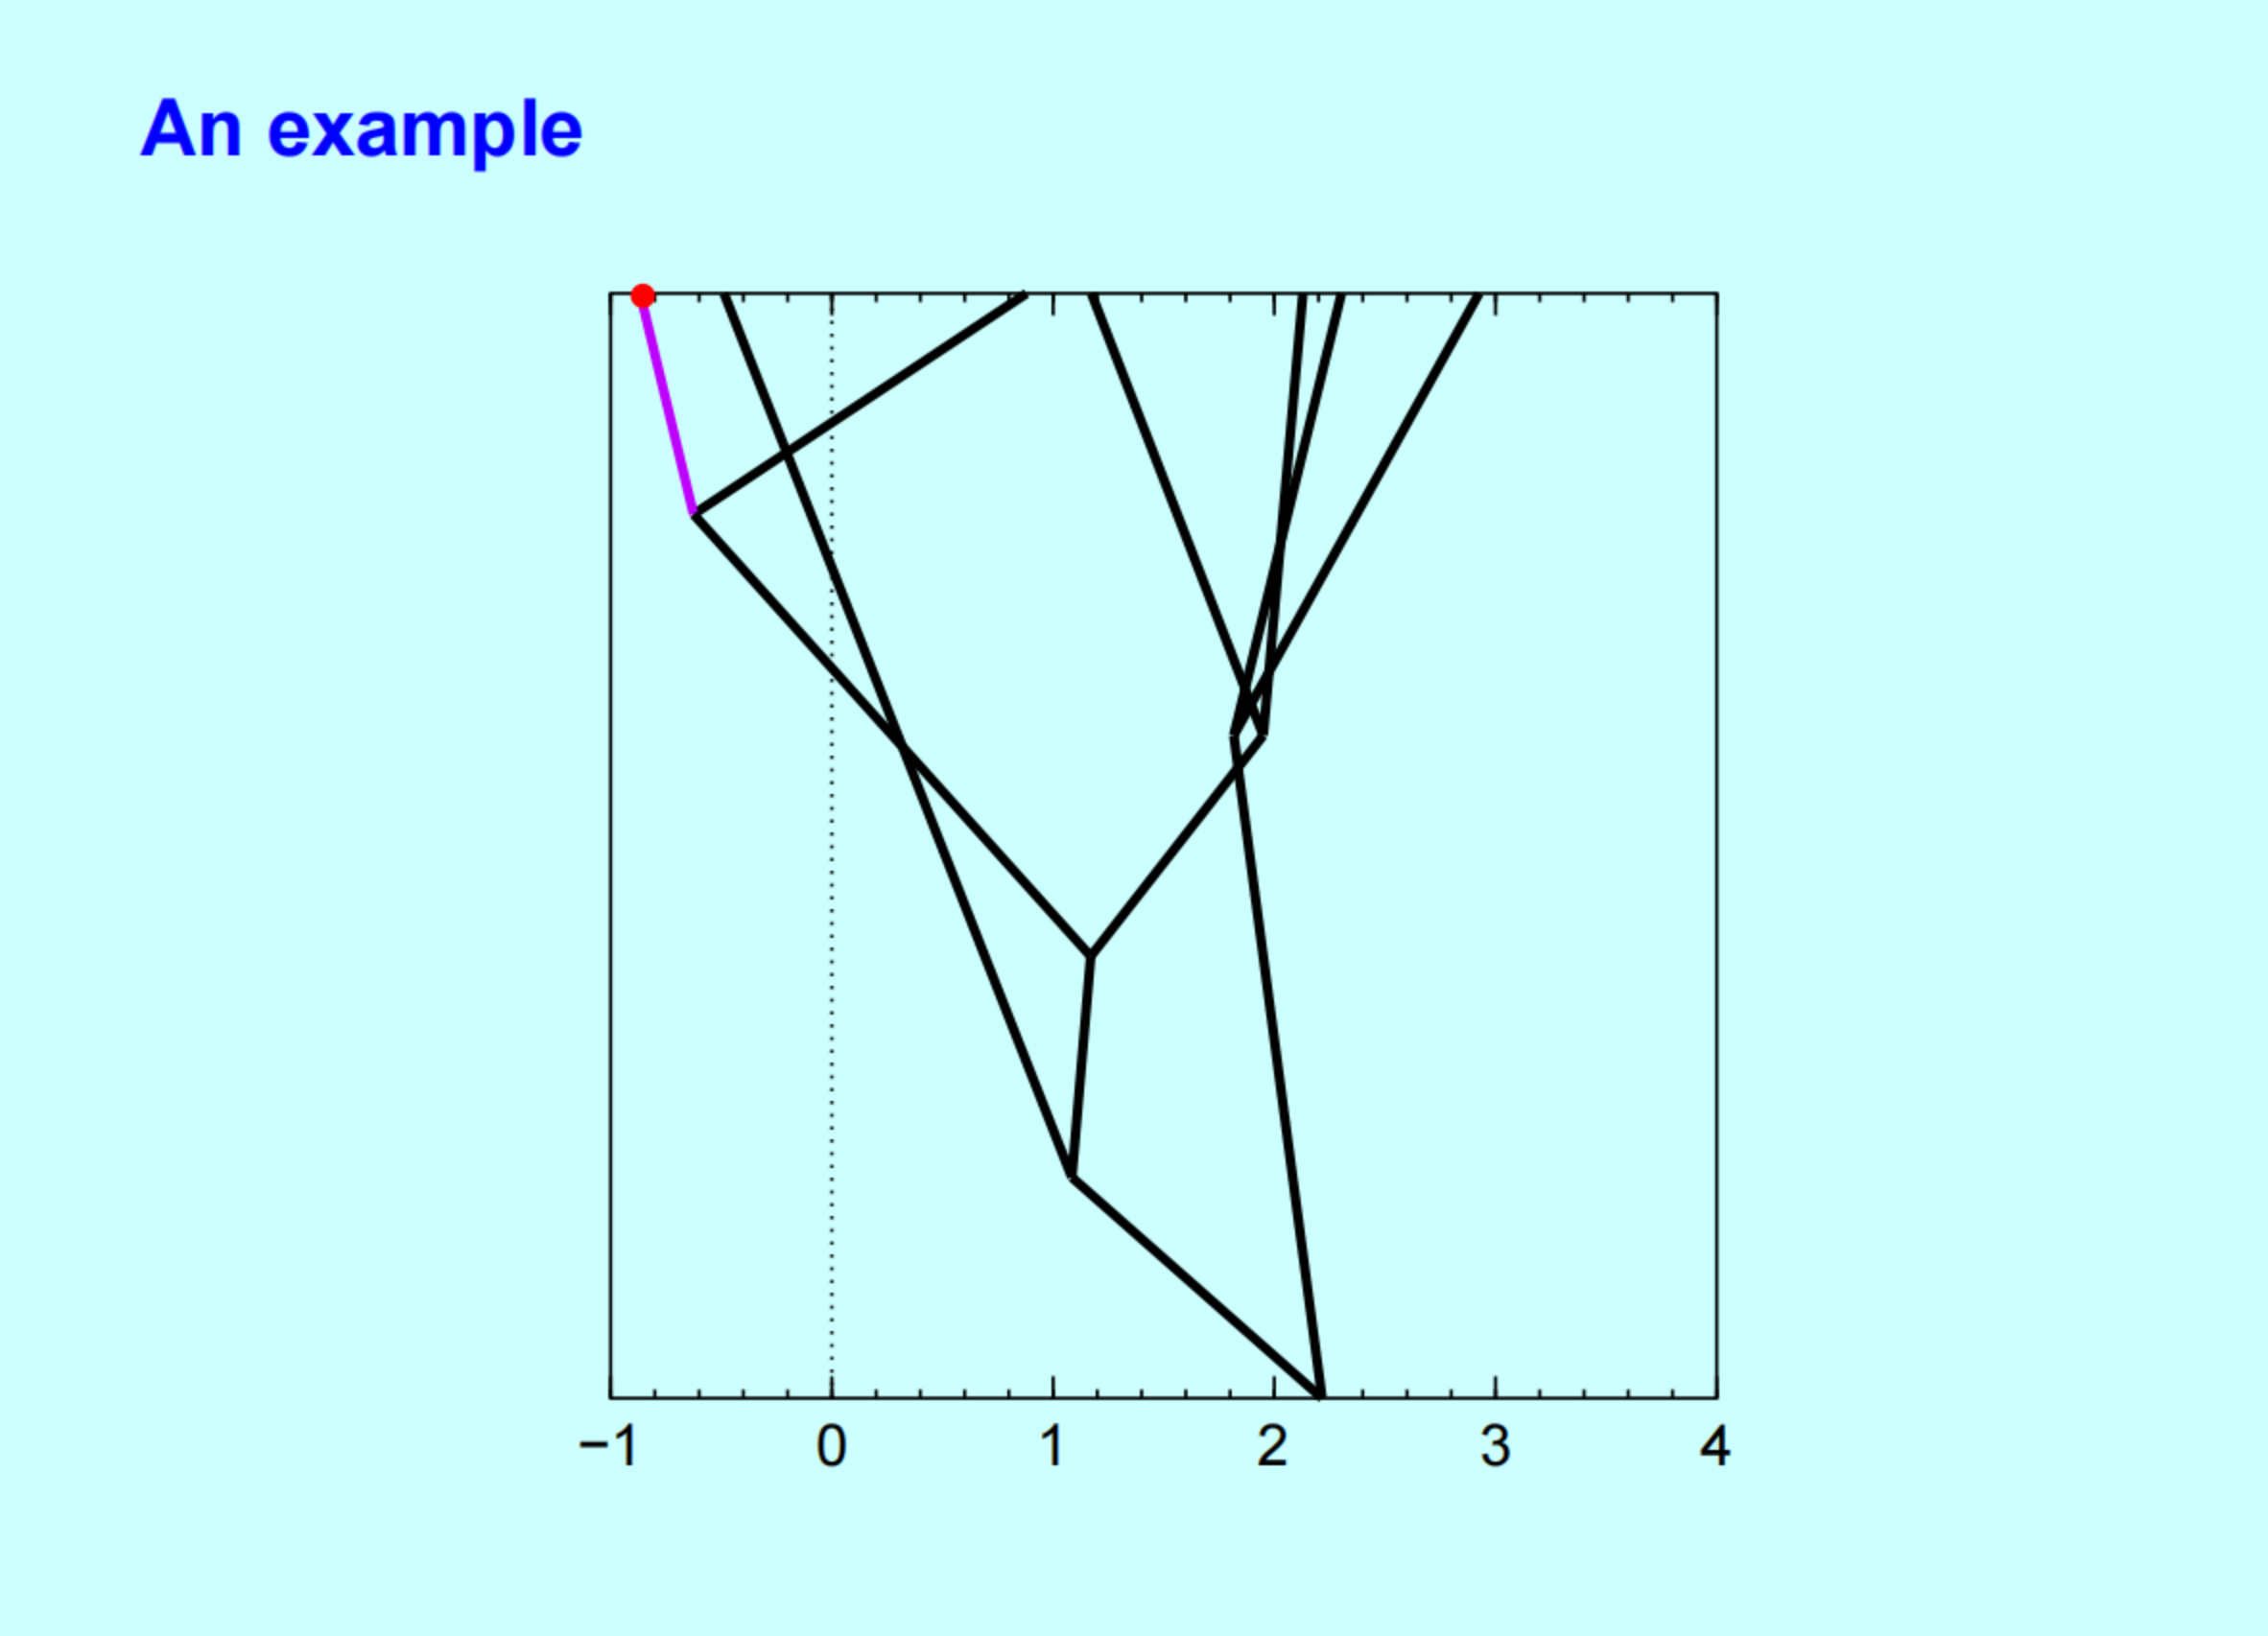

Slide 36
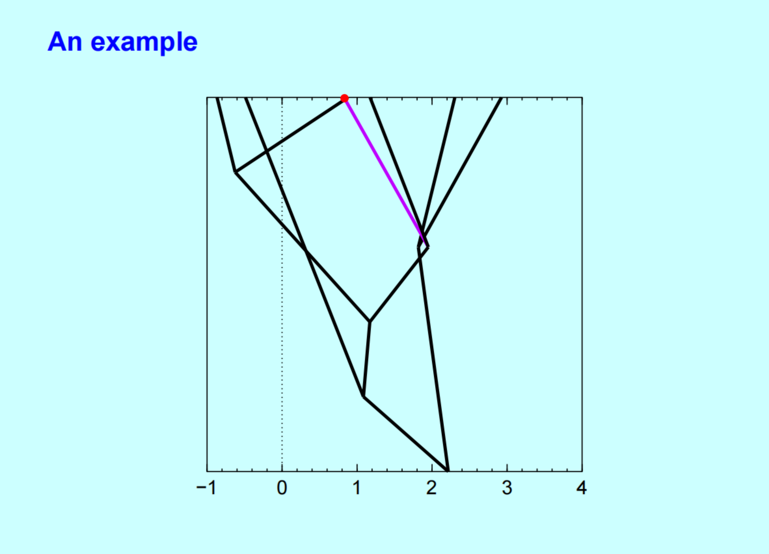

Slide 37
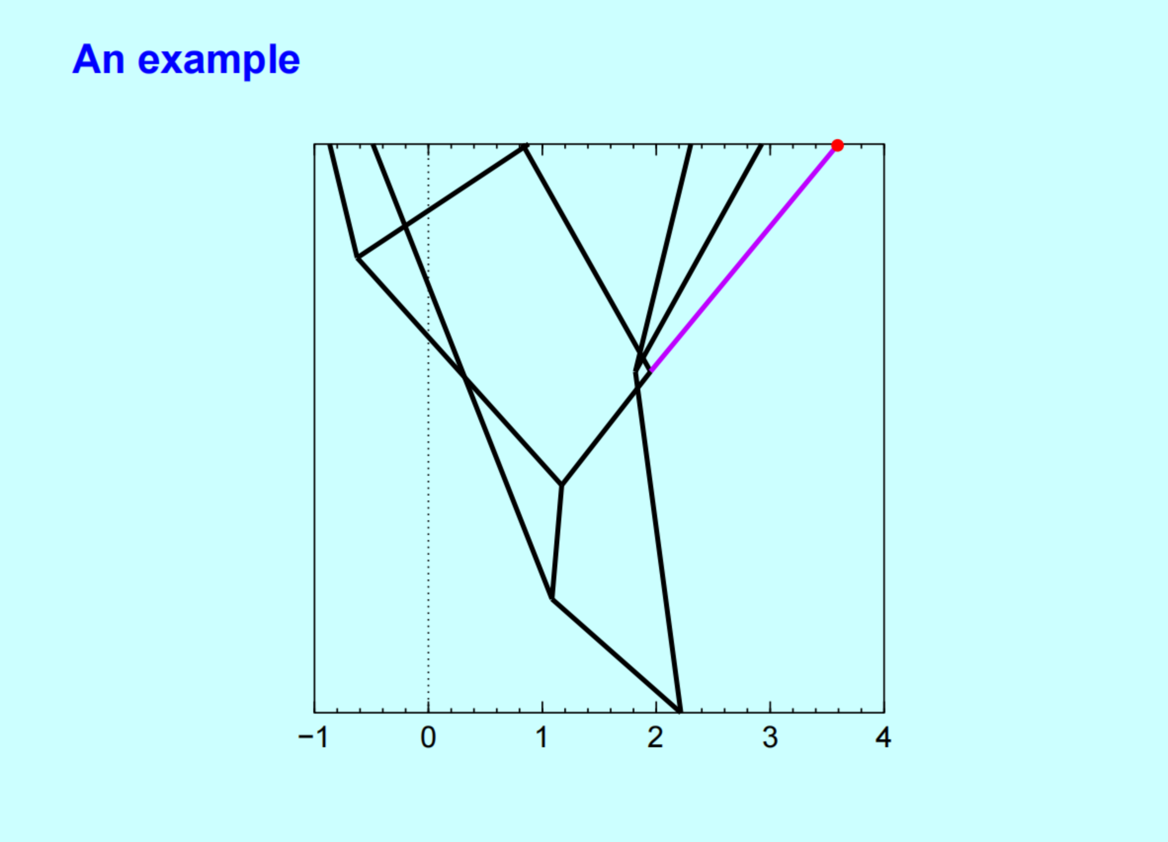

Slide 38
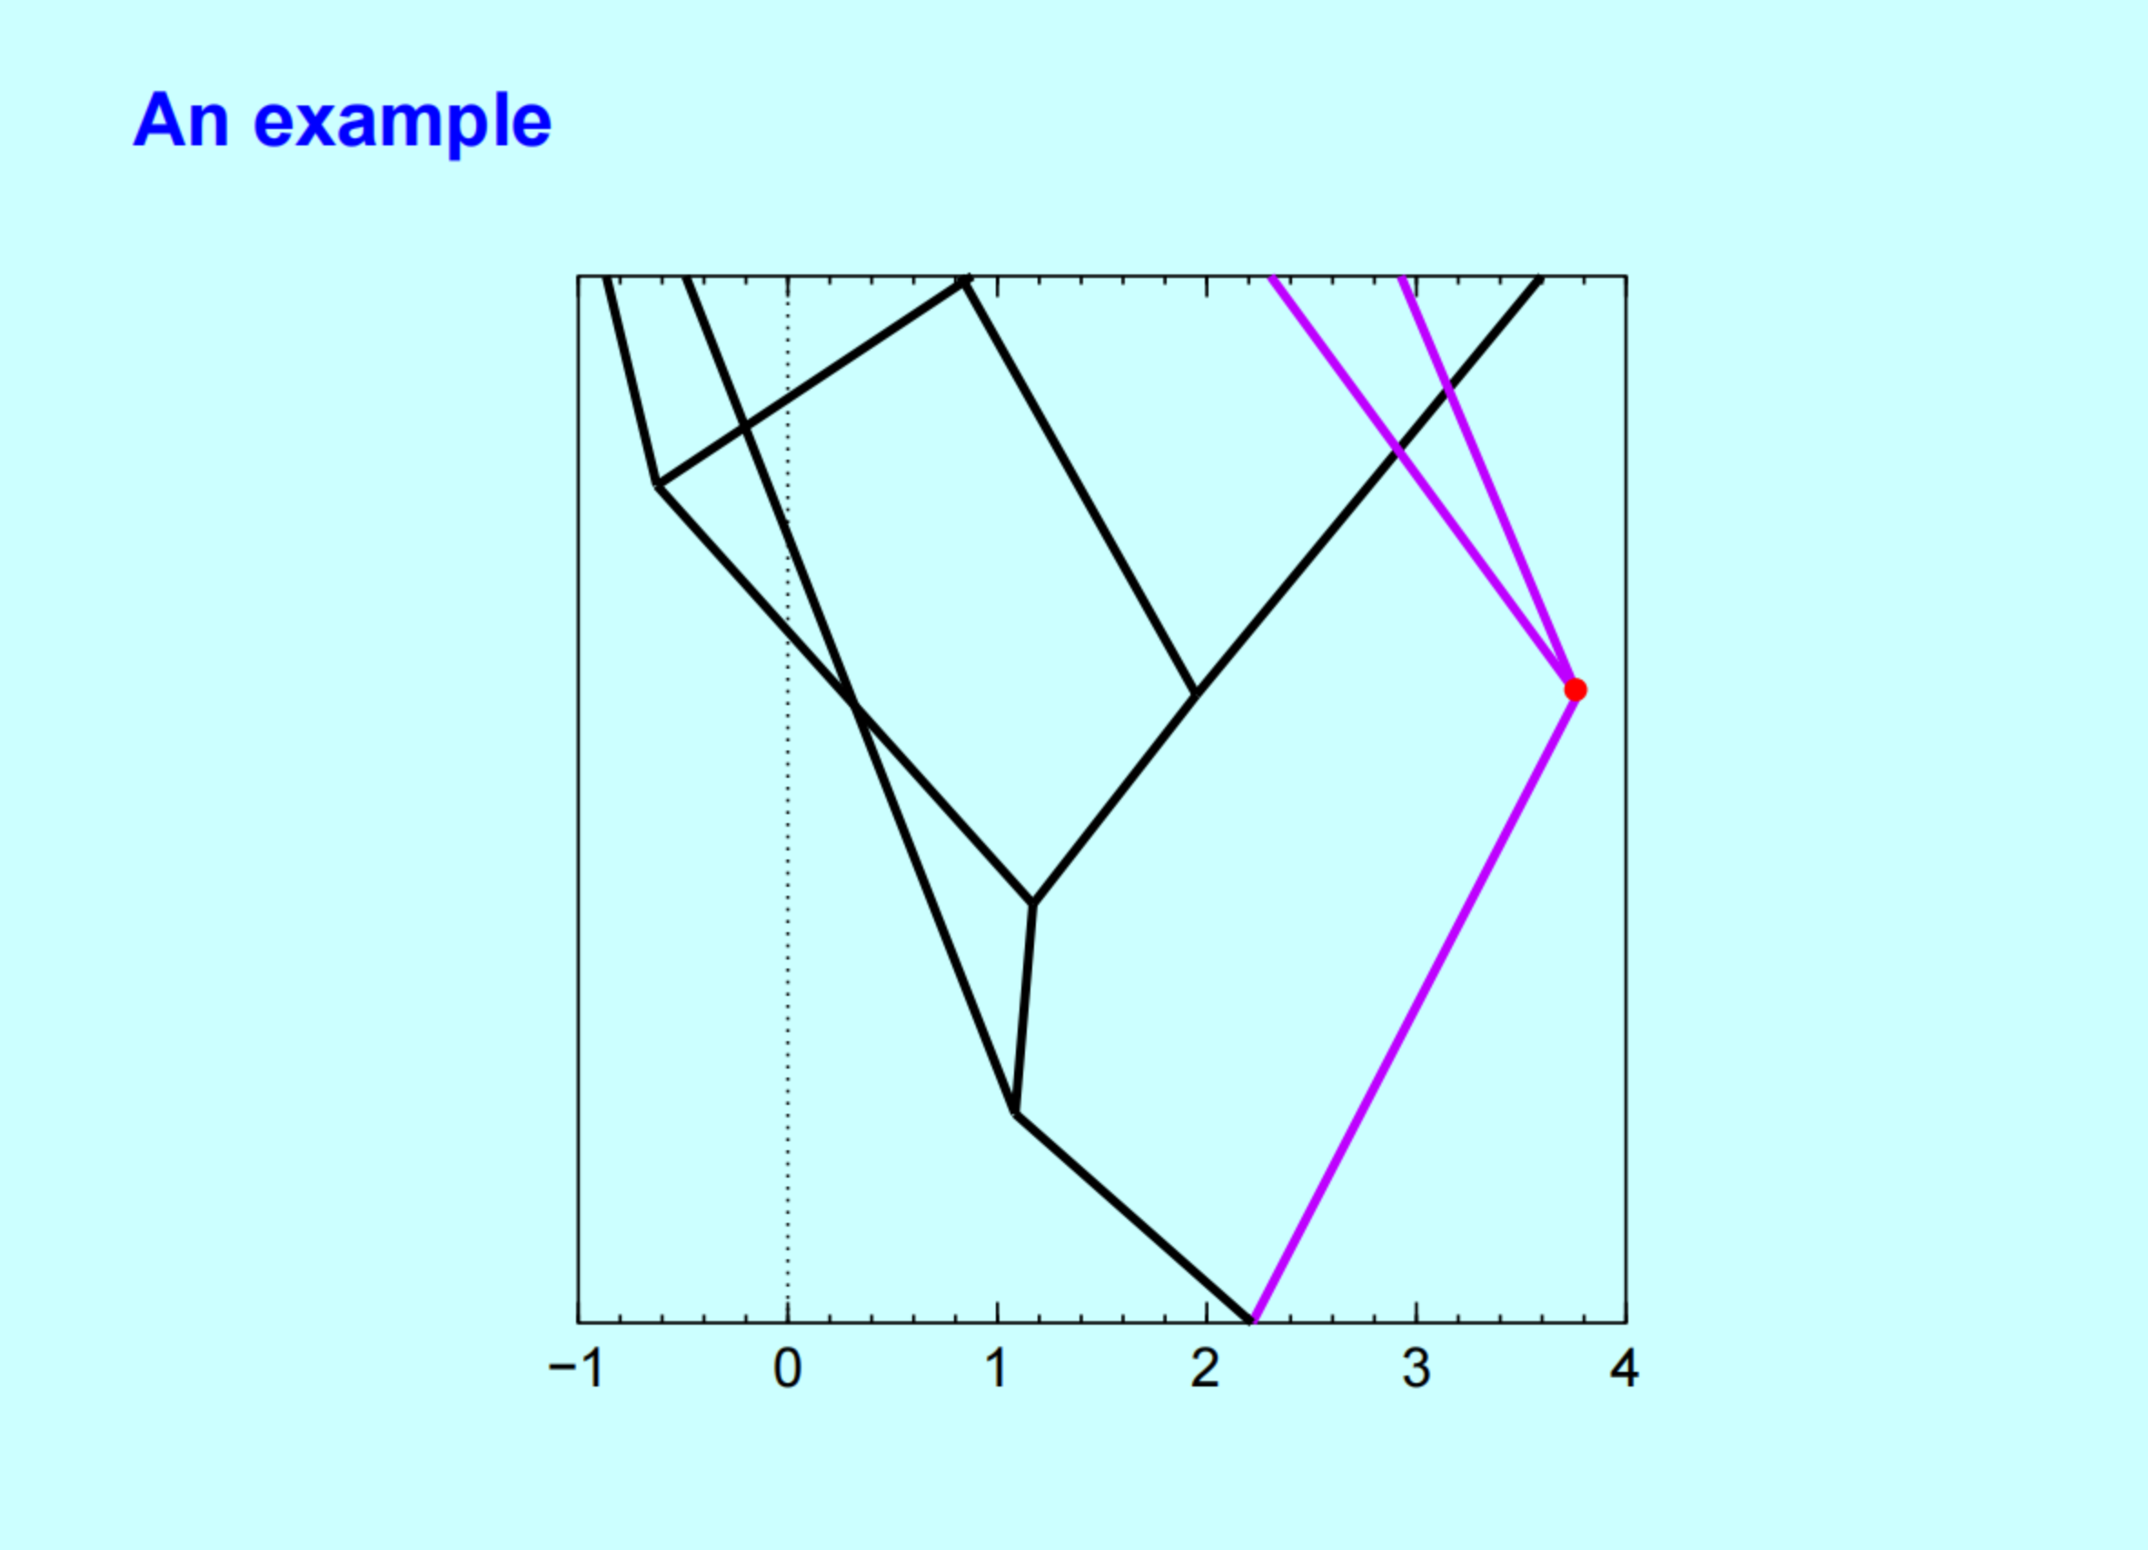

Slide 39
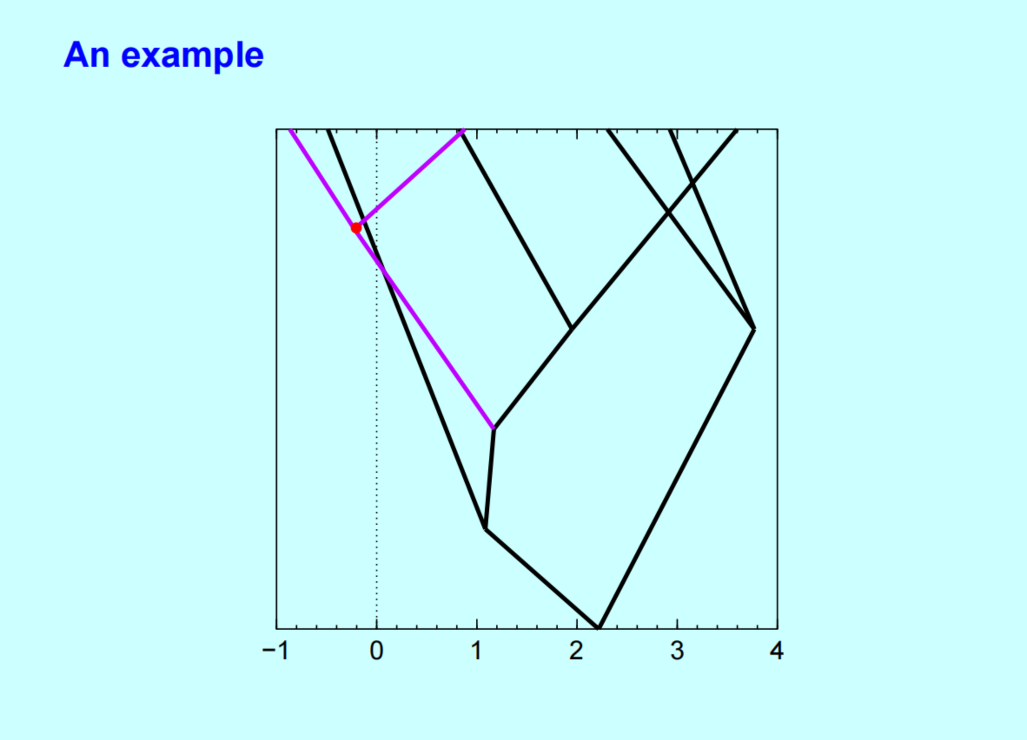

Slide 40
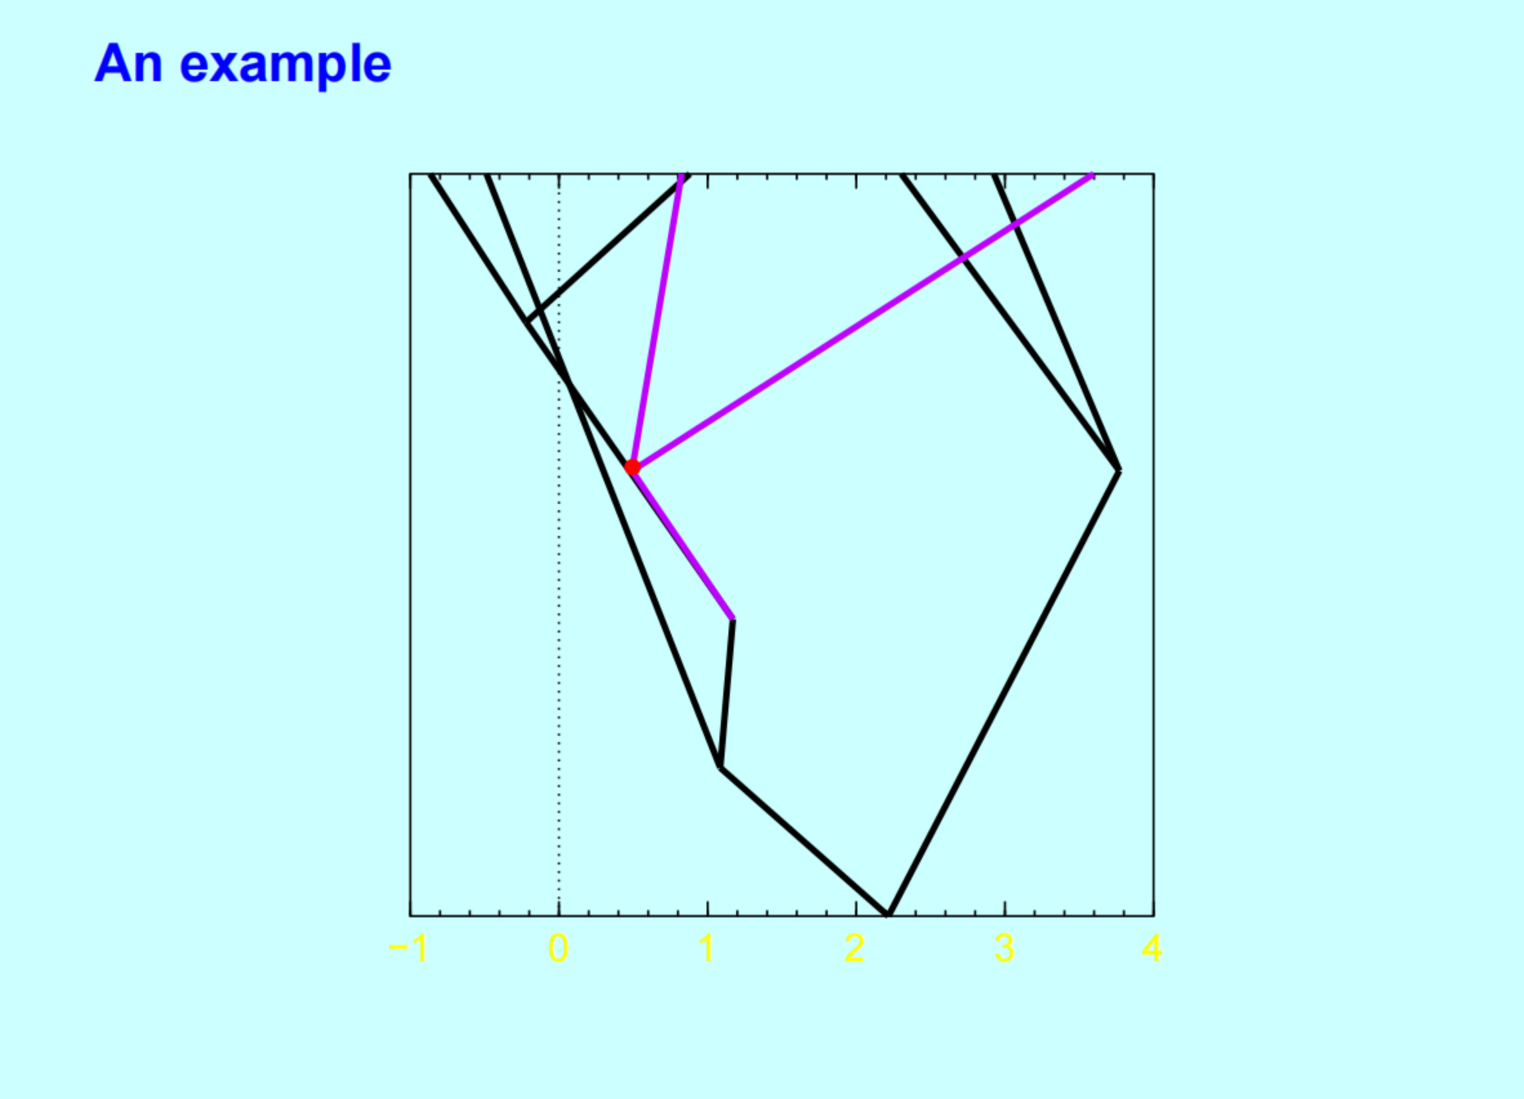

Slide 41
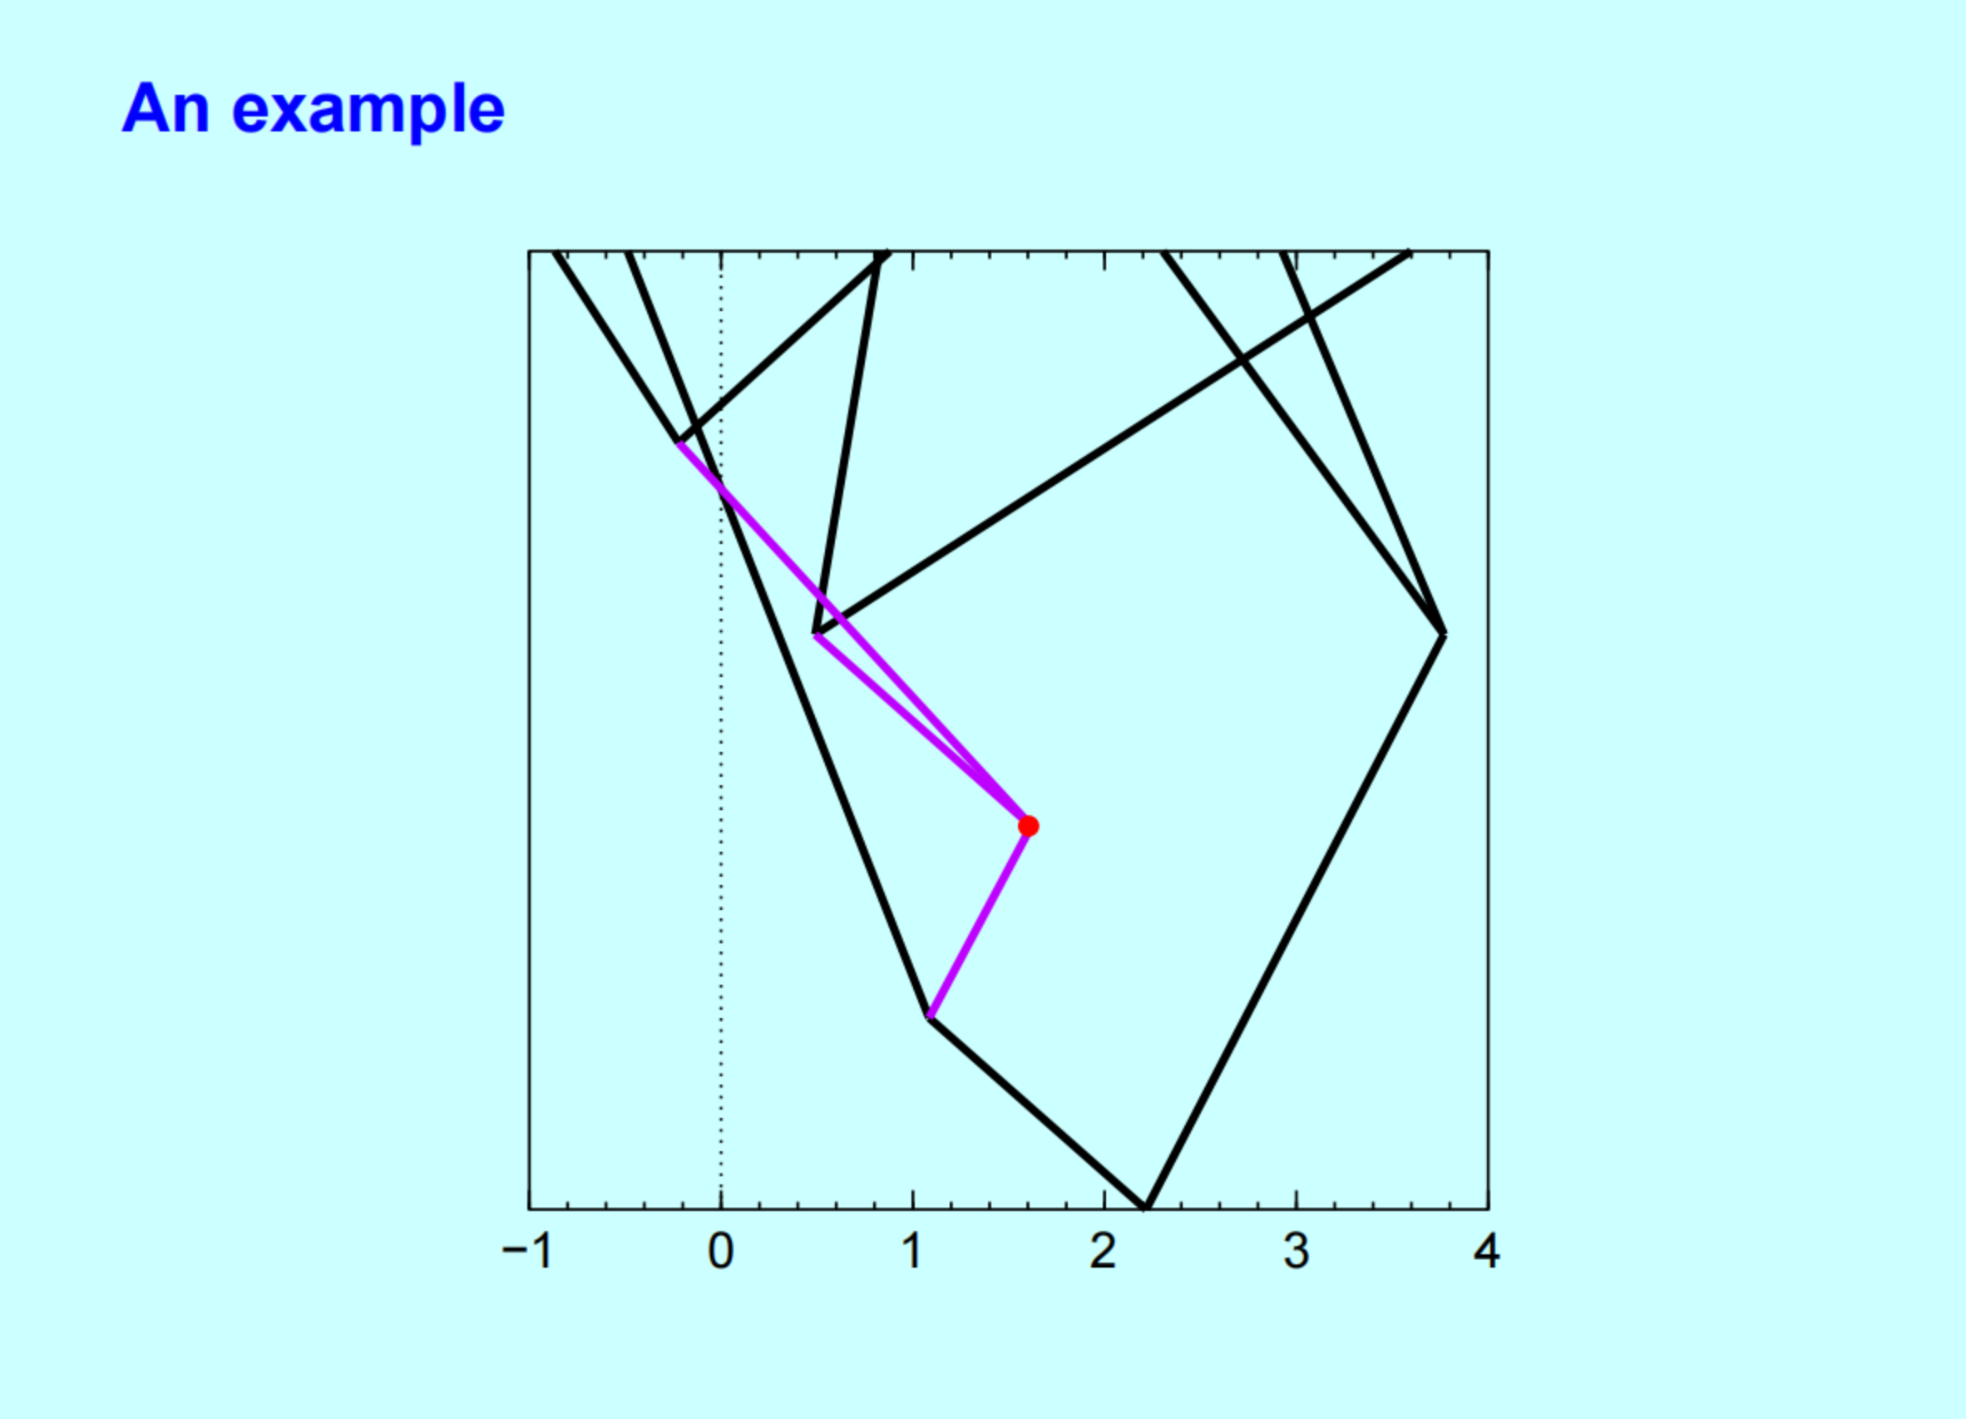

Slide 42
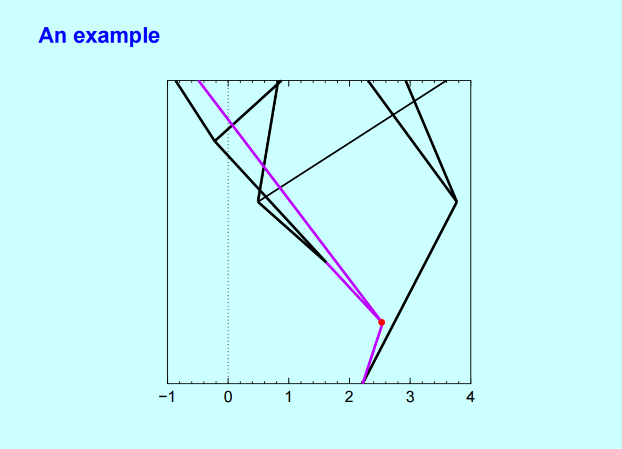

Slide 43
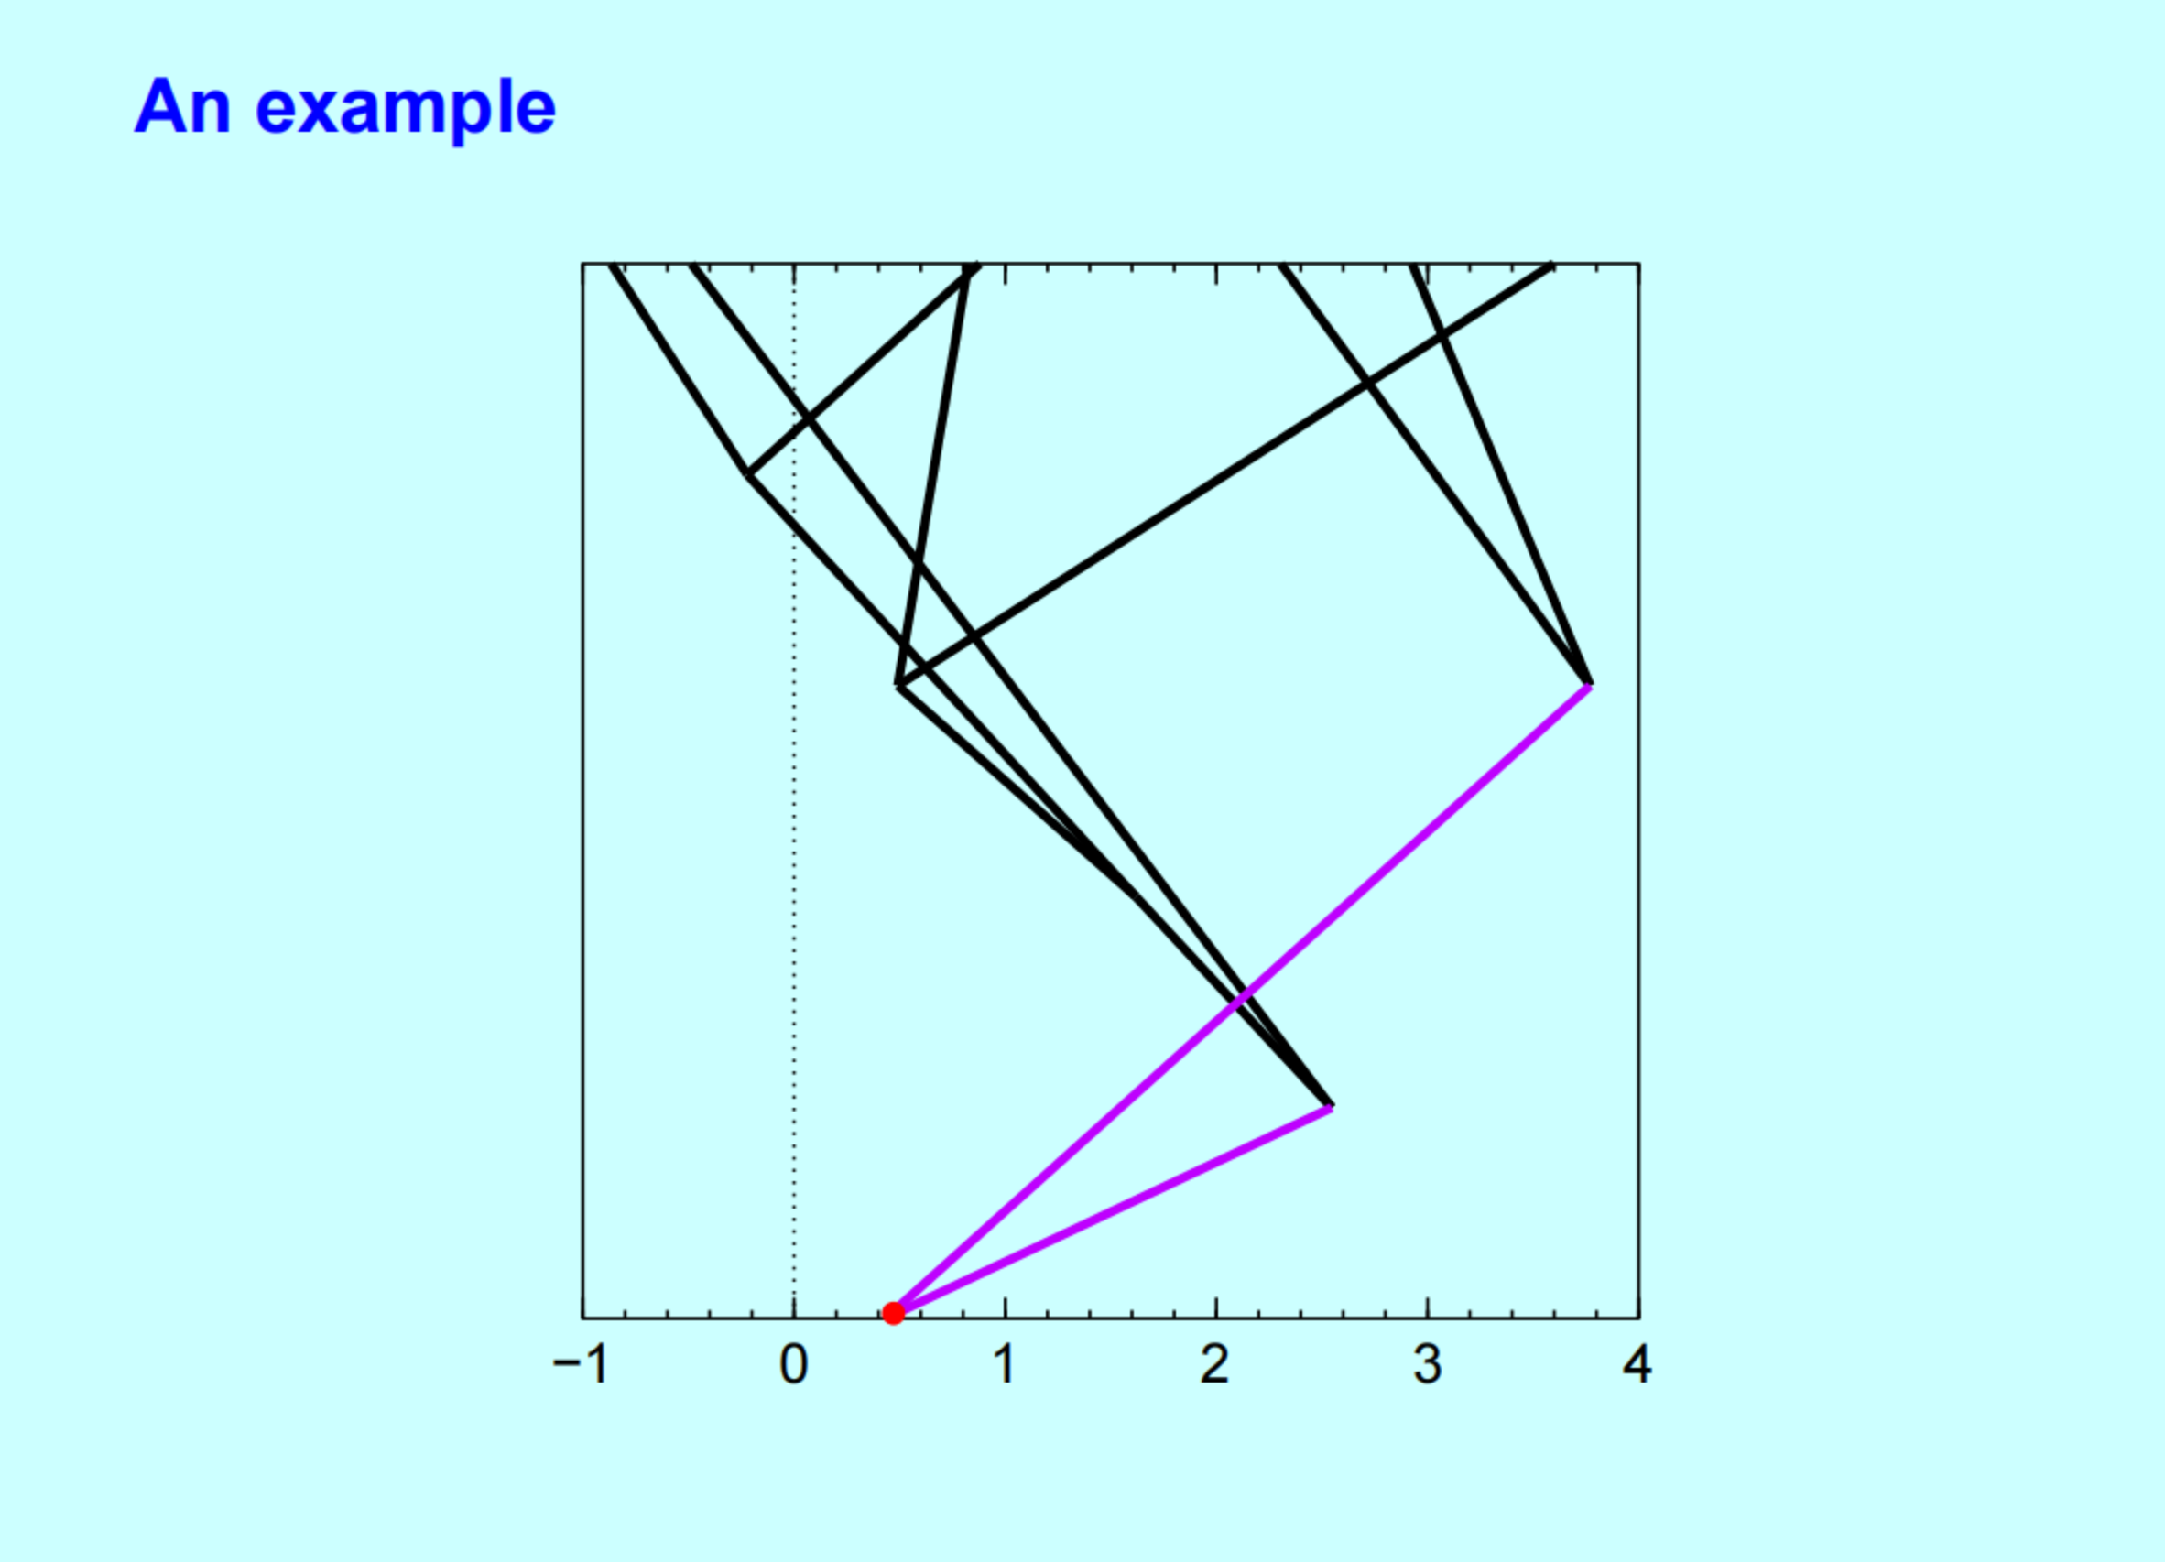

Slide 44
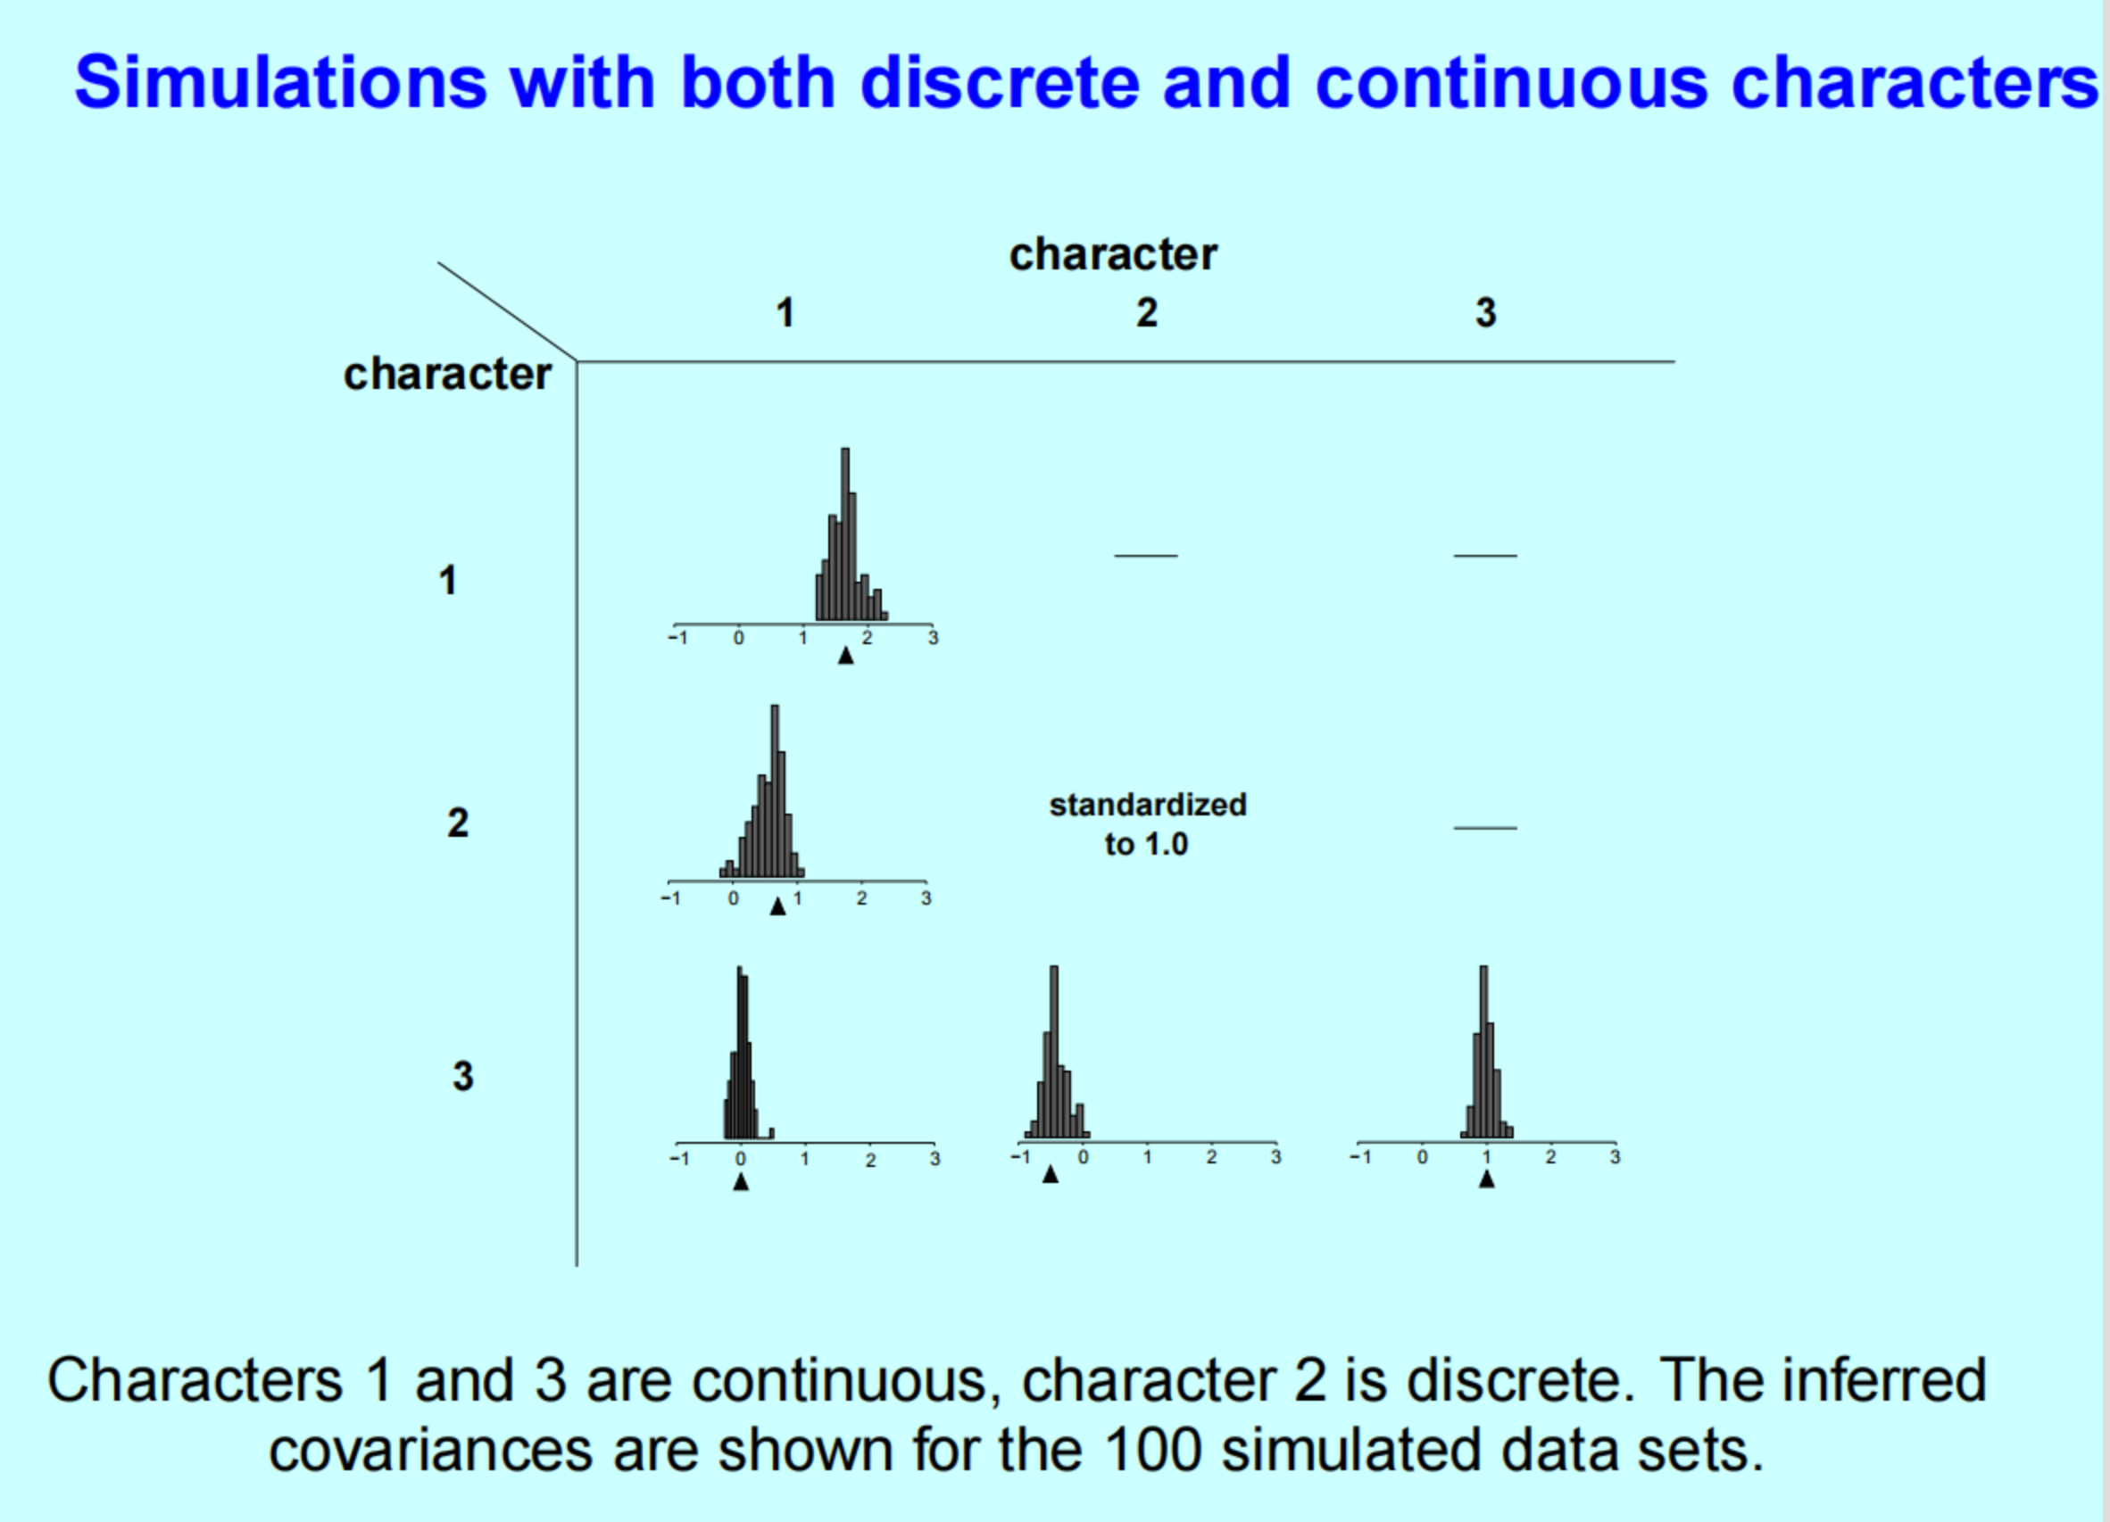
Easy to combine with continuous characters!
Easily and naturally handles missing data!!

Slide 45
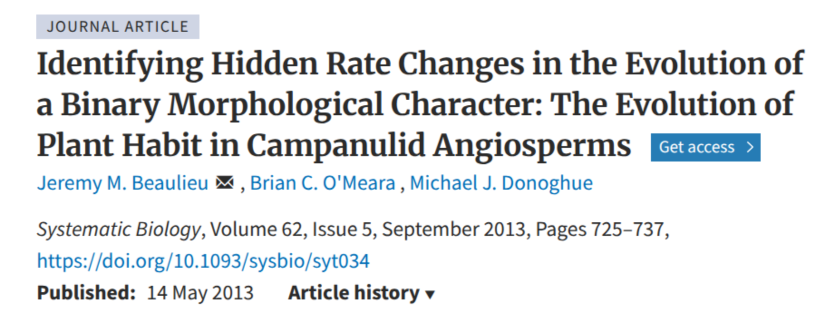
We can model the threshold models with hidden state models as well!
A
B
C
D
E
F

Slide 46



Slide 47


Slide 48


Bounded Brownian Motion

Slide 49

“To compute the likelihood of FPK, we instead discretize the trait interval by considering only a set of n points equally spaced between two extreme values, Bmin and Bmax, a procedure already used for
the BBM model (Boucher and Démery, 2016).”

Slide 50


Slide 51


Slide 52


Slide 53
BBMV is a flexible method for estimating macroevolutionary landscapes
Discretization could blow up the number of parameters, but by maintaining 1) 1-dimensional change and 2) using a FPK equation so that transition rates depend only on the estimated parameters of a simpler function
We can do this for lots of PCMs, and make things simpler

Slide 54
Problem:
PGLS assumes:
The expected value of trait Y
is predicted by the current value of X
with phylogenetically correlated residuals

Slide 55
History matters
…
…must model
evolution of predictor

Slide 56

Ornstein-Uhlenbeck models
“Painting regimes”

Slide 57
Ln(conduit diameter) ~ Temp_{min}
Temp_{min} → Freeze / Not Freeze
Phenology → Deciduous / Evergreen
398 species
Analyzed in OUwie (Beaulieu et al. 2012)

Slide 58




Will Pearse

Slide 59

OU2
D/EV
OU2
F/NF
OU4
D/EV + F/NF
99%
97.5%
95%
50%
Mean
5%
2.5%
1%
dAICc
Climate at range margins + leaf phenology best predicts conduit diameter

Slide 60

No evidence of change in variance, only mean (OUM best model)
Deciduous Non-freezing
Deciduous Freezing
Evergreen Non-freezing
Evergreen Freezing
Ln (Conduit Diameter)
OUM
OUMV

Slide 61
Discrete predictors are
…unsatisfying…
Does temperature act on adaptive optima beyond the effect of freezing?

Slide 62
Solution: SLOUCH
Hansen, Pienaar & Orzack, 2008

Slide 63



Slide 64


Slide 65


Slide 66
Functions
Step
Step0 (Center = 0°C)
Sigmoid
Sigmoid0 (Center = 0°C)
Linear
Linear + step
Simmap
Trees
w/
10 bins
}
X 100

Slide 67


Functions
AICw
dAICc
Step
Step0 (Center = 0°C)
Sigmoid
Sigmoid0 (Center = 0°C)
Linear
Linear + step

Slide 68
But what about leaf phenology?
Split the dataset into
Deciduous and Evergreen species

Slide 69


Functions
Deciduous
AICw
dAICc
Step
Step0 (Center = 0°C)
Sigmoid
Sigmoid0 (Center = 0°C)
Linear
Linear + step

Slide 70


Functions
Evergreen
AICw
dAICc
Step
Step0 (Center = 0°C)
Sigmoid
Sigmoid0 (Center = 0°C)
Linear
Linear + step

Slide 71





Slide 72

Suppose you hypothesize an ecological factor (cold or warm) is associated with increased rates of evolution of a discretely measured trait (light and dark).
In reality, the trait is threshold trait. Therefore rate variation comes from two sources:
1. Being close to the threshold and
2. The ecological factor

Slide 73



Slide 74



Reconstructing ancestral states
(handles ambiguous states!)
?

Slide 75
Summary
Threshold models bridge continuous and discrete models, reflecting potentially realistic G-P maps
Hidden state models can also represent structured hypotheses about the underlying state space
Discretization of continuous data can enable powerful tools for studying macroevolutionary landscapes
While structured models are special cases of generalized Markov models, they avoid blowing up the number of parameters, and can be informed by other things we know about biology.

Slide 76
You can change any parameter of the model (or the model itself) at the shift
Brownian Motion - σ²
Brownian Motion w/trend - σ², μ
OU - θ, σ², α
EB - σ², b
Example questions:
Does the rate of evolution change with habitat?
Does niche space expand on islands?
Do ectotherms have more constrained trait evolution than endotherms?
Is gene expression more constant early or late in cancer progression?
Are Anolis lizard ecomorphs convergent?

Slide 78
C2
C3
C4
C5
C6

